Slide 1

Azure Monitor
Monitoring your Workloads
May 02, 2019
Notes:
Hello everyone and thanks for joining today’s webinar on Azure Monitor, a great way to monitor your workloads deployed in your Azure environment.
Today we will be going over what Azure Monitor is and how it can help you gain confidence in your Azure workloads.

Slide 2



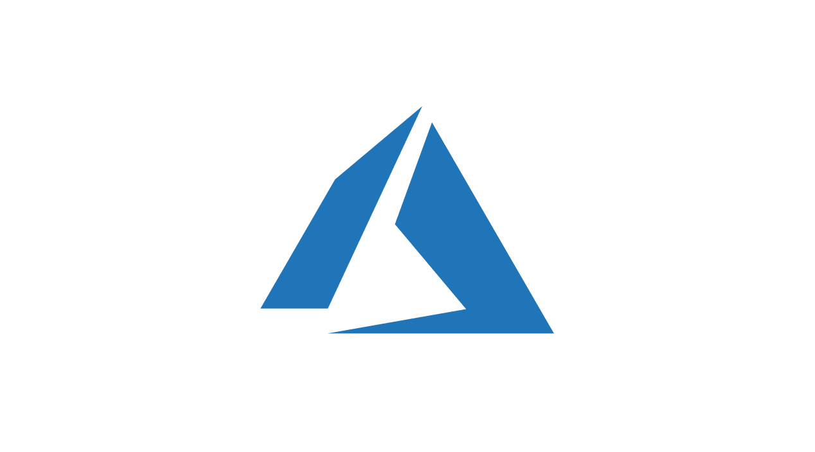




About Me
Joshua Gural
Senior Consultant at Pragmatic Works
Azure, IT Infrastructure, Office 365
Located near Pittsburgh, PA
Exercise, Outdoors, Time with Fiancée and Dog
Notes:
To get started, however, I wanted to introduce myself as today’s presenter
My name is Joshua Gural and I am a Sr. Consultant with Pragmatic Works.
I’m relatively new to Pragmatic Works, joining at the beginning of this year, but come from a strong background in Cloud Computing (with an Azure focus), traditional IT Infrastructure, and Office 365.
Even though Pragmatic Works is headquartered in sunny Florida, I am personally located just south of Pittsburgh, PA
In my free time, I recently really enjoy exercising, being outdoors either hunting, fishing, or hiking, and spending time with my fiancée (Robin) and dog (Dexter)
who you can see in the upper right above my head with one of his many toys…had to put him in the presentation somewhere

Slide 3

Agenda
What is Azure Monitor?
Breaking it down
  Data Collection
  Data Visualization and Analysis
  Data Response
  Data Integration and Export
Azure Scaffold
Notes:
Today we will be going over Azure Monitor
what it is
how it can help you on a day to day basis as an IT professional
We will also touch on some best practices and guidelines for implementation
In order to do so, we will be breaking Azure Monitor down into 4 main steps:
Data collection
Data Visualization and analysis
Data Response
and Data integration & export both inside of Azure and third-party applications
Finally, we will touch on the Azure Scaffold, and how Monitor fits into this concept
And after the presentation, I will try to answer as many questions as I can in the time, we have today, but can always be contacted as a follow up to discuss items further

Slide 4

What is Azure Monitor?
An Overview of the Service
Notes:
First and foremost, we will tackle the basic questions:
What is Azure Monitor?
Why should I care about this feature?
What does it do for me?

Slide 5

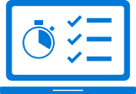
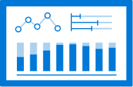

Azure Monitor?
Full-Stack Visibility
View your applications, infrastructure, and network with analytics, dashboards, and visualization maps
Intelligent Insights
Analyze, correlate, and monitor data with anomaly detection and predictive analytics.
Proactive Optimization
Identify ways to improve your applications. Analyze user behavior and measure the impact of your changes.
Open and Extensible
Out-of-the-box integration with popular DevOps, issue management, ITSM, and SIEM tools.
Notes:
Azure monitor is defined by Microsoft as a way to maximize the availability and performance of your applications by delivering a comprehensive solution for collecting, analyzing, and acting on telemetry from your cloud and on-premises environments.
It allows for full–stack visibility with visualizations, alerts, and/or automations into your
Applications
IT infrastructure (both cloud and on-prem)
And your network
This visibility allows for intelligent insights into your environment by automatically identifying and predicting anomalies in your data to prevent, or quickly alleviate issues.
Not only does it help by lowering anomalies, but also tries to optimize your environment by determining areas that can be improved across your architecture.
And finally, Azure Monitor is open and extensible. It contains many out of the box integrations with countless other possibilities available with some customizations as well.
This is helpful if you already have a third-party SIEM or ITSM tool that you are not looking to replace at this time. Azure Monitor data can be piped into the tool in which you already have current investment.

Slide 6

Azure Monitor
Visibility into 4 key areas
  Activities
  Performance metrics
  Health
  Availability
Two types of telemetry
  Metrics
  Logs
Notes:
Azure Monitor does these things by providing visibility into the following 4 key areas
Activities – Who is doing what with your Azure resources themselves?
Performance metrics – How are your azure resources performing?
Health – Are there any optimizations that can be done to increase the usability of your resources?
Availability – Is there anything that can be done to increase the uptime of your resources?
Monitor collects two main types of telemetry on these areas
Metrics - Metrics are numerical values that describe an Azure system at a point in time.
Logs – Logs are different types of data that is organized into records of varying properties (not necessarily numeric.)
We will talk more about this key difference later in the presentation

Slide 7

Collect
Visualize & Analyze
Respond
Integrate & Export
Notes:
As mentioned in the agenda, we will be breaking down Azure Monitor into 4 areas:
Collect – Gathering the data to be used in Azure Monitor
Visualize & Analyze – Making sense of the huge amount of data collected by Azure Monitor
Respond – Now that you’ve identified an issue or unwanted trend, what can you do about it?
Integrate & Export – What other workloads, both in an out of Azure, can you use with Azure Monitor data
We will deep dive into each one of these 4 areas throughout this discussion starting with…

Slide 8
Collect
Visualize & Analyze
Respond
Integrate & Export
Notes:
... Collect. This is a natural place to start as Azure Monitor data needs to first be gathered to empower the rest of the steps

Slide 9

Collect
Data Captured by Azure Monitor
Notes:
With that, lets begin with the first of the four steps, Data Collection. We will discuss:
What type of data Azure Monitor collects
The detailed difference between Metrics and Logs
And the retention of data to ensure availability of the service

Slide 10
What does Azure Monitor Collect?
Azure resource:
Operation of an Azure resource
Application:
Performance and functionality of code
Guest OS:
Cloud/on-premises OS on which your application is running
Azure tenant:
Operation of tenant-level Azure services
Azure subscription:
Operation, management, and health of Azure
Notes:
First and foremost, what type of data does Azure Monitor collect? Azure Monitor collects operation, management, health, and performance data on 5 key areas:
Azure Tenant
Azure Subscriptions
Azure Resources
Applications
Guest Operating Systems
Resource, subscription, and tenant monitoring track data about the Azure framework itself, each covering items such as created date, modified date, last modifier, etc.
Platform independent application data is collected to describe the performance of the code running in Azure.
Guest OS data is collected to give specifics around the types of VM operating systems you have hosted in Azure, another cloud service, or even on-premises.
And that is one item, to be sure to make note of here, is the capability to mix cloud and on-premises Guest Operating System data within Azure Monitor.
This can allow for a single pane of glass into the health, operation, management, and performance of all of your resources regardless of their physical location (on-prem, Azure, or another cloud service)

Slide 11
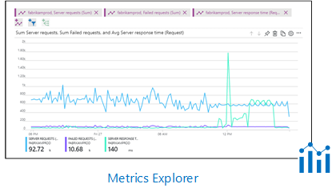
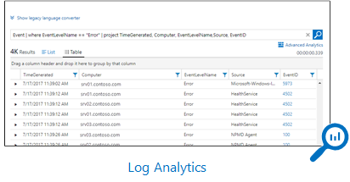
Metrics vs. Logs
Notes:
Azure Monitor data that is being collected comes in two forms, Metrics and Logs as we mentioned previously.
Metrics are numerical values that describe an Azure system at a point in time. These are known for being lightweight and capable of near real-time reporting.
Using the Metrics Explorer (shown in the upper left), you can easily graph these metrics over time to see trends and outliers in a more visual manner.
Logs, on the other hand, are different types of data that is organized into records of varying properties (not necessarily numeric.)
This data is usually telemetry data like events or traces. Using Log Analytics (shown in the upper right), you can query this data to uncover patters.
Like the Metrics Explorer, this data can be then turned into a graphical format for easy reporting.

Slide 12
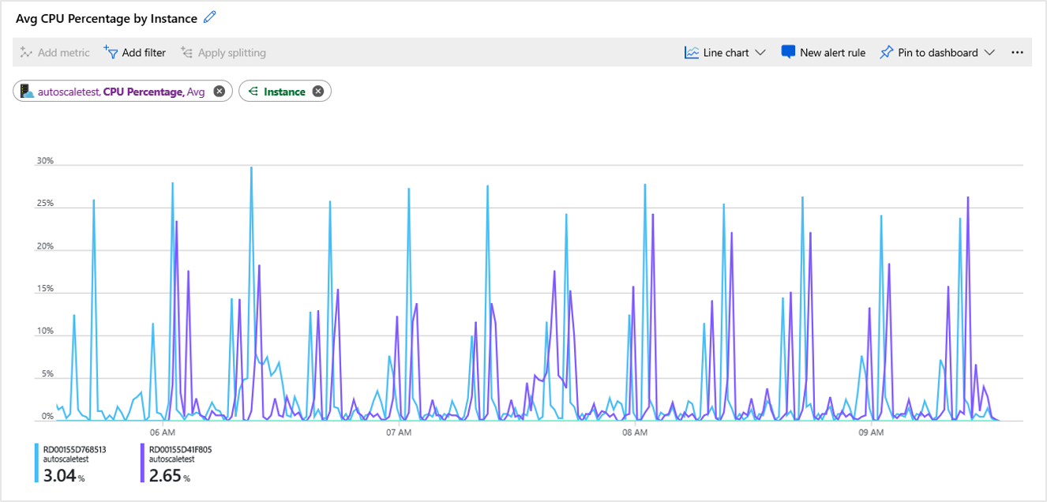
Notes:
Shown is a blown-up view of a visual created with the Metrics Explorer showing the TREND of Average CPU Percentage across time on two separate instances
Graphs such as the one shown can be generated in under a minute and can be pinned to your Azure dashboard for easy visibility.
Graphs can also be the foundation for an alert, giving you visibility into where you really would like to place that threshold to ensure you are not over alerting or under alerting. (Boy who cried wolf scenario)
In this case, perhaps 30% is a good number as it only hits once in the time range shown, however this decision should really be determined only after you ensure proper sized machines (perhaps this shows you should actually up the number of cores for instance depending on where you would like your idle CPU time to be)

Slide 13
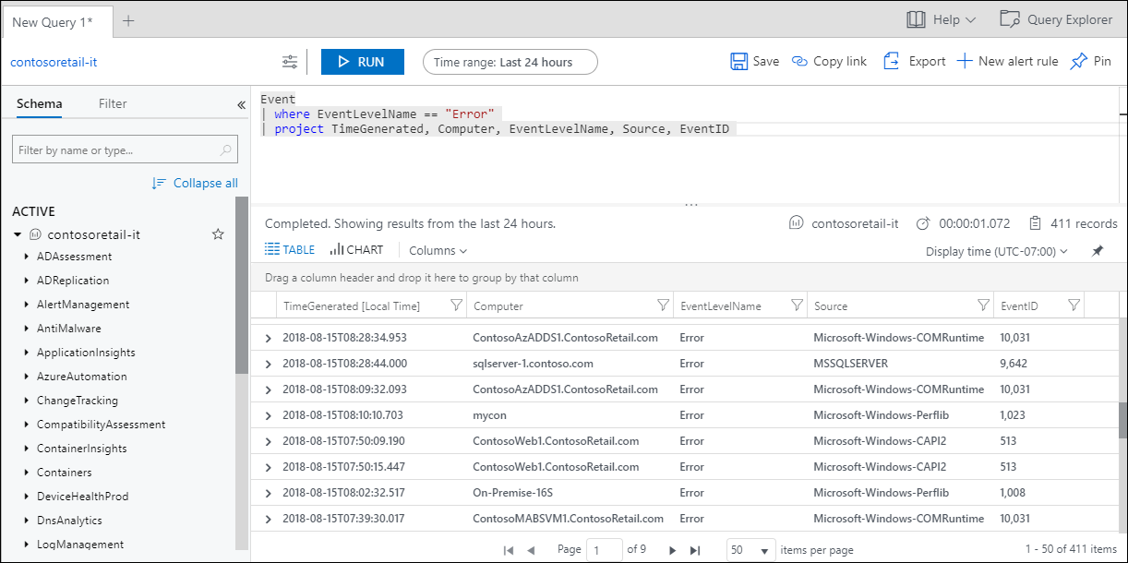
Notes:
Similarly, here is an example of Log Analytics, using the query language to display relevant log events for troubleshooting or alerting.
Notice that this data tends to be more textual (not necessarily numerical) and therefore isn’t graphed by default
However, can be graphed to show the count of errors, average number of records per day, average time of errors, and many other items.
These results can also be pinned to the dashboard and can also be the foundation of an alert rule. More on those (both visualizations and alerts) later.

Slide 14
Attribute | Metrics | Logs
Benefits | Lightweight and capable of near-real time scenarios such as alerting. | Ideal for deep analysis
Data | Numeric | Text or Numeric
Structure | Standard set of properties | Properties depending on the log type
Collection | Regular intervals | Collected sporadically as events trigger
View in Azure portal | Metrics Explorer | Log Analytics
Data sources include | Platform metrics collected from Azure resources Applications monitored by Application Insights Custom defined by application or API | Application and Diagnostics Logs Monitoring solutions Agents and VM extensions Application requests and exceptions Azure Security Center Data Collector API
Notes:
This table summarizes the key differences between metrics and logs. As you can see in the chart [read the chart]

Slide 15
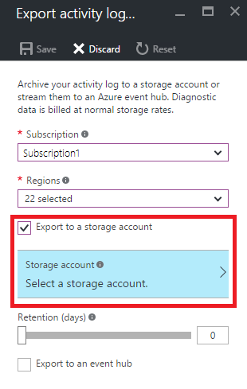
Retention of Data
Metrics are available for a 90-day period at no charge (expandable)
Log Analytics workspace is retained at no charge for the first 31 days (expandable)
Beyond this, data can be routed to a storage account, Expanded Log Analytics workspace, or event hub
Notes:
Finally, it is critical to consider retention when preparing for a successful Azure Monitor implementation.
Both metrics and logs are retained by default for a set period of time.
It is relatively low cost to extend this period, however it is important to optimize the retention, so you are only paying for the storage you need to use.
Also, a retention too long is adding more unnecessary hay to the haystack when trying to find that specific needle.
Metrics are available for a 90-day period at no charge. This is expandable of course
Logs are retained at no charge for the first 31 days and is also expandable up to an infinite retention.
Data can be routed to a storage account in Azure, and expanded retention log analytics workspace, or an event hub to be piped to a local tool.
Keep in mind, as a disclaimer, Azure pricing changes frequently, so it is best to check their pricing page and calculators for specific details on all topics covered today.

Slide 16
Collect
Visualize & Analyze
Respond
Integrate & Export
Notes:
Now that we have covered how Azure Monitor collects data, lets discuss how you can visualize and analyze that data.

Slide 17
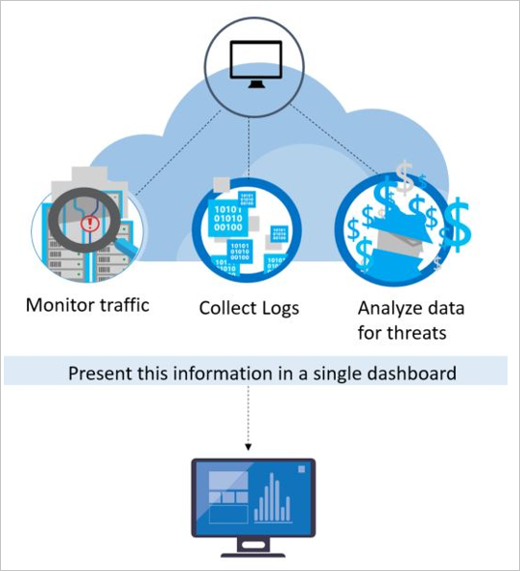
Visualize & Analyze
Making the Azure Monitor Data Consumable
Notes:
Here we will be talking about how to make this flood of data consumable in order to make intelligent decisions based on that data to either save money, increase performance or availability, or even drive off threats.

Slide 18
Visualizing Data
Dashboards
Power BI
Views
Notes:
Visualizing Azure Monitor data comes in 3 main forms including
Views (for lightweight visualizations usually of a single or small number of resources)
Dashboards (to make comparisons over a larger number of resources or to continuously monitor)
and Power BI (for the most advanced visualizations)

Slide 19
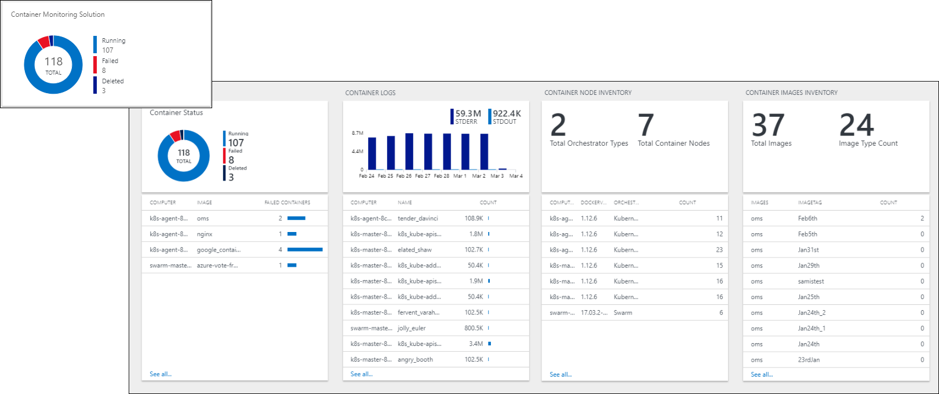
Views
Notes:
Advantages
Rich visualizations for log data
Export and import views to transfer them to other resource groups and subscriptions
Integrates into Azure itself
Filters for custom parameters
Interactive, supports multi-level drill-in (view that drills into another view)
Limitations
Supports logs but not metrics. (Workbooks are coming to help with this)
No personal views. Available to all users with access to the workspace
No automatic refresh
Limited layout options
No support for querying across multiple workspaces
Queries are limited in response size to 8MB and query execution time of 110 seconds

Slide 20
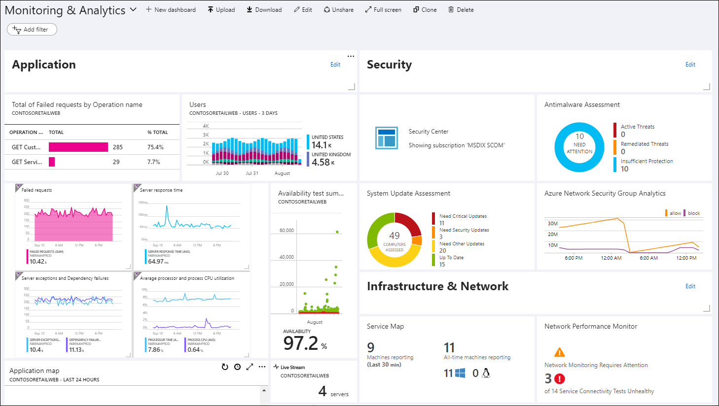
Dashboards
Notes:
Advantages
Visualizations can be pinned to dashboard
Supports both metrics and logs
Combine data from multiple sources
Option for personal or shared dashboards
Integrated with Azure role-based authentication (RBAC)
Automatic refresh. Metrics refresh minimum of five minutes. Logs refresh at one minute
Flexible layout options
Full screen mode
Limitations
Limited control over visualizations
Log charts are limited to last 30 days
Log charts can only be pinned to shared dashboards
No interactivity with dashboard data
Limited contextual drill-down

Slide 21
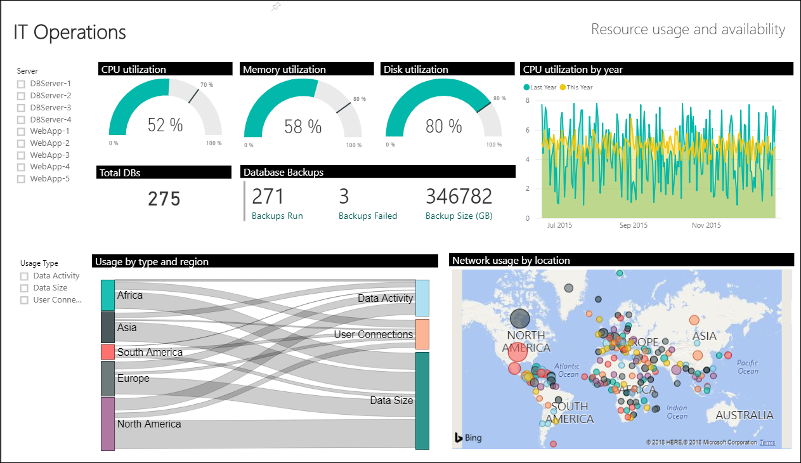
Power BI
Notes:
Advantages
Rich visualizations and interactivity
Easy to share throughout your organization
Integration with multiple data sources
Better performance
Limitations
Supports logs but not metrics
Can't manage dashboards and models in Azure itself
Limitation on result size and refresh
Limited data refresh of eight times per day

Slide 22
Collect
Visualize & Analyze
Respond
Integrate & Export
Notes:
Now that we know how to analyze this data into meaningful visualizations, lets discuss what you can do with this data.
How can you respond to the items identified in the previous step?

Slide 23

Respond
What to do with Azure Monitor Information?
Notes:
Visualizations are great, but it’s only half the story.
Now that you know there are unwelcome patters or outliers, what do you do with it?
And how can you avoid constantly checking your dashboard?

Slide 24



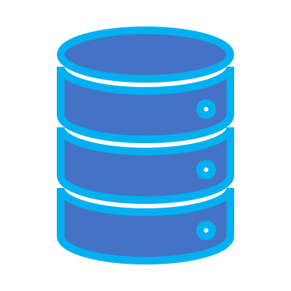



Automation
Alert Record
Log Storage
Rule Criteria
Alert Logic
Alert
Notes:
A huge part of Azure Monitor is Alert Logic.
The graphic shows how the Alert Logic workflow helps to limit the amount of effort you need to put in to Azure Monitor to gain the desired returns
Alerts start with a record, either a metric or a log, that is stored in Azure Monitor.
An Alert rule, created by you with thresholds you set, analyze the log storage environment, waiting for a trigger.
Once the Alert Rule identifies an event that surpasses the threshold, the Alert Trigger is activated in one of two ways: Automations and/or Alerts.
These Alert Triggers are organized into an entity called “Action Groups”

Slide 25



Action Groups
Email/SMS/Push/Voice
Azure Function
LogicApp
Webhook
ITSM
Automation Runbook
Action Options
Separate actions for Monitor
Alert and/or Automate
Reusable
Required Fields
Action group name
Short name
Subscription
Resource group
Notes:
Action Groups are a way to organize your Triggers into meaningful and reusable segments.
You can set alert and automation actions inside an action group in order to reuse the same actions in the future.
Required fields include Action Group Name, Short Name, Subscription, and a Resource Group, as well as type… (or types) of actions which includes [read list above]
One Best practice with an action group is to keep the scope of the action group isolated to the resource group it lives in (for efficiency purposes)
Additionally it is best to repurposing action groups as much as possible to limit the number of overall action groups

Slide 26
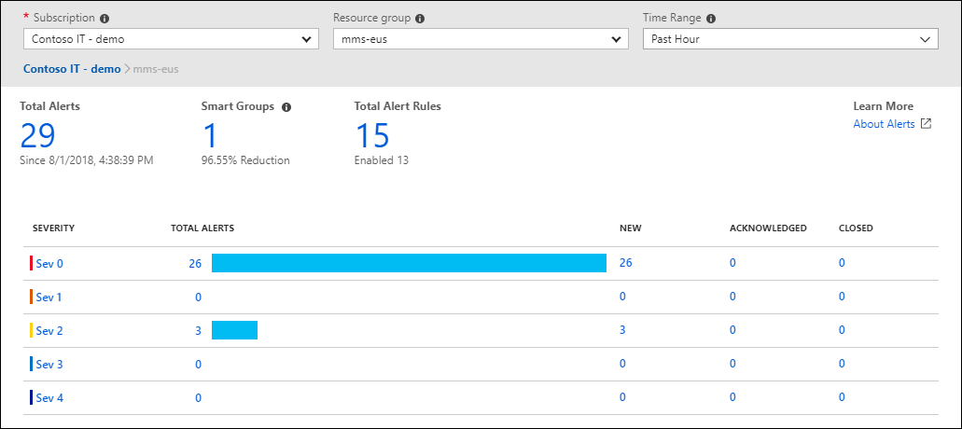
Alert
Metrics rules – Real-time alerting on numeric values
Log rules – Complex logic across data from multiple sources
Email/SMS/Push/Voice
Notes:
Of the two overall options with Action Groups, we will start with Alerts which is an excellent way to be able to be notified on a set of criteria without having to live in the portal and watch your created visualizations
[read metrics rules and log rules]
Options for alerting is quite extensive, allowing for email, SMS, push notification, and/or voice out of the box given an alert trigger
If needed, these alert options can be mixed as well, both in multiple techniques and multiple people/groups

Slide 27
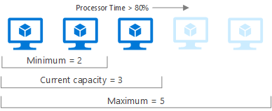
Automation
Azure Functions
Logic Apps
Webhooks
ITSM
Automation Runbook
Notes:
The other half of an alert trigger is Automation.
If you find yourself always performing the same set of steps each time you get an alert, automation would be a great way to reduce the time you spend in the Azure portal performing repetitive tasks.
Automation exists in the following formats with various use cases including [read bullet points]
As shown in the image, if you get an alert every time you have a processor time greater than 80% you expand to another instance, up to a maximum of 5 in which case you reevaluate
This use case (and countless others) can be created in Automation to reduce the effort your team needs to expend.
This workflow also has caps to ensure your costs aren’t outrun as well (in this example maximum of 5 instances, then perhaps send an email for approval to go beyond that)
Similarly, when the load is lower, Automation can trigger a descale of the environment as well to reduce costs (Microsoft likes to call this rightsizing, and it can be done automatically)

Slide 28
Collect
Visualize & Analyze
Respond
Integrate & Export
Notes:
Finally, we’re going to discuss the last stage of the 4 step breakdown, Integrations and Export in Azure Monitor

Slide 29

Integration and Export
Using Azure Monitor Data outside of Monitor
Notes:
Answering the question, “How can this data be used outside of Azure Monitor” will be analyzed here, as well as how it can integrate with other solutions both inside and outside of Azure.

Slide 30
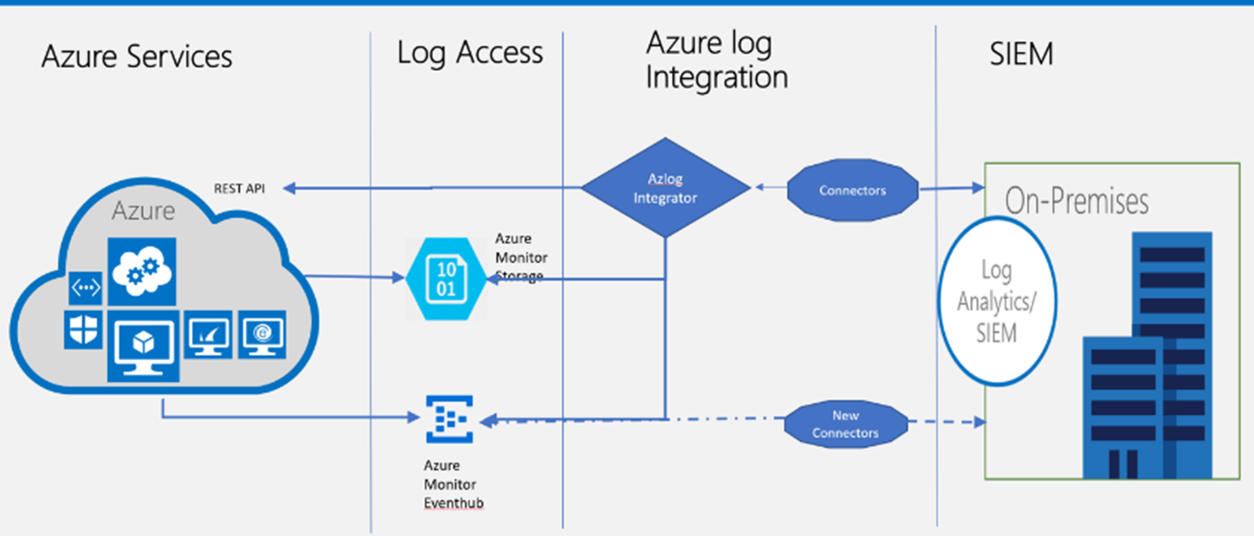
Integrations and Export
Event Hubs - Streaming platform and event ingestion service that can stream Azure Monitor data to partner SIEM and monitoring tools.
Logic Apps - Activities are available that read and write metrics and logs in Azure Monitor, which allows you to build workflows integrating with a variety of other systems.
APIs - Read/Write metrics and logs to and from Azure Monitor
Notes:
To get data out of Azure, Integrations lie in 3 main areas, event hubs, logic apps, APIs.
Azure Event Hubs can be used as a streaming platform that is ideal for streaming Monitor data out to a 3rd party SIEM tool or other monitoring solutions.
Azure Logic Apps can be used to build much more advanced workflows and automations within Azure, but also allow integrations with a number of 3rd party systems out of the box.
From there, the Azure Monitor data is accessible with an API to enable countless other custom integrations as necessary

Slide 31
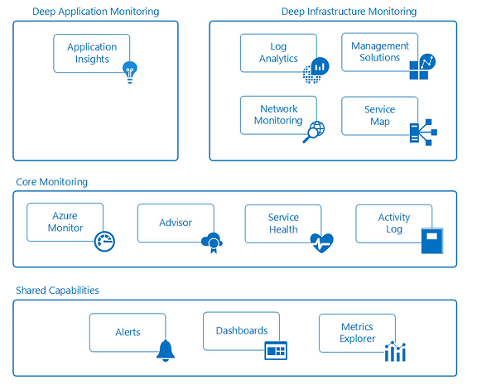

Azure Integrations
Notes:
So now we will be discussing items WITHIN AZURE that integrates with Azure Monitor.
This image shows the Azure Workloads that are associated with monitoring
Up to this point in our conversation today, we’ve discussed the items highlighted in red…

Slide 32
Azure Integrations
Notes:
The rest of this section I will touch on the items we have yet to discuss which includes items highlighted in yellow…

Slide 33
Azure Integrations
Notes:
Application Insights
Infrastructure Monitoring and Security
Azure Advisor
Azure Service Health

Slide 34
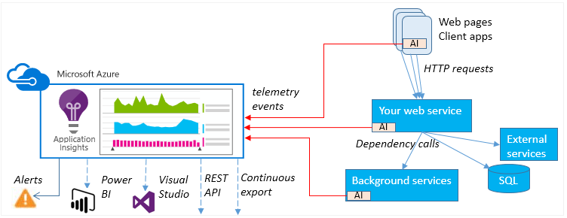
Application Insights
Notes:
Application Insights, one of the Azure workloads that can be integrated to Azure Monitor, focuses on the application layer to help analyze and monitor the code you have deployed in Azure workloads
Telemetry events from your code can be piped into Application Insights
Azure can intelligently analyze, visualize, and respond to trends and/or events in the data in the same forms as we previously discussed (visualizations, Alerts, automation, etc.)

Slide 35


Infrastructure & Security Monitoring
Network Watcher
End-to-end view of network resources
      Packet capture
      Next hop
      IP flow verify
      NSG flow logs
Security Center
Threat detection on the following
    Azure resources
    Network
    Partner solutions
Notes:
Infrastructure and security monitoring is another huge opportunity of integration within Azure.
Items such as the network watcher really focuses on the network layer in the Azure environment enabling packet capture, next hop, IP Flow Verify, and NSG flow logs.
All these items can be integrated with Azure Monitor to then trigger some sort of Alert and Automation as we already covered.
Additionally and similarly, Security Center focuses on that security layer of the Azure resources, network, and partner solutions.
Events in the security center can have the same alert logic in Azure Monitor enabled to properly alert your security staff on current or potential risks, attacks, or gaps.

Slide 36
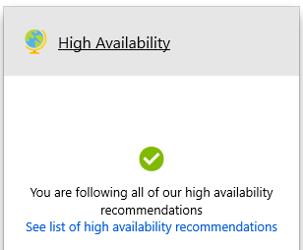
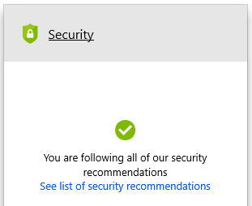
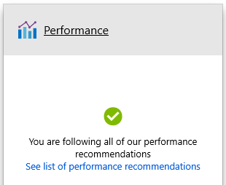
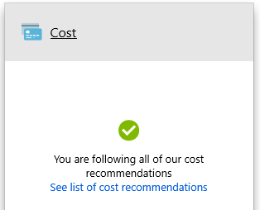
Azure Advisor
Notes:
Another area of integration is Azure advisor, which is defined by Microsoft as a “personalized cloud consultant that helps you follow best practices to optimize your Azure deployments.
It analyzes your resource configuration and usage telemetry and then recommends solutions.”
It gives recommendations on how to enhance your Azure experience in 4 distinct ways:
High Availability - Ensure and improve the continuity of your business-critical applications.
Security - Detect threats and vulnerabilities that might lead to security breaches.
Performance - Improve the speed of your applications
Cost - Optimize and reduce your overall Azure spending
Best yet, Azure Advisor recommendations come to you at no additional cost, and provides actionable results with, in many cases, step-by-step instructions and links on how to implement the suggestion.
Azure Advisor runs separately on each subscription in your Azure environment and can be turned on and off for specific subscriptions or resource group.
Azure Monitor can be enabled to send you alerts on these recommendations, keeping you up to date without having to check back to this section continuously

Slide 37
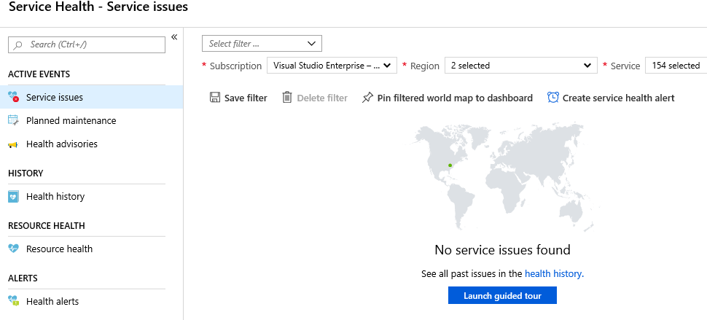
Service Health
Notes:
And finally, Service health is a way to gain visibility into the health of Azure itself from Microsoft.
Service issues, planned maintenance, and advisories are given in this area to ensure you have visibility into items out of your control and in Microsoft’s hands.
This section includes workarounds, estimated downtime, and many other details that may be helpful in the event of an outage at a Microsoft Azure datacenter.
This data can be alerted on and automation enacted via Azure Monitor as well.
For example, if a service issue is posted in East US, failover to West US copy and alert the IT leadership team.

Slide 38

Next Steps: Azure Scaffold
Step 1: Governance
Step 2: Hierarchy Definition
Step 3: Naming Standards
Step 4: Policy and Initiatives
Step 5: Identity and Access
Step 6: Security
Step 7: Monitor and Alerts
Step 8: Cost Management
Step 9: Automation and DevOps
Step 10: Core Network
Notes:
Before we end, I’d like to cover an offering Pragmatic Works has that takes all we covered into account and much more
We call this offering the Azure scaffold, a Microsoft term that sets the framework for Azure architecture, but also can help validate your architecture
Monitoring and Alerting, as shown in the highlighted section (step 7) is one of many topics we cover in this initiative.
Other topics shown are customized and go into company-specific details on each specific area including:
Step 1: Governance – Building a foundation
Step 2: Hierarchy Definition – Organizing your Azure environment
Step 3: Naming Standards – Making your Azure environment consistent
Step 4: Policy and Initiatives – Managing your risk and enforcing rules
Step 5: Identity and Access – Controlling Access to the Azure environment
Step 6: Security – Protecting your Azure Resources
*Step 7: Monitor and Alerts – Collecting, Analyzing, and Sending telemetry data
Step 8: Cost Management – Optimize and right-size your environment
Step 9: Automation and DevOps – Save time and limit mistakes making items reusable
Step 10: Core Network - Ensure effective and secure data transfer

Slide 39
Thanks for Joining!
Have Any Questions?
Notes:
Thank you for joining todays session!
Hopefully, you were able to take something away from today’s session that will help you better manage your Azure environment.
I’d be glad to answer some questions with the time we have left if there are any in the queue

