Slide 1
Azure Data Factory
Creating Pipelines
Mitchell pearson
Blog: Mitchellpearson.com
EMAIL: mpearson@pragmaticworks.com
TWITTER: @Mitchellsql
Linkedin: Mitchellpearson1

Slide 2
Data Factory Navigation

Slide 3
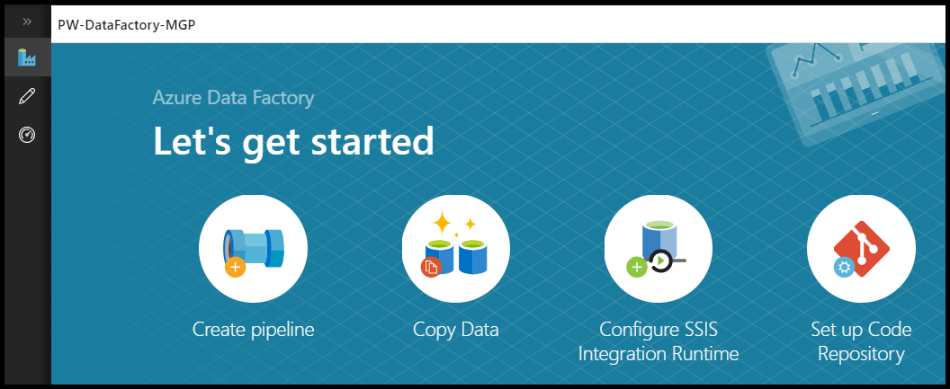
Let’s get started
Navigation
  Overview (Let’s get started)
    Actions
    Videos & Tutorials
  Author
  Monitor
Actions
  Create pipeline
  Copy Data
  Configure SSIS Integration Runtime
  Set up Code Repository
Notes:
Currently supported in Microsoft Edge or Google Chrome

Slide 4
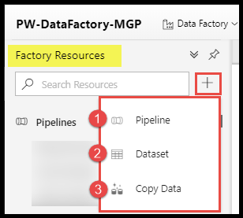
Author
Factory Resources
  Pipeline
  Dataset
  Copy Data

Slide 5
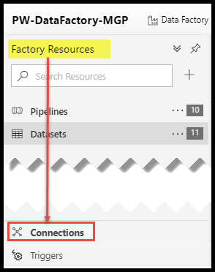
Connections
Linked Services
  Create and Edit Linked Services
Integration Runtimes
  Create and edit Integration Runtimes
  Manage Integration Runtimes

Slide 6
Linked Services and Datasets
Linked Services
  Defines connection information so that Data Factory can connect to the data source.
  Can be reused among pipelines in a Data Factory
Datasets
  Named view of data that points or references the data
  Data Stores: Tables, Files, Folders, and Documents

Slide 7
Data Factory Navigation

Slide 8
Copy Activity Wizard
Azure Blob to Azure SQL DB

Slide 9
Copy Activity Wizard
Blob Storage to Azure SQL DB
  Azure Blob Source

Slide 10
Copy Activity Wizard

Slide 11
Data Factory
Pipelines
Linked Services
Datasets

Slide 12
Pipeline Activities
What does an activity do?
  The activities in a pipeline define actions to perform on your data.
Activities
  Batch Service (custom activity)
  Databricks
  Data Lake Analytics
  HDInsight
  Machine Learning
  Copy
  Stored Procedure

Slide 13
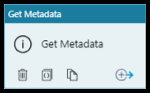
Get Metadata activity
Purpose
  Retrieve metadata information of data
Metadata options
  Item Name
  Item Type
  Size
  Created
  Last Modified
  Child Items
  Content MD5
  Structure
  Column Count
  Exists
Notes:
itemName: Name of the file or folder.
itemType: Type of the file or folder. Output value is File or Folder.
Size: Size of the file in byte. Applicable to file only.
Created: Created datetime of the file or folder.
lastModified: Last modified datetime of the file or folder.
childItems: List of sub-folders and files inside the given folder. Applicable to folder only. Output value is a list of name and type of each child item.
contentMD5: MD5 of the file. Applicable to file only.
Structure: Data structure inside the file or relational database table. Output value is a list of column name and column type.
columnCount: Number of columns inside the file or relational table.
Exists: Whether a file/folder/table exists or not. Note if "exists" is specified in the GetaMetadata field list, the activity won't fail even when the item (file/folder/table) doesn't exists; instead, it returns exists: false in the output.

Slide 14
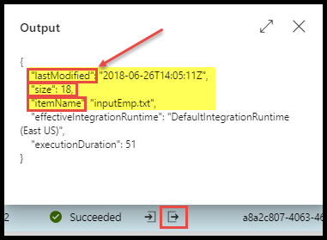
Output Parameters
Output Parameters
  Outputs can be used in other activities
Output parameter names
  Add dynamic content
  Debug results (activity output)

Slide 15
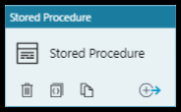
Stored Procedure Activity
Purpose
  Invoke a stored procedure
  Utilize outputs from other activities
Supports
  Azure SQL Database
  Azure SQL Data Warehouse
  SQL Server Database
Limitations
  No output parameters to ADF

Slide 16
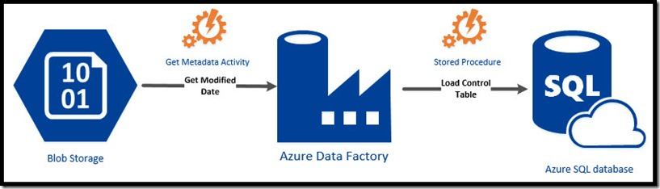
Pipeline Design
Metadata Activity → Stored Procedure Activity

Slide 17
Metadata Activity
Stored Procedure Activity

Slide 18
Lookup Activity

Slide 19
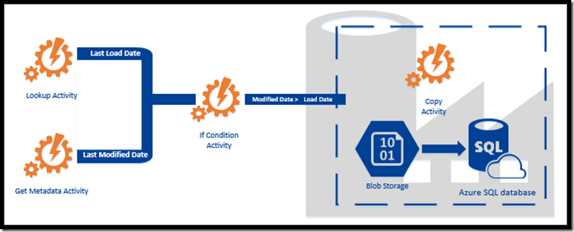
Pipeline Design

Slide 20
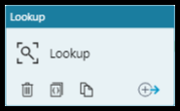
Lookup Activity
Purpose
  Retrieve a dataset
Supports
  Any Azure Data Factory data source
  Executing Stored Procedures
  Executing SQL Scripts
  Output parameters
Outputs
  Single Value
  Array / Object

Slide 21
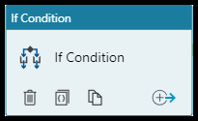
If Condition Activity
Purpose
  Conditional support
  True = Set of activities
  False = Set of activities
Supports
  Comparing output parameters from activties
Outputs
Notes:
The If Condition activity provides the same functionality that an if statement provides in programming languages. It evaluates a set of activities when the condition evaluates to true and another set of activities when the condition evaluates to false.

Slide 22
Lookup Activity
If Condition Activity

