Slide 1
Controlling Project Chaos with Azure DevOps
Michael French
Principal Consultant
2/4/2020

Slide 2

About Me
Principal Consultant, Pragmatic Works
20+ years of IT Experience
B.S. of Applied Mathematics, Kent State University
Azure Data Week and SQLSaturday Presenter
Community Volunteer

Slide 3
How About Now?
When Will It Be Done?
Are We There Yet?
How Do I Know That You Are Making Progress?
Do You Need More Time?
… Just One More Thing

Slide 4
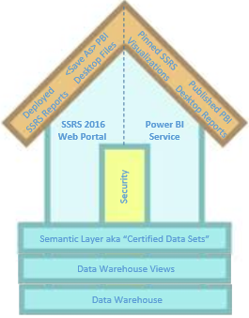

Goals
Iterative Development
Modified Agile
INTRODUCTION
Azure DevOps Overview
Basics of Project Planning
Demo
Event Driven ELT Project

Slide 5
Iterative Development
Sprint Planning & Team Capacity
Chaos Wrangling
User Acceptance
Control Scope Creep
Improved Communications

Slide 6
Agile Based
Three Week Sprints
Iterative Development
Team Members
Sprint Planning
Daily Standup Meetings

Slide 7
Failing to Plan
Is Planning to Fail
Notes:
As a youth a sign hung our Scout Hut, Failing to Plan is Planning to Fail as the last part of the message got smaller and curved towards the bottom corner of sheet off the line.

Slide 8
What Was Done Last Sprint
What Needs to Move and Why
Sprint Planning
Meeting
What Will Be Done Next Sprint
Team Capacity
Avoid Over Loaded Sprints
Notes:
Sausage Making
Who Should Attend and Why
Every Developer
Project Manager
Tech Lead
Business Stakeholder

Slide 9

Overall Task Planning
Staff Up Team
Sprint 0
User Story Estimation
Sprint Planning
Stakeholder Signoff
Notes:
No Tasks Hours Yet
User Story Points 1,2,3,5,8,13

Slide 10
From Sprint 1
Increased End User Adoption
User Acceptance
Business Certified Data
Deliver What They Want
Documented Stakeholder Signoff

Slide 11
New Requirements
Effects of Bug Fixes
Scope Creep
Timeline Goals
Extensions and More Hours
Additional Resources

Slide 12
GitHub Integration
Code Churn
Other Benefits
Task Workflow History
Maintain Team Direction
Bug Tracking and Prioritization

Slide 13
Goals
Iterative Development
Modified Agile
INTRODUCTION
Azure DevOps Overview
Basics of Project Planning
Demo
Event Driven ELT Project

Slide 14
Epics
Features
Agile Template
User Stories
Tasks
Bugs
Notes:
Epics - I want to Analyze Sales
Features – I want to Analyze Profitability of my Sales OR I want Analyze my Customers based upon Sales
User Stories – I want to Capture Data about my Customers. I want to Capture Data about my Products. I want to Capture Point of Sale Data
Task – Hours Live Here. Design Customer Dimension. Create Source for Customer. Verify Source to Target Mapping. Create ELT for Customer Dimension. Certify Customer Data.
Bugs – use to track issues

Slide 15
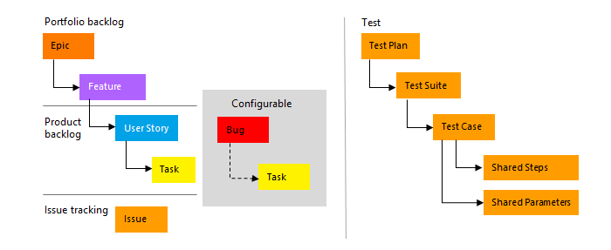
Agile Template

Slide 16
Goals
Iterative Development
Modified Agile
INTRODUCTION
Azure DevOps Overview
Basics of Project Planning
Demo
Event Driven ELT Project

Slide 17
Event Driven ELT
Typical EDW and BI Reporting Project
Demo Outline
Kimball Based Design
Team Composition
Power BI Reporting (Beta)
Notes:
Epics - I want to Analyze Sales
Features – I want to Analyze Profitability of my Sales OR I want Analyze my Customers based upon Sales
User Stories – I want to Capture Data about my Customers. I want to Capture Data about my Products. I want to Capture Point of Sale Data
Task – Hours Live Here. Design Customer Dimension. Create Source for Customer. Verify Source to Target Mapping. Create ELT for Customer Dimension. Certify Customer Data.
Bugs – use to track issues

Slide 18



Demo

Slide 19
Goals
Iterative Development
Modified Agile
CONCLUSION
Azure DevOps Overview
Basics of Project Planning
Demo
Event Driven ELT Project

Slide 20
Have Any Questions?

Slide 21
Additional Resources
Start Using Azure Boards
  https://docs.microsoft.com/en-us/azure/devops/boards/get-started/?view=azure-devops
Azure Every Day
  http://blog.pragmaticworks.com/choosing-the-right-tools-for-elt-workloads-in-the-cloud
Contact Me
  MFrench@PragmaticWorks.com

Slide 22






app
Training Delivery Options
Bootcamps
Week long deep-dive
Workshops
One-day training primer
On-Demand Training
Web-based subscription training

Slide 23

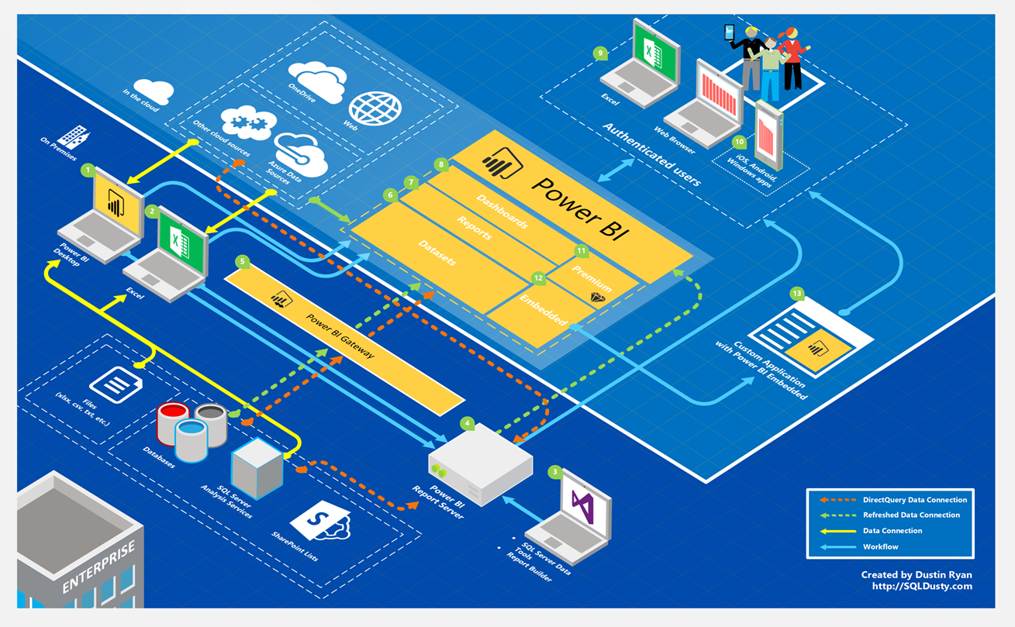
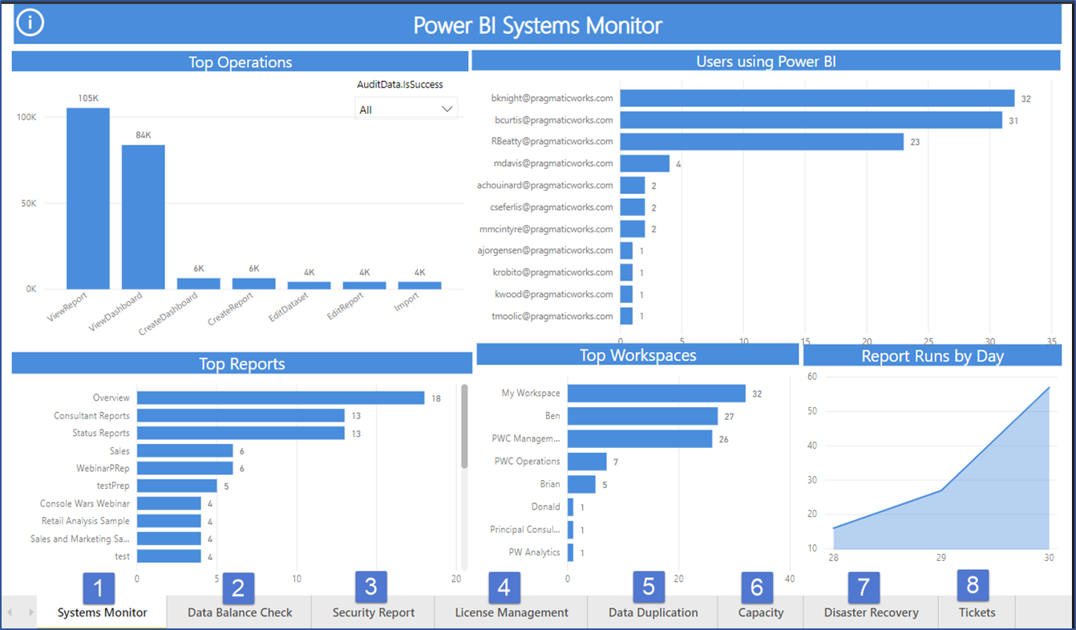

65
25
Power BI -Managed Services-2019
User support
Skills and Development
Ecosystem Management
Plan, Configure, Remediate
Systems Monitor
Daily validation of your Power BI ecosystem.

