Slide 1
Data Quality Patterns in the Cloud with Azure Data Factory Mark Kromer Sr. Program Manager Azure Data Factory

Slide 2
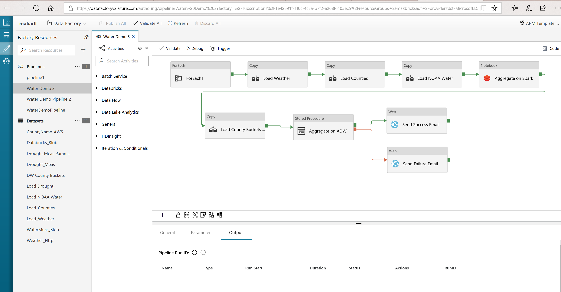
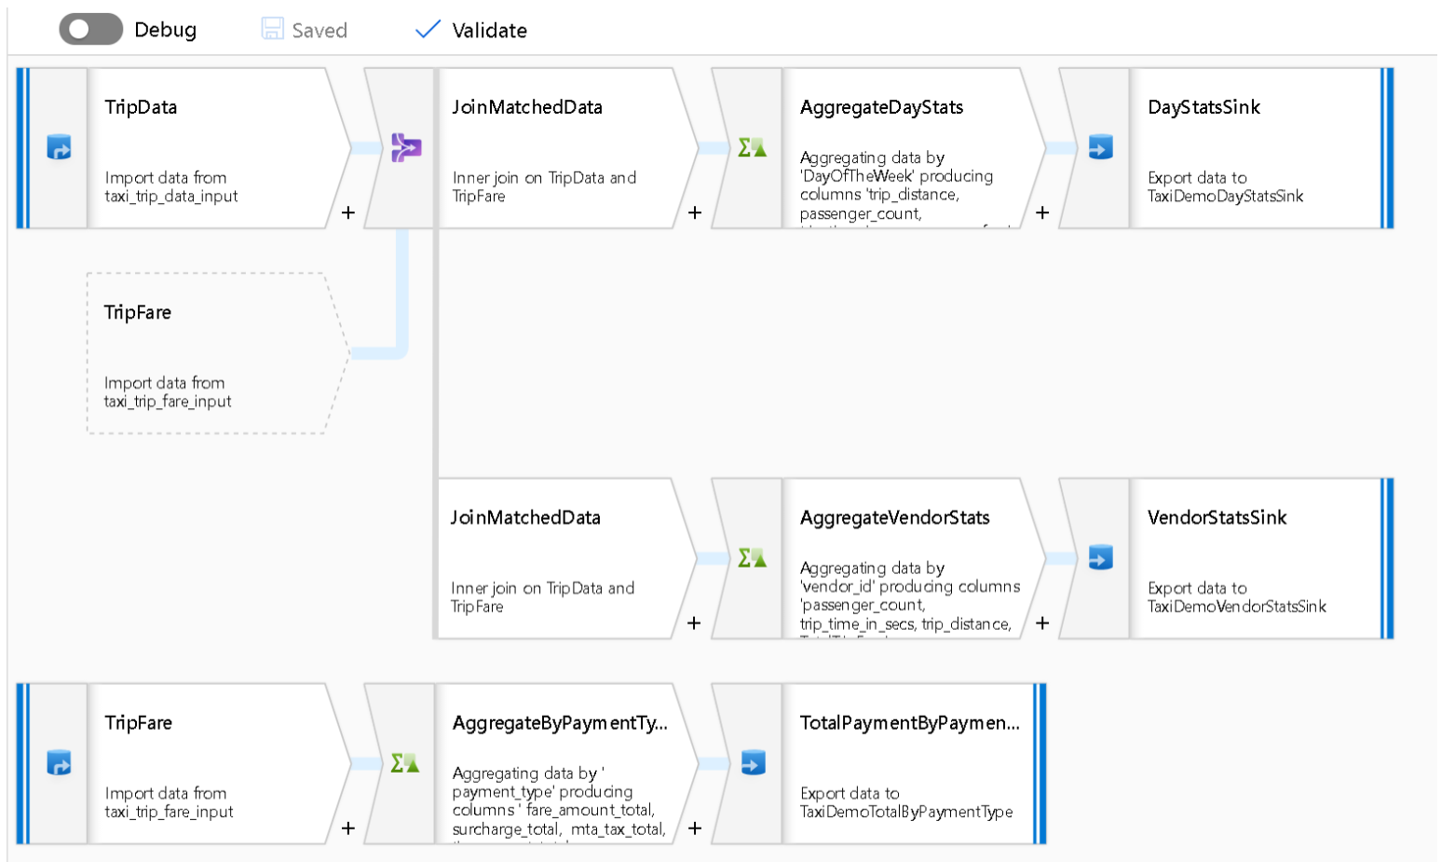
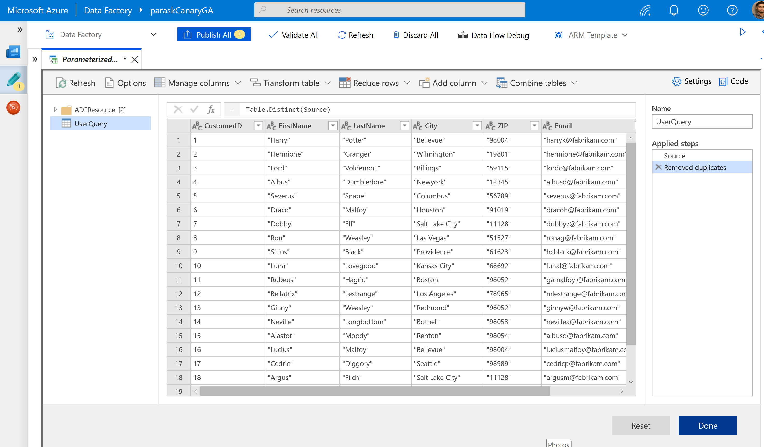
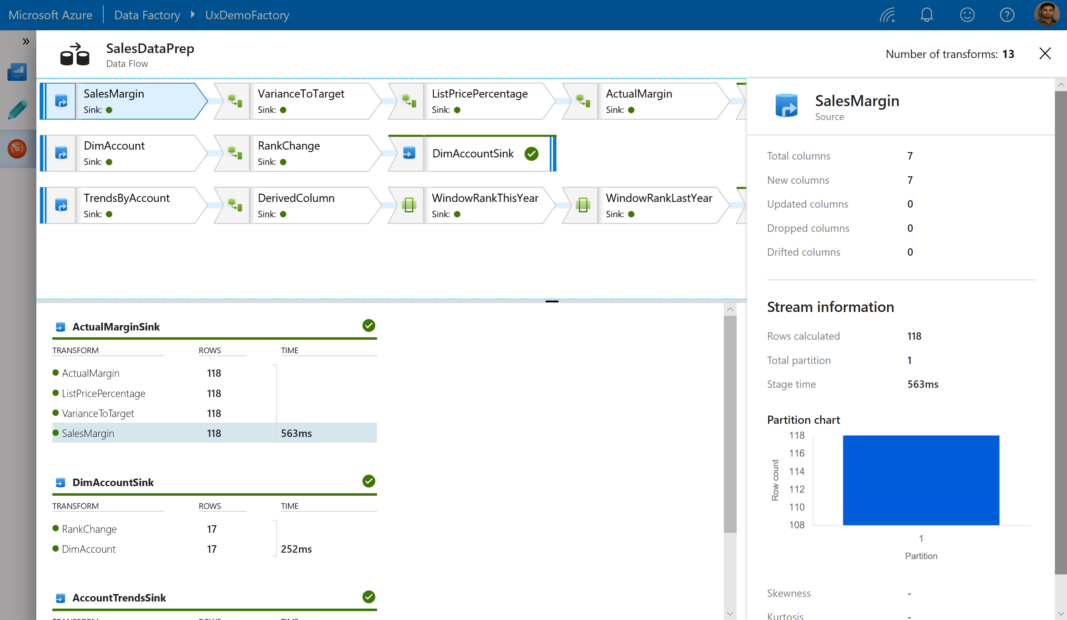
ADF: Simple and Productive ETL in the Cloud at any Scale
Orchestration
Mapping Data Flows
Wrangling Data Flows
Rich Monitoring
Notes:
Let’s take a look at the process through the visual user interface
Orchestration. Directs other services to execute actions as part of the transformation process.
Mapping Data Flows. Develop graphical data transformation logic at scale without writing code using Mapping Data Flows (preview).
Mapping Data Flows. Develop graphical data transformation logic at scale without writing code using Mapping Data Flows (preview).
Monitoring: Monitor pipeline and activity runs with a simple list view interface

Slide 3
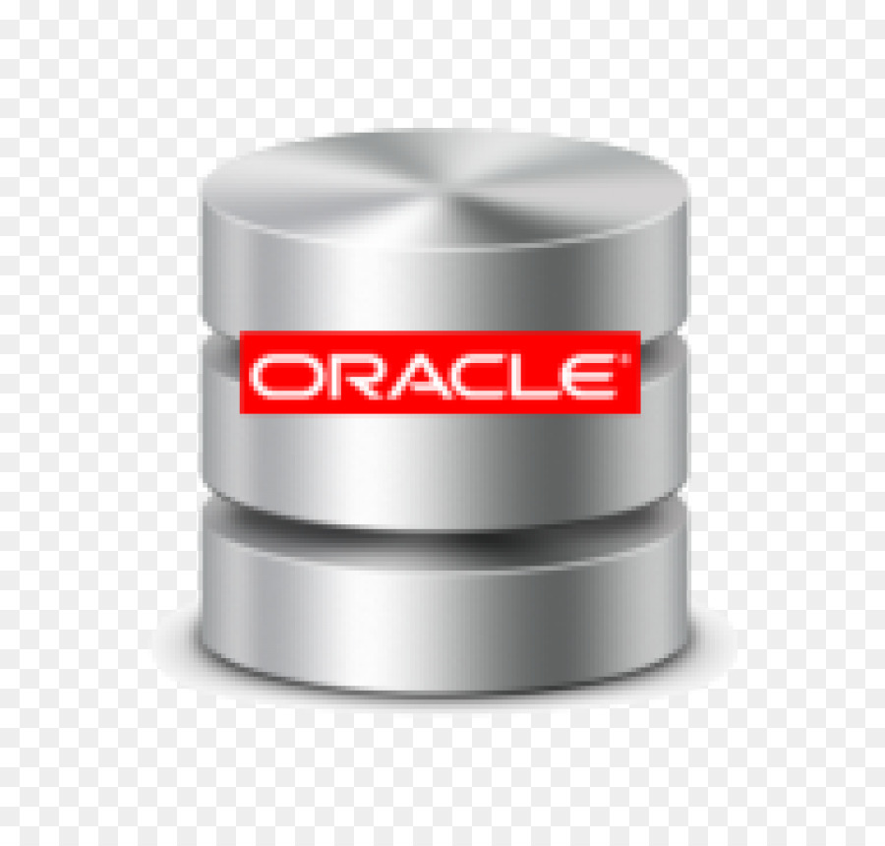
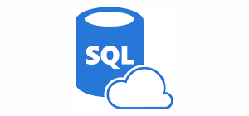
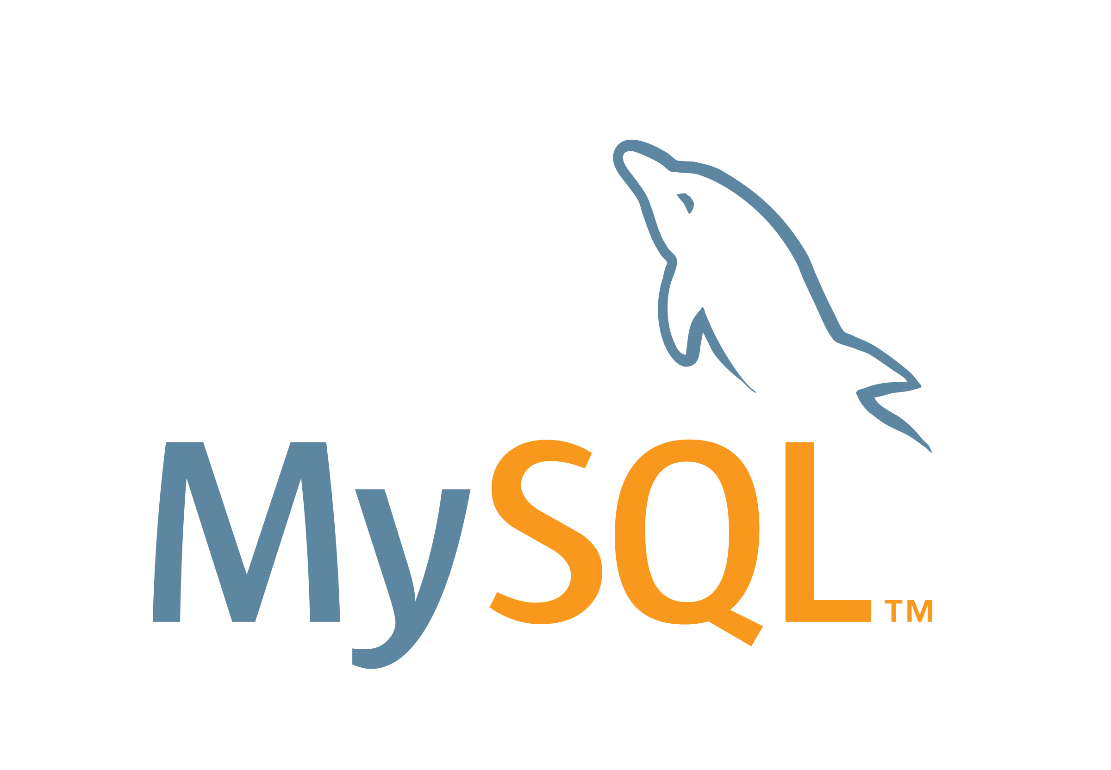
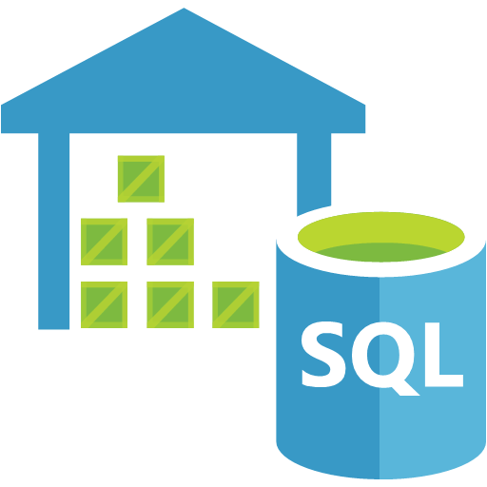
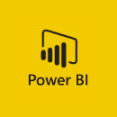
As Data Engineer, you are responsible for building, managing, maintaining data pipelines that take raw data from multiple sources and produce refined data for business consumption. This can be in machine learning models, analytics, BI reports …
Data Loading
Databases
Ingest storage
Serving storage
Data Flow Data Transformation
Azure Data Factory
Applications
Extract and transform relational data
Load processed data into tables optimized for analytics
r
Load files into data lake on a schedule
Azure Storage/ Data Lake Store
Logs, files, and media (unstructured)
Azure Data Factory
Azure SQL DW
Clean and join disparate data
Azure Databricks
Dashboards
Scheduled & orchestrated by ADF
Business/custom apps (structured)

Slide 4
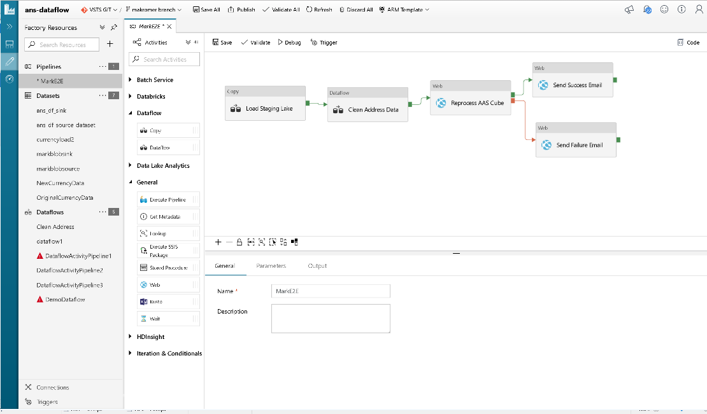
Design code-free ETL workflows
Copy data from on-prem, other clouds and Azure
Stage data for transformation
Build visual data transformations
Schedule triggers for your pipeline execution
Monitor processes and configure alerts
All within ADF

Slide 5
ADF Components

Slide 6
Pipeline
Logical grouping of activities that performs a unit of work
What gets run by a data factory
Activities can be run sequentially or in parallel
Data factory can have one or more pipelines
Ex: a pipeline can ingest data from S3 to ADLS (Copy activity), and then on success run a Data Flow transforming the data and writing it to a SQL DB (Data Flow activity)

Slide 7
Activity
A processing step in a pipeline
Ex: Copy activity to copy data from one data store to another data store
Ex: Hive activity to run a Hive query on an Azure HDInsight cluster, to transform or analyze your data.
Three categories of activities:
Data movement (Copy and Data Flow)
Data transformation (Data Flow, Notebook, HDInsight, etc)
Control flow (Lookup, For Each, Get Metadata, etc)

Slide 8
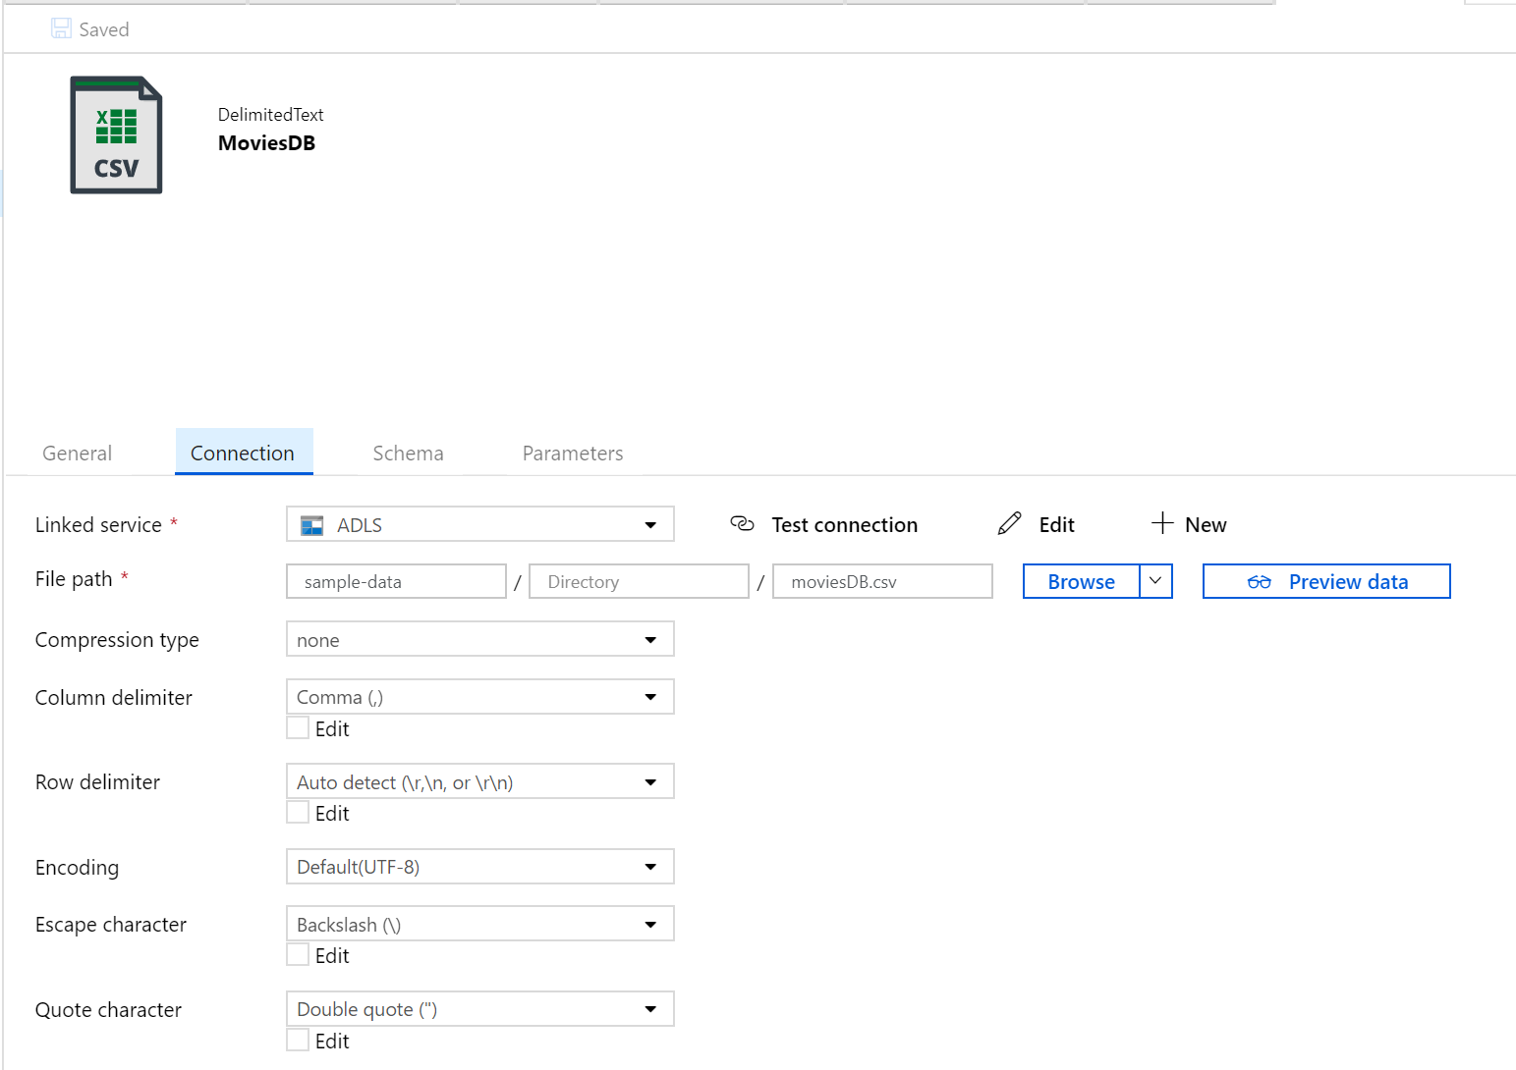
Datasets
Data structures within the data stores (connectors)
Point to or reference the data you want to use in your activities as inputs or outputs
Physical representation of the data in the store
Associated with a linked service
Many datasets can point to single linked service
Referenced by activities
Ex: Copy has source/sink datasets

Slide 9
Linked Services
Define the connection to a data source
The connection information that's needed for Data Factory to connect to external resources
Ex: Azure Blob Storage linked service uses connection string stored in Key Vault (another linked service) to connect to the storage account
90+ connectors
Two types:
Represent a data store
Ex: on-premises SQL Server database, Oracle database, file share, Azure blob storage account, etc
See list of connectors
Represent a compute resource that can host the execution of an activity.
Ex: the HDInsightHive activity runs on an HDInsight Hadoop cluster
See full list of compute environments data

Slide 10
Data Flows
Visually-designed data transformation run on spark
Execute from Data Flow activity in pipeline
Comprised of data transformations
Source and Sink reference datasets

Slide 11
Triggers
Unit of processing that determines when a pipeline execution needs to be kicked of
One trigger can have multiple pipelines associated
One pipeline can be associated with multiple triggers
3 types:
Schedule
Tumbling Window
Event-Based
Ex: Schedule trigger runs a data ingest pipeline at 0:00 UTC everyday

Slide 12
Integration Runtime
Compute infrastructure used by Azure Data Factory to provide the following data integration capabilities across different network environments:
Data Flow: Execute a Data Flow in managed Azure compute environment.
Data movement: Copy data across data stores in public network and data stores in private network (on-premises or virtual private network). It provides support for built-in connectors, format conversion, column mapping, and performant and scalable data transfer.
Activity dispatch: Dispatch and monitor transformation activities running on a variety of compute services such as Azure Databricks, Azure HDInsight, Azure Machine Learning, Azure SQL Database, SQL Server, and more.
SSIS package execution: Natively execute SQL Server Integration Services (SSIS) packages in a managed Azure compute environment.

Slide 13
Data Quality Patterns

Slide 14
Data Quality for Data Warehouse
Verify data types and lengths
How to handle NULLs
Domain value constraints
Single source of truth (master data)
Late arriving dimensions
Lookups

Slide 15
Data Quality for Data Science
Duplicate Data
Descriptive data statistics
Length, type, mean, median, average, stddev …
Frequency distribution
Missing values
Enumerations / Lookups
Value replacement

Slide 16
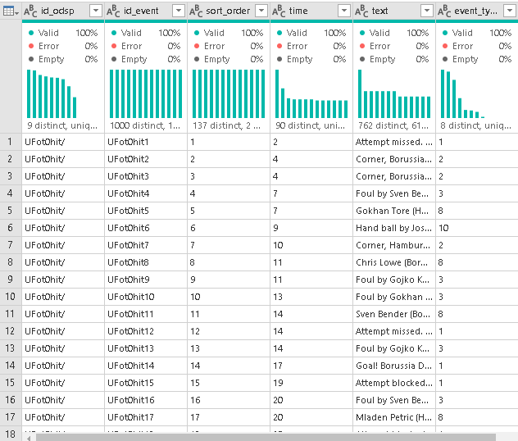
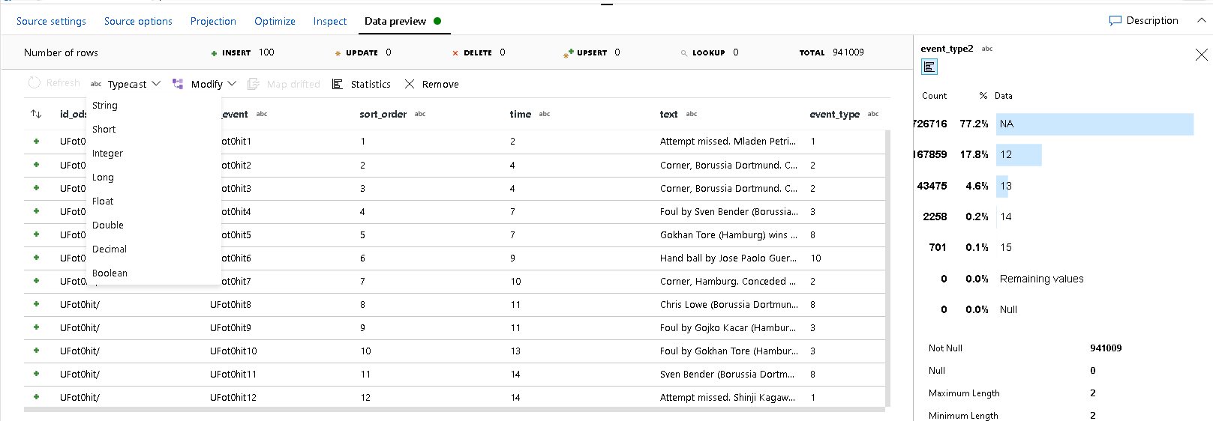
Data Profiling
Summary statistics describing the shape, size, content of your data
Helps you to understand what is inside your data
As a Data Engineer, you have the responsibility to provide proper data for analytics and models
For big data sets, use sampling / good enough approach
View data statistics at any step in your data transformation

Slide 17
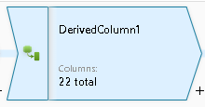
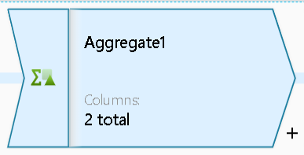
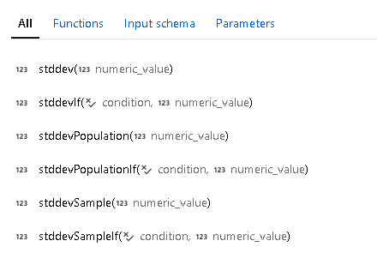
Replacing Values
Replace empty strings with nulls
iif (length(title) == 0,toString(null()),title)
Replace nulls with values
iif (isNull(customername), ‘NA’, customername)
Replace missing measurements with aggregates

Slide 18
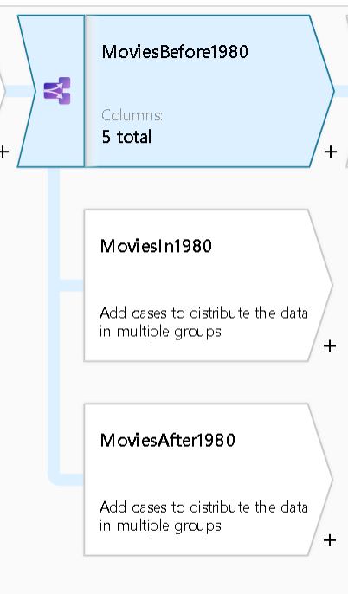
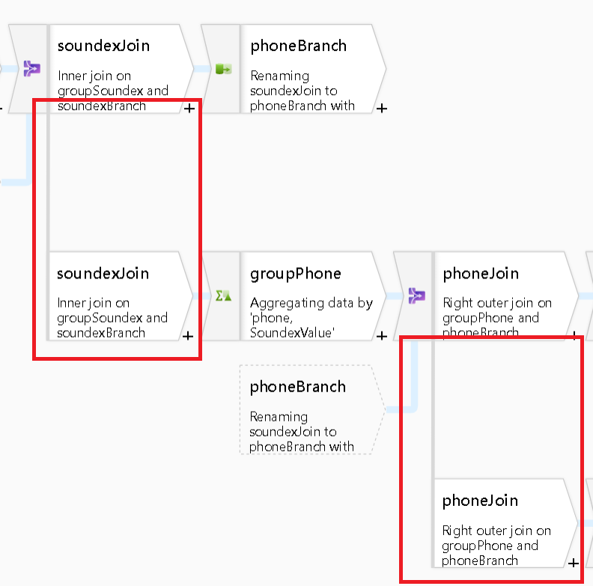
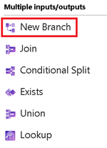
Splitting Data Based on Values
Create separate paths to separate training data from testing data
Separate rules can be applied to streams based on value conditions
Create a full copy of data at any point

Slide 19
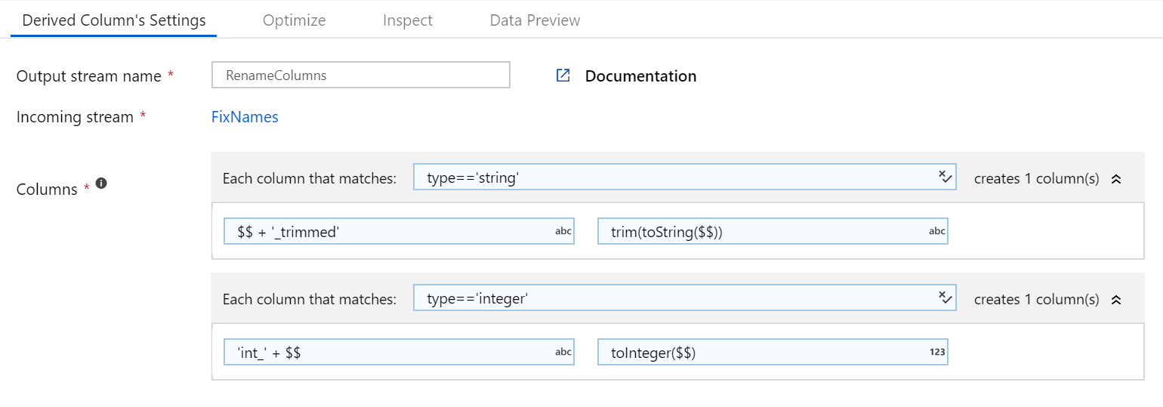
Pattern Matching
With very wide datasets or datasets where you cannot anticipate all column names, generate pattern-matching rules to apply data quality rules en masse without the need to name each column and describe each rule individually.

Slide 20
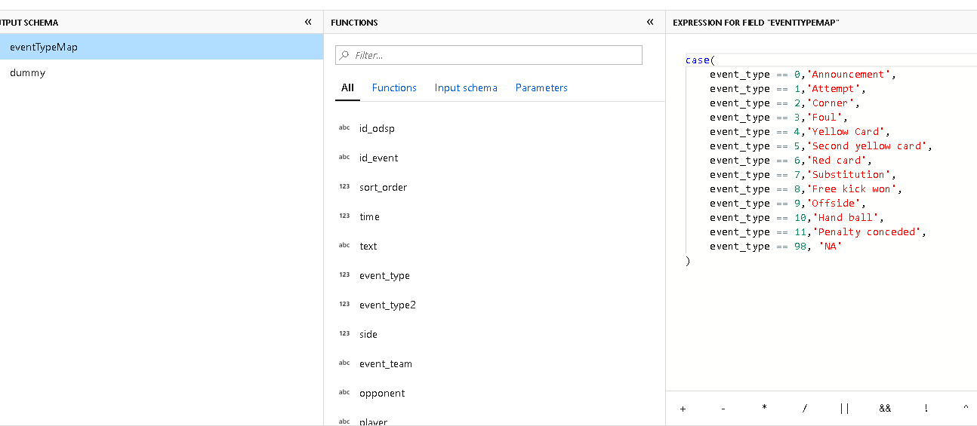
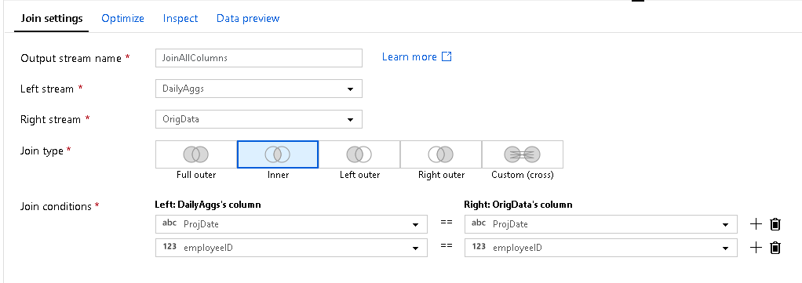
Enumerations / Lookups
Replace coded values with categorical strings, or vice-versa
Hard code rules inside Case() statement or use a Join or Lookup method against a reference file or table
Models and analytics will sometimes require codes or string literal values

Slide 21
Data De-Duplication and Distinct Rows
Use this pattern to eliminate common rows from your data
You pick a heuristic to use during duplicate matching
You can tag rows and/or remove duplicate rows
Use exact matching and/or fuzzy matching
Available as pipeline template Dedupe Pipeline

Slide 22
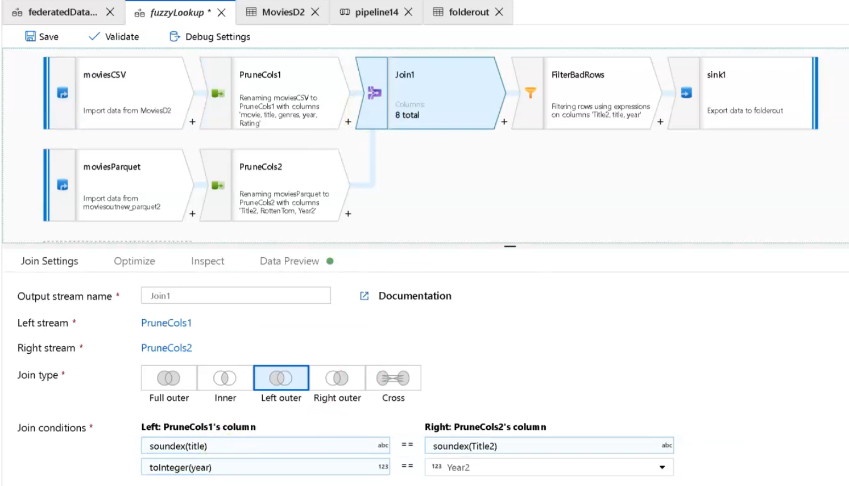
Fuzzy Lookups
Sometime when performing inline lookups, you don’t have exact matches when looking for references
Fuzzy Lookups with Soundex helps find matches based on phonetic algorithms
Very useful in data lake scenarios where joins and lookups are against data that is not normalized or cleaned

Slide 23
Resources
Tutorial Videos: http://aka.ms/dataflowvideos
Patterns: http://aka.ms/dataflowpatterns
Documentation: https://docs.microsoft.com/en-us/azure/data-factory/concepts-data-flow-overview
Expression Language: http://aka.ms/dataflowexpressions
Data Flow Performance guide: https://aka.ms/dfperf
Combined Links: https://aka.ms/dflinks
Sample Data: https://github.com/kromerm/adfdataflowdocs/tree/master/sampledata
These slides: http://slideshare.net/kromerm

