Slide 1
DYNAMIC
Power BI
Part 2
Empowering Users to Change the Way They View Their Own Reports

Slide 2
Robin Abramson
Senior Consultant, Pragmatic Works
Former PASS Board Member
Nineteen Years Experience with Data
Power BI Enthusiast – I love my job!
Resides in the Pacific Northwest – I love where I live!
Email: rabramson@pragmaticworks.com

Slide 3
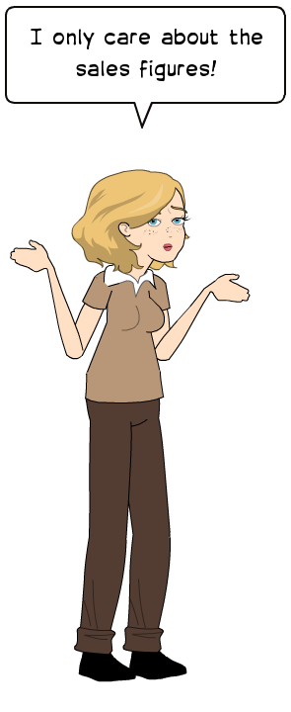
Dynamic Reporting
Empowering Users through Choice
In the first presentation in this series, we discussed how a greater number of Power BI users with varying experience are utilizing reports to find the actionable data that helps them run their business.
Common amongst all Power BI users is a desire to see data presented in the ways most useful to their own workflows.
Dynamic Power BI visualizations allow the users greater control of their own experience.

Slide 4
Why go Dynamic
Audience vs. Content
In the past, report authors either worked to create a broad dataset that could be downloaded and further refined for more specific analysis or did their best to include as many parameters or filters as possible. It was still up to the users to spend time finding their specific set of parameters or even to use tools like Excel to create entirely new reports or visualizations from those provided.
Now We Can
Bundle related data on a single report without sacrificing individual users needs.
Allow users to choose what datapoints are important to them without downloading for further manipulation.
Create a single report instead of several related ones.

Slide 5
Why go Dynamic
Its important to always keep the fact that Power BI is a new technology to many users in mind. Business users are often still very accustomed to old-school SSRS, Excel or Crystal Reports as their sole means of understanding their data. It may take them a while to even understand that they don’t have to manipulate what you give them – but can request reports and dashboards that give them the information in a way that is actionable without further effort. Dynamic report techniques can be as much a learning opportunity for users as they are a convenient technique for the developer.

Slide 6
It’s Dynamic!
Requirements for Dynamic Visualizations:
At a simple level, any report can be dynamic. But, not all methods will work with direct connections.
Top & Bottom – Any Direct Connect or Import model.
Slicer Tables – Create in the data source if required for direct connections. Often, these are dimensions from your tabular model. For import models, create in the PBIX file for import models or import – from your data source either works.
Measures with Switch – any model – but be careful with performance in large datasets.
Unpivoted Data – either create in your datasource (direct connect) or in the PBIX (import)

Slide 7
SECURITY
PERFORMANCE
Row Level Security will continue to function as designed with proper dynamic technics.
Dynamic techniques must be applied with an eye to performance.

Slide 8
Let the Users Drive!
They know what data they need & they don’t want to have to jump through hoops to get it!

Slide 9
It’s Dynamic!
The Techniques we will use:
Whatif Parameters
Top & Bottom Records
Slicer Tables
Measures with Switch
Unpivoted Data
Non-linear Date Slicers

Slide 10
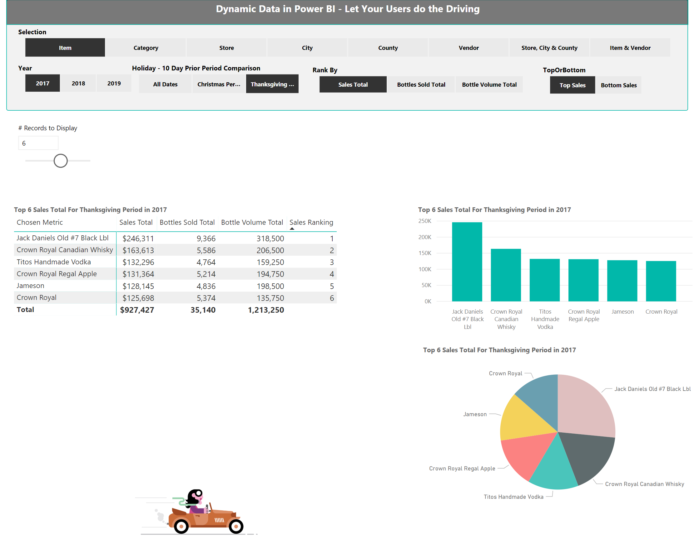
The Report:
Real Data Downloaded from data.gov
Real Questions Answered Dynamically
Horribly Excessive in its use of Dynamic Techniques (but great for learning!)

Slide 11
A Few Notes About the Data
This Data is free to the public and can be downloaded from https://data.iowa.gov/Sales-Distribution/Iowa-Liquor-Sales/m3tr-qhgy.
The full dataset is extremely large. The csv download is over 3GB. For the purposes of this presentation we’re using a smaller subset of this data.
Data included is from 2017 to present. Thanksgiving and Christmas data is not available for the current year.
Only a subgroup of vendors was included for ease of presentation.
The file can be downloaded from https://pragmaticworksonline.sharepoint.com/:u:/s/FileShare/EQQqVc9-cplCqdmBI0nDXcABh4Nypgpa9QJgCcUNTX4tzw?e=9pNFlL

Slide 12
Why this Data?
This dataset offers us a great opportunity to compare two high volume, non-linear date periods.
It’s a pretty simple dataset. There’s not a lot to understand.
While simple, this dataset mimics a lot of the needs that we all have in our day to day work.

Slide 13
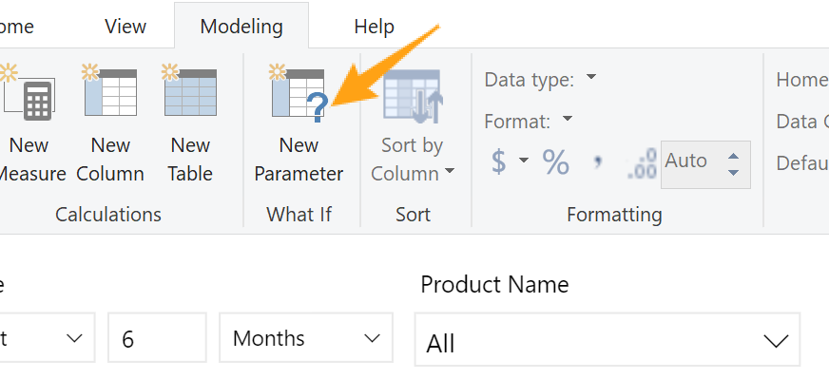
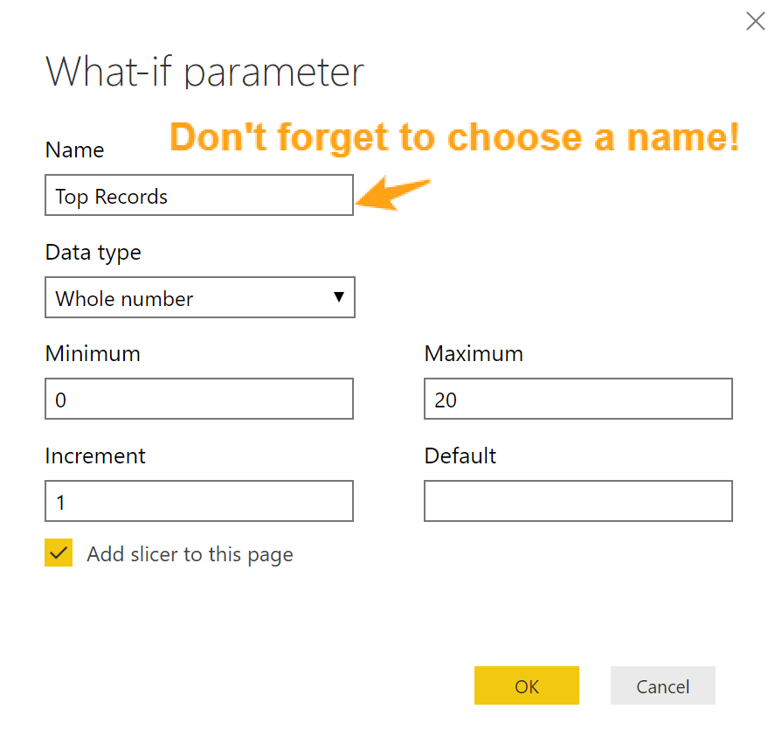
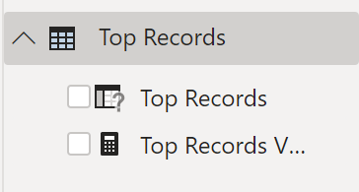
WhatIf
Adding a runtime parameter for your users
#1: Click on the New Parameter WhatIf on the Modeling Tool Bar
#2: Rename for a Meaningful Parameter!
#3: Add to measures where you want!

Slide 14
A Simple TopN Measure Example
This file contains the actual measure in use in the pbix
Top N by Chosen Value = VAR TopNum = SELECTEDVALUE ( 'Top Records'[Top Records] ) RETURN VAR RankN = IF ( ISINSCOPE ( 'Dynamic Axis'[Dynamic] ), RANKX ( CALCULATETABLE ( ALLSELECTED ( 'Dynamic Axis'[Dynamic] ) ), [Sales Amount Total], , DESC, SKIP ) ) RETURN IF ( RankN <= TopNum, RankN )

Slide 15
See the attached file with the measure code!
The TopN Measure We’ll be Using
Returns the number of records chosen in the WhatifParameter Slicer.
Returns top or bottom records based on slicer choice.
Ignores blank values via a filter measure – for some datasets, this is ideal. For others, it’s a bad choice. Filter blanks with caution.
Chooses what metric to rank the records by based on a slicer value.
Returns the Top or Bottom based on all the above choices.

Slide 16
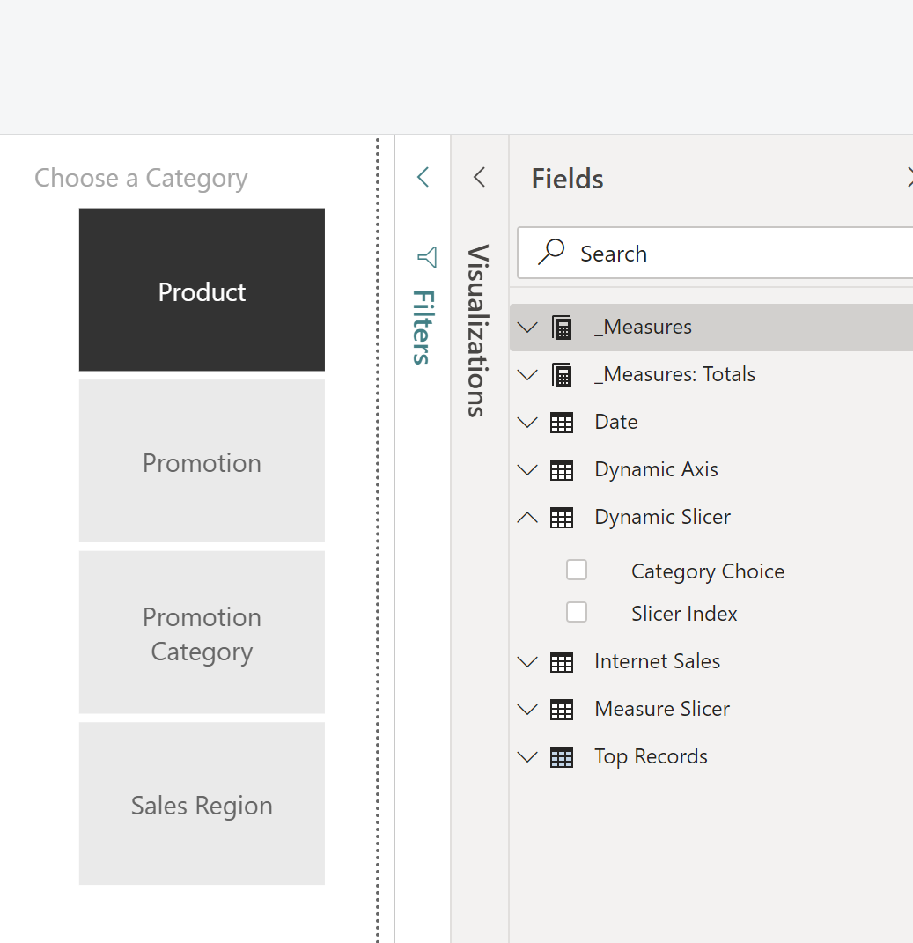
Slicer Tables
Adding tables to facilitate your dynamic elements
#1: Create a new table with your slicer categories.
The easiest way to do this is the enter data button.
#2: Add a relationship to your dynamic table!
#3: Add the categories as a slicer.

Slide 17
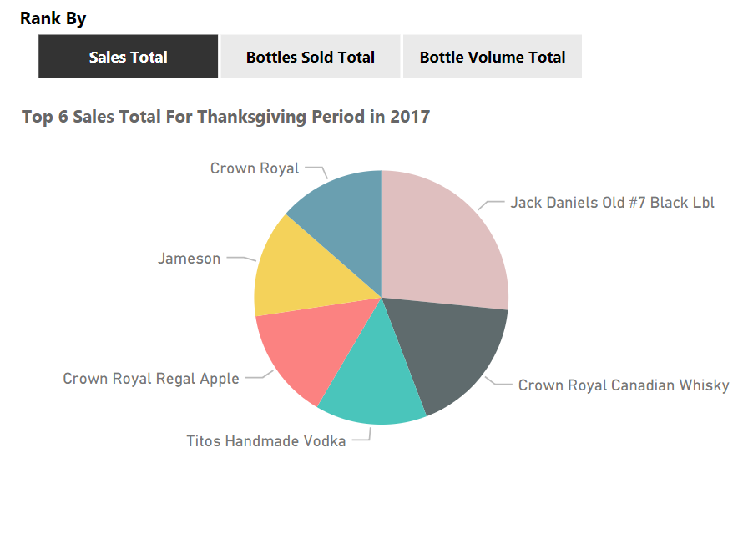
A Measure With Switch Example
Dynamic Total = VAR RankBy = SELECTEDVALUE ( 'Rank By'[Rank By] ) RETURN SWITCH ( RankBy, "Bottle Volume Total", [Bottle Volume Total], "Bottles Sold Total", [Bottles Sold Total], "Sales Total", [Sales Total] )
Choose a Slicer Value to Switch the Metric Displayed
Please note that switch measures should be used cautiously. Always performance test them and use other techniques when they cause issues.

Slide 18
See the Example Script for the M Code.
Unpivot the Data
The Key to Dynamic Reports
Add a Unique Index to your Fact Table if it doesn’t already have one.
Make a Reference Copy of your Fact Table query by right clicking it and choosing Reference from the menu. Rename the new query.
In the new reference copy select your index and the columns you want to turn into categories. Remove the other columns.
If compound fields are required, use the Query Editor to add a new column and combine the fields in the table.
Highlight the columns except for the index. In the Transform Tab, click on Unpivot Columns and unpivot only selected columns.
Close & Apply. Add your new values as a slicer.

Slide 19
Create the Dynamic Column
This is a calculated column in your new Dynamic Table. When used in a visual, it switches based on your slicer value. Without this, you can’t use the pivoted dimension!
The Calculated Column
Dynamic Column = /* Each value represents a slicer value and looks up a related dimension to use
You MUST include a row for each value you want included in your visualizations.*/ SWITCH ( FIRSTNONBLANK ( 'Dimensions'[Attribute], 1 ), "Category", RELATED ( 'Category'[Category Name] ), "Store Number", RELATED ( 'Stores'[Store Name] ), "Item Number", RELATED ( 'Items'[Item Description] ), "Vendor Number", RELATED ( Vendor[Vendor Name] ), "City", RELATED ( 'Stores'[City] ), "County", RELATED ( 'Stores'[County] ), "Combined Store Info", RELATED ( Stores[Store Name] ) & ", " & RELATED ( Stores[City] ) & ", " & RELATED ( 'Stores'[County] ), "Item & Vendor", RELATED ( Items[Item Description] ) & ", " & RELATED ( Vendor[Vendor Name] ) )

Slide 20
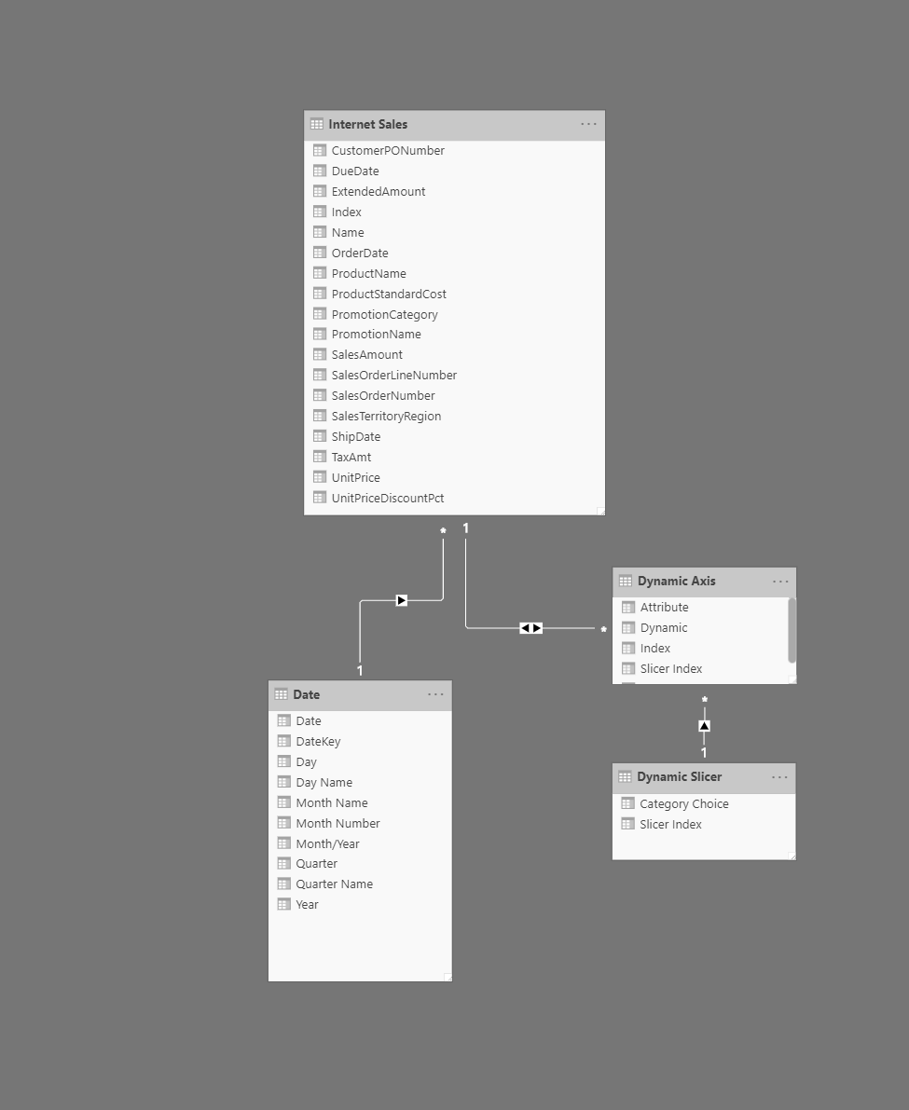
Add Relationships
The Glue that Makes the Rest Work!
Both Ways!
Your Dynamic table needs a bidirectional relationship to your main fact table. Without this, it will not work! Don’t use on the rest of your relationships!
Slicer Table
Single Direction slicer to your slicer table!

Slide 21
A Dynamic Table Name Example
Dynamic Table Title with TopN = VAR Selection = SELECTEDVALUE ( 'Metric Selection'[Selection] ) VAR Year = SELECTEDVALUE ( 'Date'[Year] ) VAR Holiday = SELECTEDVALUE ( 'Holidays'[Holiday] ) VAR TopOrBottomNumber = SELECTEDVALUE ( 'Top Records'[Top Records] ) VAR RankBy = SELECTEDVALUE ( 'Rank By'[Rank By] ) VAR TopOrBottom = SELECTEDVALUE ( 'Top or Bottom'[TopOrBottomTitle] ) RETURN TopOrBottom & " " & TopOrBottomNumber & " " & RankBy & " " & "For " & Holiday & " " & "in " & Year
Change the Name of the Table based on your Slicer Selection
Click on the table and choose the paintbrush under Visualizations.
Under Title, click the … elipses and choose conditional formatting
Under “Based on Field”, choose your table name measure.

Slide 23
DYNAMIC
Power BI
V2
Questions?
Email: rabramson@pragmaticworks.com

Slide 24
DYNAMIC
Power BI
V2
Thank you!
Email: rabramson@pragmaticworks.com
The Power BI File for this presentation can be downloaded from: https://pragmaticworksonline.sharepoint.com/:f:/s/FileShare/EsQNdtTaeohFo1um0d652MYB_LJCQvXgIJcyivStBa11kA?e=uakueC Extract to a folder named ‪C:\Webinar Example

