Slide 1
DYNAMIC
Power BI
Empowering Users to Change the Way They View Their Own Reports

Slide 2
Robin Abramson
Senior Consultant, Pragmatic Works
Former PASS Board Member
Nineteen Years Experience with Data
Power BI Enthusiast – I love my job!
Resides in the Pacific Northwest – I love where I live!
Email: rabramson@pragmaticworks.com

Slide 3
Dynamic Reporting
Empowering Users through Choice
As Power BI becomes more popular, a greater number of users with varying experience are utilizing reports to find the actionable data that helps them run their business.

Slide 4
Old School
The Way Things Were
The standard for many companies in recent years has been SSRS. Switching to Power BI was a major leap forward, but many analysts and end users are still utilizing the reports in a similar manner to how they used the old reports.
How did I do?
What’s actionable?
What’s next?
Users are looking at reports to see how they did. Old School Reports provided this information – usually in tabular form that could be downloaded for further analysis.
Old School Reports rarely provided this information. Analysts had to download and shape the data to work for their needs.
Old school reports might contain forecast data, but without interactive visualizations, it could be hard to absorb. Again, analysts often downloaded to Excel.

Slide 5
Offer Categories!
Find the Opportunities!
New School
Using Dynamic Techniques, we can let users quickly find the data that matters to them.

Slide 6
Let the Users Drive!
They know what data they need & they don’t want to have to jump through hoops to get it!

Slide 7
It’s Dynamic!
The Techniques we will use:
Whatif Parameters
Slicer Tables
Measures with Switch
Unpivoted Data

Slide 8
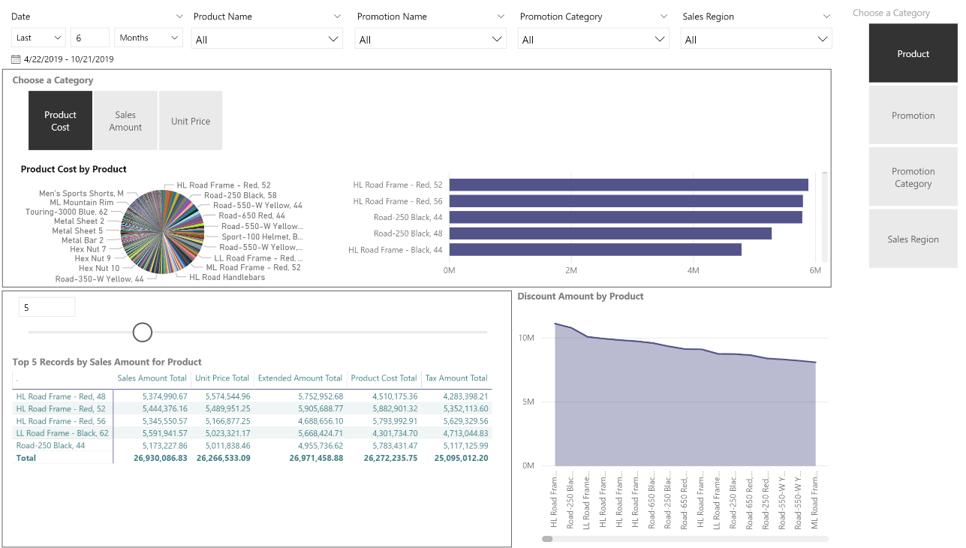
The Report:
AdventureWorks Data
Five Million Rows Added
Maybe a Tiny Bit Excessive in its use of Dynamic Techniques

Slide 9
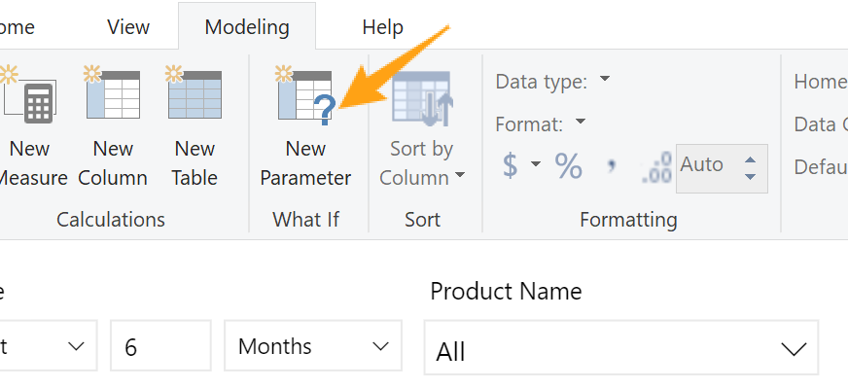
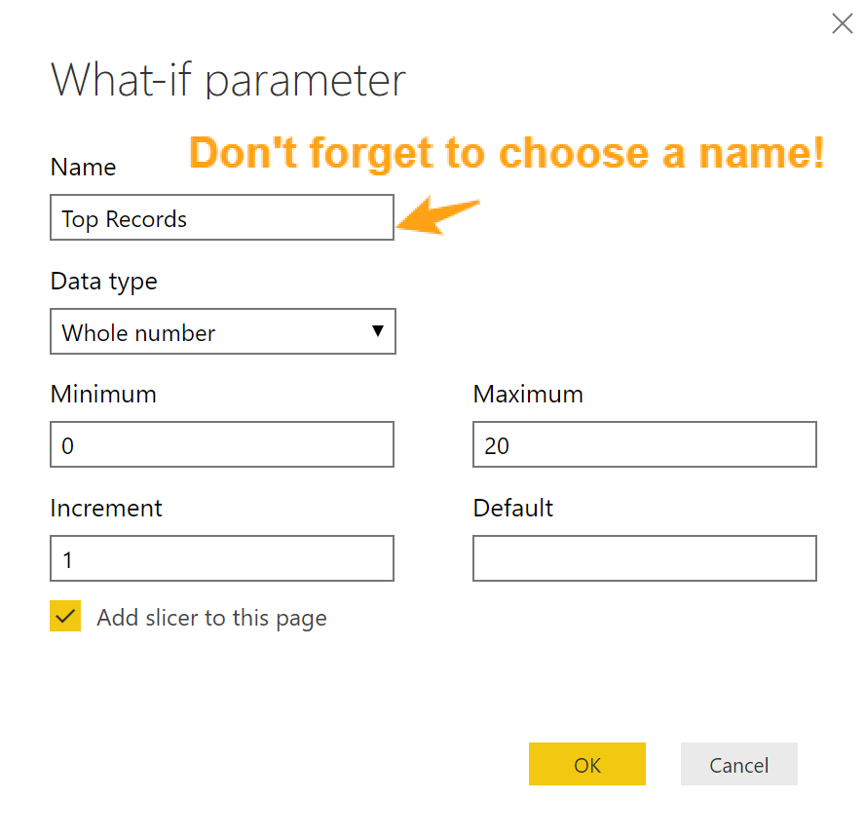
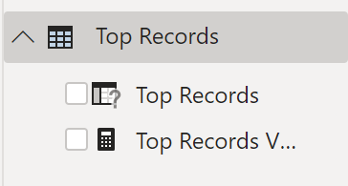
WhatIf
Adding a runtime parameter for your users
#1: Click on the New Parameter WhatIf on the Modeling Tool Bar
#2: Rename for a Meaningful Parameter!
#3: Add to measures where you want!

Slide 10
A TopN Measure Example
Top N by Chosen Value = VAR TopNum = SELECTEDVALUE ( 'Top Records'[Top Records] ) RETURN VAR RankN = IF ( ISINSCOPE ( 'Dynamic Axis'[Dynamic] ), RANKX ( CALCULATETABLE ( ALLSELECTED ( 'Dynamic Axis'[Dynamic] ) ), [Sales Amount Total], , DESC, SKIP ) ) RETURN IF ( RankN <= TopNum, RankN )

Slide 11
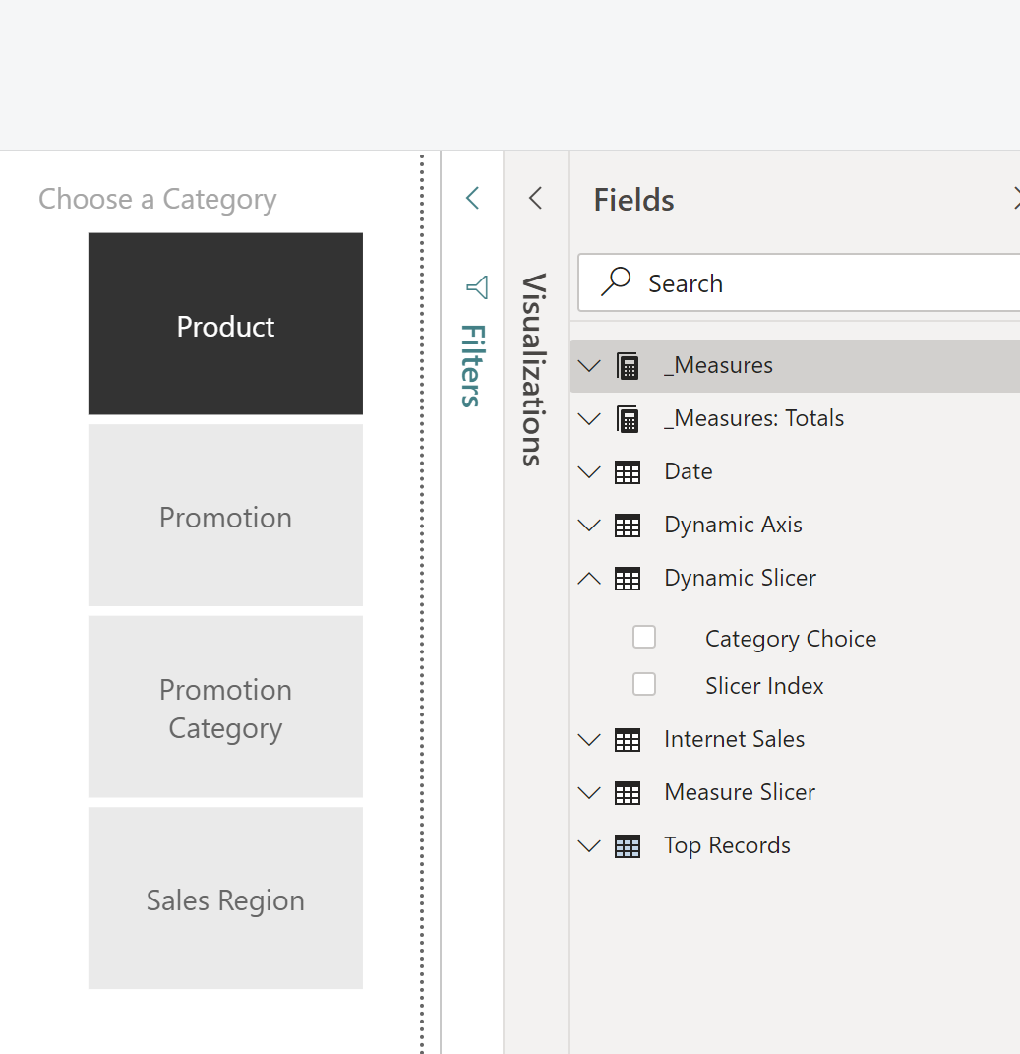
Slicer Tables
Adding tables to facilitate your dynamic elements
#1: Create a new table with your slicer categories.
#2: Add a relationship to your dynamic table!
#3: Add the categories as a slicer.

Slide 12
A Measure With Switch Example
Switch Values = VAR SelectedMetric = SELECTEDVALUE ( 'Measure Slicer'[Metric] ) RETURN IF ( HASONEVALUE ( 'Measure Slicer'[Metric] ), SWITCH ( SelectedMetric, "Product Cost", [Product Cost Total], "Sales Amount", [Sales Amount Total], "Unit Price", [Unit Price Total] ) )
Choose a Slicer Value to Switch the Metric Displayed

Slide 13
See the Power BI Example Script for the M Code.
Unpivot the Data
The Key to Dynamic Reports
Add a Unique Index to your Fact Table if it doesn’t already have one.
Make a Reference Copy of your Fact Table query by right clicking it and choosing Reference from the menu. Rename the new query.
In the new reference copy select your index and the columns you want to turn into categories. Remove the other columns.
Highlight the columns except for the index. In the Transform Tab, click on Unpivot Columns and unpivot only selected columns.
On the Add Column Tab, add a conditional column. Assign the attributes a number using the “Columns From Examples” functionality. This index will map to your Slicer Table index for a relationship.

Slide 14
Below, we see the code created by the previous steps.
Unpivot the Data
The M-Code
let
Source = #"Internet Sales",
#"Removed Duplicates" = Table.Distinct(Source, {"Index", "ProductName", "PromotionName", "PromotionCategory", "SalesTerritoryRegion"}),
#"Removed Other Columns" = Table.SelectColumns(#"Removed Duplicates",{"Index", "ProductName", "PromotionName", "PromotionCategory", "SalesTerritoryRegion"}),
#"Unpivoted Columns" = Table.UnpivotOtherColumns(#"Removed Other Columns", {"Index"}, "Attribute", "Value"),
#"Added Conditional Column" = Table.AddColumn(#"Unpivoted Columns", "Slicer Index", each if [Attribute] = "ProductName" then 1 else if [Attribute] = "PromotionName" then 2 else if [Attribute] = "PromotionCategory" then 3 else if [Attribute] = "SalesTerritoryRegion" then 4 else null, type number)
in
#"Added Conditional Column"

Slide 15
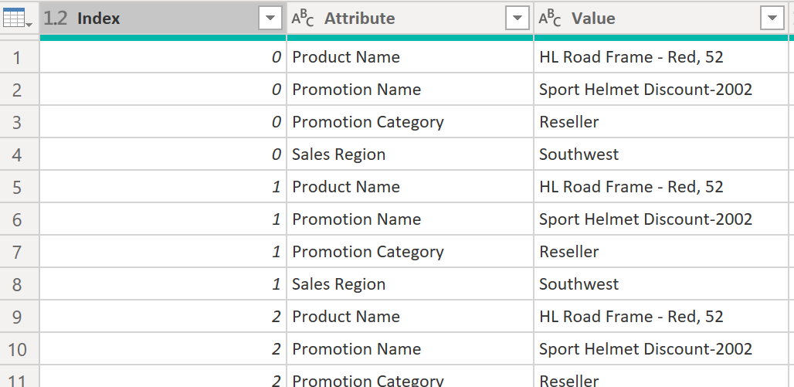
What we just did!
Flipping the Table Around!
By Unpivoting the columns we want to make available as categories, we’ve made a more narrow, longer table. Each row from the initial table is now four rows, one for each of the attributes we’ve chosen. Because Power BI handles long, narrow tables very well, the result is performant.
The new index column will act in a relationship to the original Internet Sales table – allowing us to create an app-like experiences for the users!

Slide 16
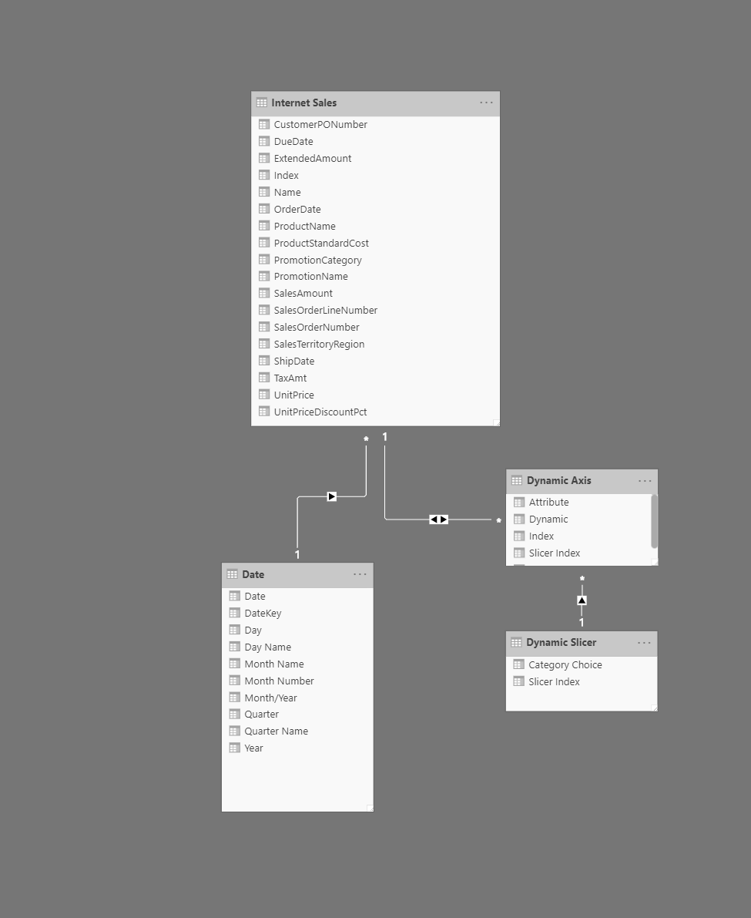
Add Relationships
The Glue that Makes the Rest Work!
Both Ways!
Your Dynamic table needs a bidirectional relationship to your main fact table. Without this, it will not work!
Slicer Table
Single Direction slicer to your slicer table!

Slide 17
The Column With Switch Example
Dynamic Column =
SWITCH (
FIRSTNONBLANK ( 'Dynamic Slicer'[Metric Choice], 1 ),
"Product", RELATED ( 'Internet Sales'[Product Name] ),
"Promotion", RELATED ( 'Internet Sales'[Promotion Name] ),
"Promotion Category", RELATED ( 'Internet Sales'[Promotion Category] ),
"Sales Region", RELATED ( 'Internet Sales'[Sales Region] )
)
Choose a Slicer Value to Change the Column Values

Slide 18
A Dynamic Table Name Example
Dynamic Table Title with TopN = VAR CurrentCategory = SELECTEDVALUE ( 'Dynamic Slicer'[Metric Choice] ) VAR TopNNumber = SELECTEDVALUE ( 'Top Records'[Top Records] ) RETURN "Top " & TopNNumber & " Records by Sales Amount for " & CurrentCategory
Change the Name of the Table based on your Slicer Selection
Click on the table and choose the paintbrush under Visualizations.
Under Title, click the … elipses and choose conditional formatting
Under “Based on Field”, choose your table name measure.

Slide 19
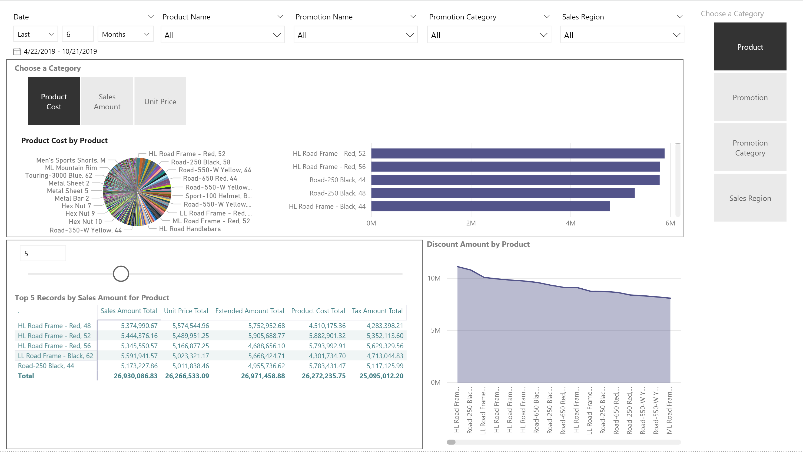

Slide 20
DYNAMIC
Power BI
Questions?
Email: rabramson@pragmaticworks.com

Slide 21
DYNAMIC
Power BI
Thank you!
Email: rabramson@pragmaticworks.com

