Slide 1
Event Driven ELT
Michael French
Principal Consultant
5/18/2019

Slide 2
About Me
Principal Consultant, Pragmatic Works
20+ years of IT Experience
B.S. of Applied Mathematics, Kent State University
SQLSaturday Presenter
Community Volunteer

Slide 3
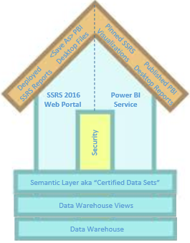

Goals
Architecture Overview
Migrating from Traditional Architectures
INTRODUCTION
Life of a File
How do I function without SSIS?
Demo
Event Driven ELT

Slide 4
Traditional Data Architecture for BI Programs
Audit, Balance & Control
Source
Extract
& Load
Raw
Data Store
Transform
& Load
Structure
Data Store
Semantic
Layer
Data
Delivery
API Call
Source 1
On-Prem
SQL Server
Source 2
Source 3
SSIS
Azure Sql DB
SSIS
Azure Sql DB
SSAS
Power BI
SMFT
Source 4
Source 5
Source 6
Azure Sql DB Views
1 2 3 4 5 6 7
Data Governance
Notes:
Link to traditional data architecture
https://www.delorabradish.com/modeling-for-bi/your-bi-blueprint-road-to-a-successful-bi-implementation
Link to Azure data architecture
https://www.delorabradish.com/modeling-for-bi/data-architecture-for-azure-bi-programs

Slide 5
Why Migrate to Azure?
Cost (scale up, scale down)
Offset Limited Local IT Resources
Event Based File Ingestion
Unstructured Data
Large Data Volumes
Near Real Time Requirements
Data Science Capabilities
Development Time to Production
Support for large audiences
Mobile
Collaboration
File based history (SCD2 equivalent)

Slide 6


Azure Data Architecture for BI Programs
Azure Logic App & SQL Server Procedure event logging to Cosmos DB or Azure SQL Database
PBI Logs
Data
Pull or Push
Raw
Data Store
Transform & Load
Standardized Data Store
Transform & Load
Enterprise
Data Store
Semantic
Layer
Data
Delivery
Source
API Calls
Self-hosted
Integration
Runtime
Azure Logic App SFTP File Watcher
Temporary
Data
Store
Generate
Current Version File
+
Generate
Separate
Delta
Files
Permanent
Current
File
+
Deltas
(Separate
New
Update, Delete)
Files
Multi-file
Consolidation
To
Data Models
Logical
Model
+ Metadata
Dimensional model
Dashboards
Workbooks
Reports
Cloud
Source 1
Source 2
8
9
Source 3
Subject area OLAP Model
Azure SQL DB
AAS
Azure Function ABS Watcher
10
On-Prem 4
Data Science
SFTP
AI, ML Tools
Source 5
Azure SQL DW
Unstructured
Data
Source 6
+ Metadata
Source 7
…
Azure Blob Storage
Data Bricks
Azure Data Lake
PolyBase t-SQL
Cosmos DB
Spark
Power BI
1 2 3 4 5 6 7 11 12 13
Azure Data Factory Pipeline Ingestion “Orchestrators”
Analyze
Visualize
Notes:
Link to traditional data architecture
https://www.delorabradish.com/modeling-for-bi/your-bi-blueprint-road-to-a-successful-bi-implementation
Link to Azure data architecture
https://www.delorabradish.com/modeling-for-bi/data-architecture-for-azure-bi-programs

Slide 7
Azure Data Architecture ~ Traditional Comparison
Azure Logic App & SQL Server Procedure event logging to Cosmos DB or Azure SQL Database
PBI Logs
Data
Pull or Push
Raw
Data Store
Transform & Load
Standardized Data Store
Transform & Load
Enterprise
Data Store
Semantic
Layer
Data
Delivery
Source
API Calls
Self-hosted
Integration
Runtime
Azure Logic App SFTP File Watcher
Temporary
Data
Store
Multi-file
Consolidation
To
Data Models
Dimensional model
Dashboards
Workbooks
Reports
Cloud
Source 1
Source 2
8
9
Source 3
Subject area OLAP Model
Azure SQL DB
AAS
10
On-Prem 4
SFTP
Source 5
Azure SQL DW
Source 6
Source 7
…
Azure Blob Storage
Databricks
Azure Data Lake
PolyBase t-SQL
Cosmos DB
Spark
Power BI
1 2 3 4 5 6 7 11 12 13
Azure Data Factory Pipeline Ingestion “Orchestrators”
Analyze
Visualize
PBI
SSIS
SQL DB
SSIS
SQL DB
Tabular
Traditional →

Slide 8
Azure Data Architecture ~ Value Add
Azure Logic App & SQL Server Procedure event logging to Cosmos DB or Azure SQL Database
PBI Logs
Data
Pull or Push
Raw
Data Store
Transform & Load
Standardized Data Store
Transform & Load
Enterprise
Data Store
Semantic
Layer
Data
Delivery
Source
API Calls
Self-hosted
Integration
Runtime
Azure Logic App SFTP File Watcher
Temporary
Data
Store
Generate
Current Version File
+
Generate
Separate
Delta
Files
Permanent
Current
File
+
Deltas
(Separate
New
Update, Delete)
Files
Multi-file
Consolidation
To
Data Models
Logical
Model
+ Metadata
Dimensional model
Dashboards
Workbooks
Reports
Cloud
Source 1
Source 2
8
9
Source 3
Subject area OLAP Model
Azure SQL DB
AAS
Azure Function ABS Watcher
10
On-Prem 4
Data Science
SFTP
AI, ML Tools
Source 5
Azure SQL DW
Unstructured
Data
Source 6
+ Metadata
Source 7
…
Azure Blob Storage
Databricks
Azure Data Lake
PolyBase t-SQL
Cosmos DB
Spark
Power BI
1 2 3 4 5 6 7 11 12 13
Azure Data Factory Pipeline Ingestion “Orchestrators”
Analyze
Visualize
PBI
SSIS
SQL DB
SSIS
SQL DB
Tabular
Traditional →

Slide 9
Talking Points
Azure Data Factory Orchestrator
Listening for new Files in Azure Logic Apps
Life of a File
Preprocessing in Azure Blob Storage
Current & Historical Files in Azure Data Lake
Azure Data Warehouse Ingestion

Slide 10
Azure Logic App ~ SFTP Listener
Push from Source
Data
Pull or Push
Raw
Data Store
Source
Azure Logic App SFTP File Watcher
Temporary
Data
Store
SFTP File Watchers
2
3
Logic App
SFTP File Watcher
SFTP File Added or Changed
Logic App
Log Event
SFTP File Found
Azure Database
Stored Proc
Log File Found
Logic App
Log Event
& Call ADF Pipeline
Azure Data
Factory
SFTP Orchestrator
Azure
Blob Storage
SFTP
Source 5
Source 6
Event Hub
Send Event
Azure Blob Storage
1 2 3
Azure Data Factory

Slide 11
Azure Data Factory Orchestrator
Scheduled Pull from Source (traditional SSIS)
Data
Pull or Push
Raw
Data Store
Source
API Calls
Self-hosted
Integration
Runtime
Azure Logic App SFTP File Watcher
Temporary
Data
Store
2 ~ ADF Orchestrator
3
Cloud
Source 1
Azure Data
Factory
Triggered Pipeline
Azure Database
Stored Proc
Get Start Date
Azure Data
Factory
Copy Dataset
Azure Database
Stored Proc
Update Run Date
Azure
Blob Storage
Source 2
Source 3
On-Prem 4
Logic App
Log Event
After every activity!!
…
Azure Blob Storage
1 2 3
Azure Data Factory
Event Hub
Send Event

Slide 12

Azure Blob Storage ~ Preprocessing
1 2 3 4
No Deletes Needed
Source
Azure Data Factory
Azure Blob Storage
finalContainer
Azure Function
Raw
Data Store
Must Delete
Unapproved Departments
Cleansed CSV File
Temporary
Data
Store
2b
2c
Azure Blob Storage
tempContainer
HDInsight of ADFgen2
Delete.py /or/ Pipeline
Azure SQL Database
Azure Function ABS Watcher
5a 5b 5c 5d 5e 6
If
found
Logic App
Cosmos DB
Logic App
Data Factory
HDInsight
Data Lake Store
Full or incremental load parameter passed to ADL Orchestrator
Cosmos DB
Azure Blob Storage

Slide 13
Azure Data Factory Orchestrator
Scheduled Pull from Source
1 2 3 4
No Preprocessing
Needed
Source
Azure Data Factory
Azure Blob Storage
finalContainer
Azure Function
Raw
Data Store
Temporary
Data
Store
Azure SQL Database
Azure Function ABS Watcher
5a 5b 5c 5d 5e 6
If
found
Logic App
Cosmos DB
Logic App
Data Factory
HDInsight
Data Lake Store
Full or incremental load parameter passed to ADL Orchestrator
Cosmos DB
Azure Blob Storage

Slide 14
Same Song, Second Verse
1 2 3 4
Some ingestion method
Azure Blob Storage
finalContainer
Azure Function
Raw
Data Store
Temporary
Data
Store
Azure Function ABS Watcher
5a 5b 5c 5d 5e 6
If
found
Logic App
Cosmos DB
Logic App
Data Factory
HDInsight
Data Lake Store
Full or incremental load parameter passed to ADL Orchestrator
Cosmos DB
Azure Blob Storage

Slide 15
Azure Data Lake Ingestion
For all Sources
Raw
Data Store
Transform & Load
Standardized Data Store
Temporary
Data
Store
Generate
Current Version File
+
Generate
Separate
Delta
Files
Current
File
+
Deltas
(Separate
New
Update, Delete)
Files
3
4 – ABS File Watcher (Root Container)
5
6
Azure
Blob
Azure
Function
ABS File Added or Changed
Logic App
Log Event
ABS File Found
Logic App
Log Event
& Call ADF Pipeline
Azure Data
Factory
ADL Orchestrator
Azure Data Lake Store
Azure Function ABS Watcher
Event Hub
Send Event
Azure Blob Storage
Data Bricks
Azure Data Lake
3 4 5 6
Azure Data Factory

Slide 16
Azure Data Factory Orchestrator
One Orchestrator Pipeline For all Sources
All ADF
Metadata Logging
or
ADL Orchestrator
Pipeline
Logic App
Log Event
Success
Logic App
Log Event
Failure
Source For
Azure
Blob
Ingestion Pipeline
Event Hub
Send Event
PySpark
Create row-level checksum
PySpark
Create delta files
Source For
Azure Data Lake Store
Separate
New, Changed & Deleted Files
AsIs Pipeline
PySpark
Create AsIs Files
Azure Data Lake Store
Single “AsIs” Current File

Slide 17
Azure Data Warehouse Ingestion
For all Sources
Standardized Data Store
Transform & Load
Enterprise
Data Store
Current
File
+
Deltas
(Separate
New
Update, Delete)
Files
Multi-file
Consolidation
To
Data Models
3NF
Schema
Subject area specific integrated Data Hub
With historical tracking
OLAP
Schema
6
7
8
Azure Data Lake Store
Azure Data
Factory
Orchestrator
Execute series of Stored
Procedures
Azure SQL
Data Warehouse
External Tables
Azure SQL
Data Warehouse
3NF Tables
Event Hub
Send Event
Azure SQL
Data Warehouse
Logging Tables
8 9
Azure SQL DB or ADW
Azure Data Lake
PolyBase t-SQL
6 7 8 and/or 9
Azure Data Factory

Slide 18
Cloud Tools
 | Tool | Purpose
1 | Azure Logic Apps | SFTP "watcher“ Event logging Blob storage and data lake delete methodologies Notifications Automatic emails Cosmos DB document upload and deletions
2 | Azure Function | Azure Blob Storage "listener"
3 | Azure Event Hub | event handling
4 | Azure Blob Storage | temporary work space
5 | Azure Data Factory | Process flow orchestrators Data copy QA methodologies

Slide 19
Cloud Tools (continued)
 | Tool | Purpose
6 | Databricks | Data processing and write to Azure Data Lake Other pre-processing data requirements
7 | HD Insight | Originally implemented, but replaced with Databricks
8 | Azure Data Lake | Delta files -- change data capture at the file level Current “AsIs” files Data science self-service Power BI self-service
9 | Cosmos DB SQL API | Logging ELT metadata
10 | Azure Key Vault | Supports Dev/QA/Prod Migration

Slide 20
Cloud Tools (continued)
 | Tool | Purpose
11 | Azure SQL Database | ELT metadata
12 | Azure SQL Data Warehouse | Both Inmon and Kimball data stores (loosely speaking)
13 | Azure Analysis Services | Tabular semantic layer
14 | Power BI | Reporting and self-service

Slide 21
Development Tools
 | Tool | Purpose
1 | Visual Studio Python project | Auto generate the file-level metadata for complete file ingestion to Azure Data Lake
2 | Visual Studio Azure Data Warehouse project | Team Foundation Server source code control for Azure Data Warehouses
3 | Visual Studio Logic App Project | Team Foundation Server or GIT source code control for Azure Logic Apps
4 | Visual Studio Database Project | Team Foundation Server or GIT source code control for Azure SQL Databases
5 | GIT Hub | Source code control for Azure Data Factory and Databricks

Slide 22



Demo

Slide 23
Have Any Questions?

Slide 24
Additional Resources
Azure Messaging Services
  https://docs.microsoft.com/en-us/azure/event-grid/compare-messaging-services
Azure Every Day
  http://blog.pragmaticworks.com/choosing-the-right-tools-for-elt-workloads-in-the-cloud
Colleague Site
  http://www.delorabardish.com
Contact Me
  MFrench@PragmaticWorks.com

Slide 25






app
Training Delivery Options
Bootcamps
Week long deep-dive
Workshops
One-day training primer
On-Demand Training
Web-based subscription training

Slide 26

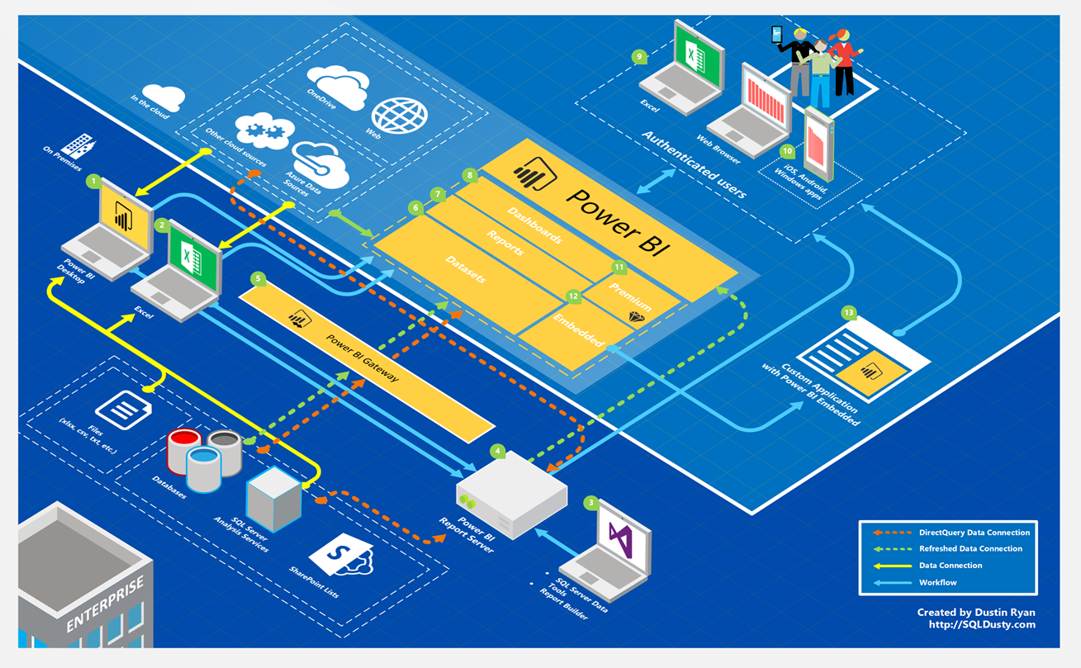
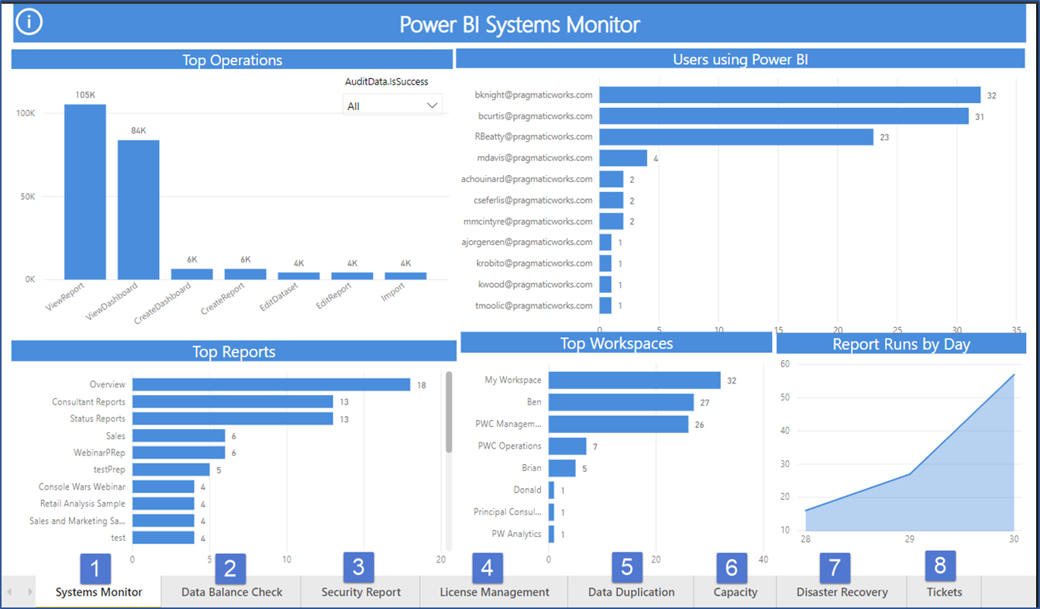

65
25
Power BI -Managed Services-2019
User support
Skills and Development
Ecosystem Management
Plan, Configure, Remediate
Systems Monitor
Daily validation of your Power BI ecosystem.

