Slide 1

Hybrid Cloud Strategies and Management
Chris Seferlis
Senior Principal Architect
Pragmatic Works
cseferlis@pragmaticworks.com
@bizdataviz
Linkedin.com/in/cseferlis

Slide 2
Session objectives and takeaways
Answer this question:
Notes:
The objective of this session is to answer this one question…

Slide 3
How can my organization begin using Hybrid Cloud today?
Notes:
With the stuff I have right now in my environment

Slide 4
Hybrid Cloud Presents Great Opportunity
58%
87%
Enterprises see themselves operating hybrid clouds for the foreseeable future
Enterprises have a hybrid cloud strategy up from 55% a year ago
Organizations are planning to integrate on-premises datacenters with public cloud
Sources:
Microsoft Study, 2017
RightScale 2017 State of the Cloud report
Avanade research on IT modernization, April 2017
Notes:
Huge Opportunity
Initially The Idea of Hybrid was rejected
Some said all On-Prem
Some said all in cloud
Hybrid is consistency of services
Why do we need to stay on prem?
Data sovereignty
Regulatory
Physical nature

Slide 5
Hybrid cloud consistency
Azure Active
Directory
Azure Management
and Security
Azure
Data Services
Azure
Services
Common
Identity
Management
& Security
Data
Platform
Unified Development
Windows Server Active Directory
On-premises Infrastructure
SQL
Server
Azure
Stack
Notes:
Hybrid maintains Consistency
Connectivity is not hybrid

Slide 6
Hybrid Identity with Windows Server AD and Azure AD
Notes:
A key part of this is Consistent Identity
Who doesn’t use Active Directory in their environment?
Massive adoption of Azure AD
Want to provide a great Hybrid experience by:
Better secure your organization
Ideal situation – New Employee comes in, set up, long career, leaves, removed
Who here has forgotten to turn someone off?
Someone is let go and IT isn’t notified

Slide 7

Mobile-first, cloud-first reality
63%
80%
0.6%
Data breaches
  63% of confirmed data breaches involve weak, default, or stolen passwords.
Shadow IT
  More than 80 percent of employees
  admit to using non-approved
  software as a service (SaaS) applications in their jobs.
IT Budget growth
  Gartner predicts global IT spend will grow only 0.6% in 2016.
Notes:
In the cloud, what does that look like?
The cloud is different
Mobile First/Cloud first
All different devices we use
New Challenges

Slide 8










The current reality
EC2
On-premises
Managed devices
Active Directory
Notes:
Current Reality looks like this:
Lots of Services
Lots of Devices
Lots of internal stuff
Control has left the building

Slide 9


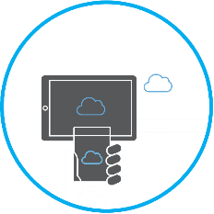


Identity is the new control plane
1000s of apps,
1 identity
Enable business without borders
Manage access
at scale
Cloud-powered protection
Azure Active Directory at the core of your business
Notes:
Important to realize… we’ve moved past the firewall
A firewall is not protecting your users in the cloud
Brute Forcing a Firewall is Passé – instead they’ll try a Spear-Phishing attempt with info from your website

Slide 10


Identity as the core of enterprise mobility
Azure Active Directory as the control plane
Partners
Customers
Windows Server
Active Directory
Other
directories
Self-service
Single sign-on
Azure
SaaS
Public
cloud
Simple connection
On-premises
Microsoft Azure Active Directory
Cloud
Notes:
You’ve got On-Prem
You’ve got Cloud Resources
Services you need – no one wants to take them away
Azure AD in the Middle gives a single consistent way to use all resources
And when that person leaves the company, and you disable 1 azure ad account, all services are disabled

Slide 11
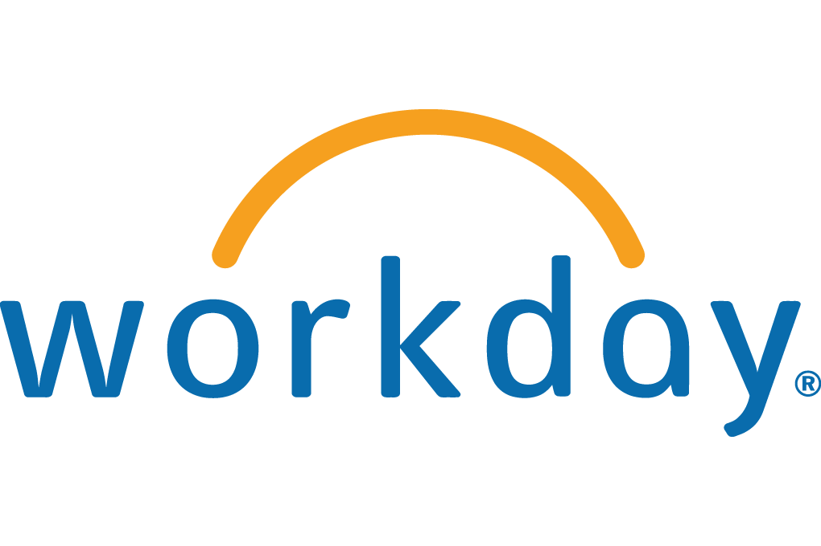





1000s of apps, 1 identity
Single sign-on to any app
Other directories
Microsoft Azure
SaaS apps
Web apps
(Azure Active Directory Application Proxy)
Integrated
custom apps
Notes:
With Azure AD
On Prem – AD, etc
SaaS Apps
Web Apps
Custom in-house apps

Slide 12

Azure Active Directory Domain Services
Your domain controller as a service for lift-and-shift scenarios
1000s of apps, 1 identity
Azure
Lift-and-shift on-premises apps to Azure IaaS
Your virtual
network
Azure AD
Domain Services
Azure AD Connect
Kerberos
Your Azure IaaS workloads/apps
NTLM
LDAP
Windows Server Active Directory
Group Policy
Azure
Active Directory
On-premises
Notes:
Easier migration to Azure because you’re already getting synchronized

Slide 13
Better security starts at the OS
Security
threats
Datacenter
efficiency
Supporting innovation
Datacenter efficiency
Protect identity
Supporting innovation
Protect the OS on-premises or in the cloud
Help secure virtual machines
Notes:
Let’s start with security

Slide 14

Equifax Announces Cybersecurity Incident Involving Consumer Information
Sep 07, 2017
ATLANTA, Sept. 7, 2017 /PRNewswire/ -- Equifax Inc. (NYSE: EFX) today announced a cybersecurity incident potentially impacting approximately 143 million U.S. consumers. Criminals exploited a U.S. website application vulnerability to gain access to certain files. Based on the company's investigation, the unauthorized access occurred from mid-May through July 2017. The company has found no evidence of unauthorized activity on Equifax's core consumer or commercial credit reporting databases.
The information accessed primarily includes names, Social Security numbers, birth dates, addresses and, in some instances, driver's license numbers. In addition, credit card numbers for approximately 209,000 U.S. consumers, and certain dispute documents with personal identifying information for approximately 182,000 U.S. consumers, were accessed. As part of its investigation of this application vulnerability, Equifax also identified unauthorized access to limited personal information for certain UK and Canadian residents. Equifax will work with UK and Canadian regulators to determine appropriate next steps. The company has found no evidence that personal information of consumers in any other country has been impacted.
ATLANTA, Sept. 7, 2017 /PRNewswire/ -- Equifax Inc. (NYSE: EFX) today announced a cybersecurity incident potentially impacting approximately 143 million U.S. consumers…
…The information accessed primarily includes names, Social Security numbers, birth dates, addresses and, in some instances, driver's license numbers.

Slide 15
Windows Server 2016 Built-in security
Shielded Virtual Machines
Host Guardian Service
Secure Boot for Windows and Linux
Virtualization-based Security (VBS)
Containers with Hyper-V Isolation
Containers in Shielded VMs
Windows Defender
Credential Guard
Just in Time Administration
Just Enough Administration
Control Flow Guard
Code Integrity
Enhanced Threat Detection
Notes:
Just by Deploying Server 2016, I’ve made my environment more secure
Shielded VMs
Hyper-V Only
“Guarded Fabric” blocks access
VHD Encrypted - Virtual Black Box
Now supports Windows, soon to Support Linux
Just a few of the enhancements for the OS

Slide 16

Enable security at cloud speed
  Continuously assesses the security of your workloads even as they change
  Creates policy-driven recommendations and guides users through the process of remediating security vulnerabilities
  Enables rapid deployment of build-in security controls as well as products and services from security partners (firewalls, endpoint protection, and more)
Notes:
But, by coupling Server 2016 with Azure
Sure, can be done on prem, it’s not easy, but you can do it
Spend weeks and months Configure environment
Create Policies
Create Best Practices
Or Microsoft’s team of expers
Based on Internal MS Best Practices and ML

Slide 17
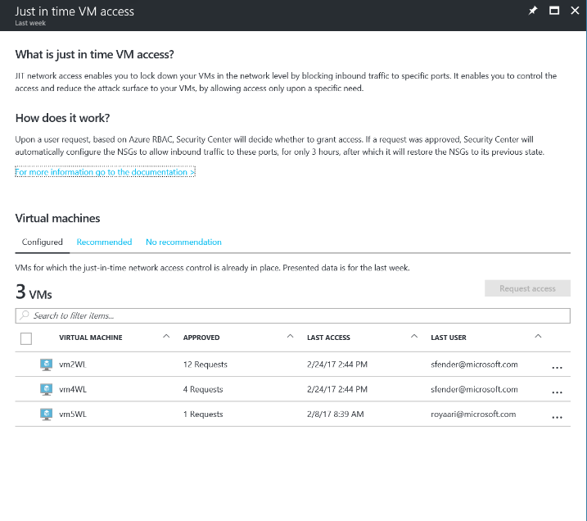
Limit exposure to brute force attacks with just-in-time
RDP and SSH access to virtual machines
Preview
Notes:
An example of this:
Upon user request for RDP, based on RBAC, security center provides access for 3 hours with Auto Privilege and De-privilege
You should not need to stay logged in as admin
Already baked in to Azure and Server 2016

Slide 18
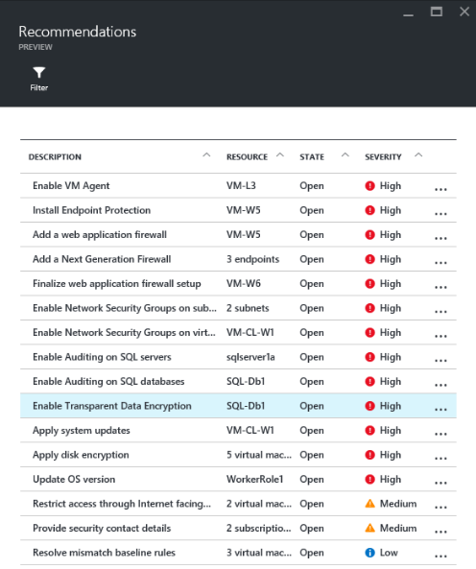
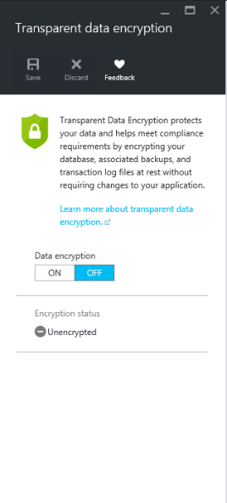
Prioritized recommendations take the guesswork out of security for resource owners
Notes:
Another good example
Prioritized recommendations
Here’s a quick list of all the workloads running
How many of you can do this without having to run another tool that took weeks/months to install?
Helping you secure the workloads with an on/off switch!

Slide 19






Integrate partner solutions
Recommends and streamlines provisioning of partner solutions
Integrates signals for centralized alerting and advanced detection
Enables monitoring and basic management with easy access to advanced configuration using the partner solution
Leverages Azure Marketplace for commerce and billing
Notes:
We love the tools we have already, so Azure provides that!

Slide 20
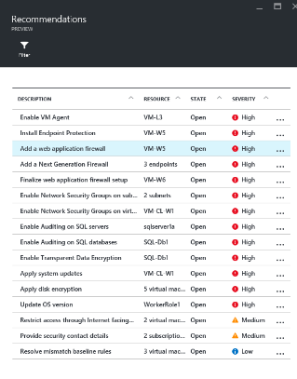
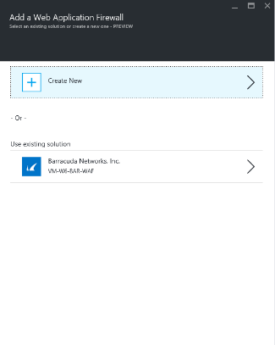
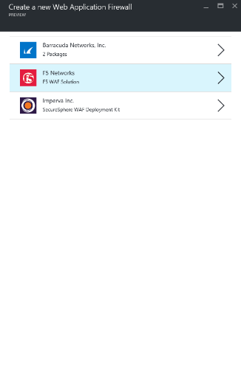
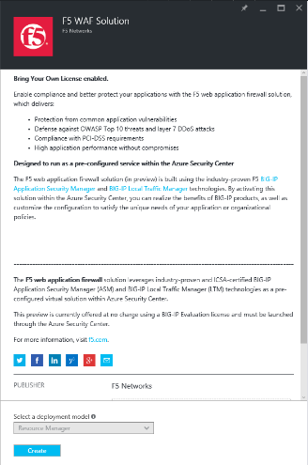
Easily deploy security solutions from partners and automatically integrate logs
Notes:
Marketplace is rich with 3rd party solutions
Adding a web application firewall
Who do you want it from?
And I don’t have to build a new appliance
Select my deployment model and click create
Use existing licenses and configurations

Slide 21
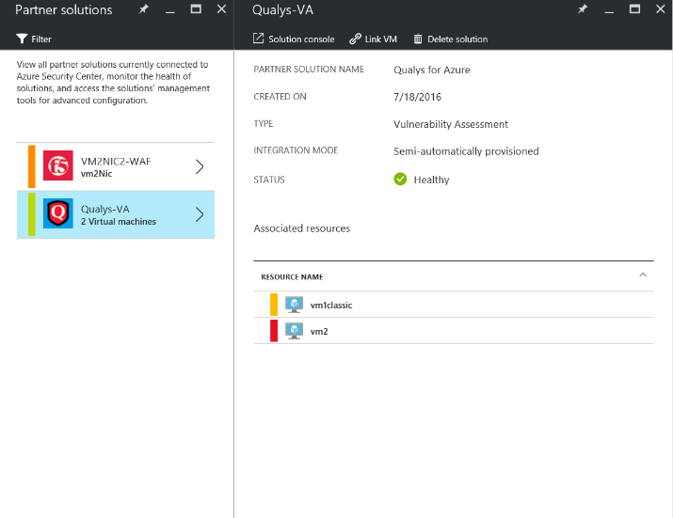
Monitor and manage partner security solutions
Notes:
Another example of integration across platform
Integration in the security center to help you manage and monitor your environment
Microsoft is making a major commitment to integration with 3rd party tools for ease of transition and true Hybrid approach

Slide 22

The world is changing

Slide 23
Data will grow to
44 ZB in 2020
Today, 80% of
organizations
adopt cloud-first
strategies
AI investment
increased by
300% in 2017

Slide 24
Data will grow to
44 ZB in 2020
Today, 80% of
organizations
adopt cloud-first
strategies
AI investment
increased by
300% in 2017
DATA
CLOUD
AI

Slide 25
CLOUD
Organizations that harness data,
cloud, and AI outperform
AI
Data

Slide 26
Organizations that harness data,
cloud, and AI outperform
Nearly double
operating margin
$100M in additional
operating income

Slide 27






Organizations that harness data,
cloud, and AI outperform
They out-innovate
Nearly double operating margin
$100M in additional operating income

Slide 28
They rely on a modern data estate

Slide 29
TRANSFORM your business
With a MODERN DATA ESTATE
HYBRID
On-premises
Private cloud
Cloud
Operational databases
Operational databases
Data warehouses
Data warehouses
Data lakes
Reason over
any data, anywhere
Flexibility
of choice
Security
and performance
Data lakes

Slide 30
SQL Server 2017
Industry-leading performance and security NOW ON LINUX and DOCKER
1/10th the cost of Oracle
Choice of platform
and language
Industry-leading performance
Most secure
over the last 7 years
Only commercial DB
with AI built-in
End-to-end mobile BI
on any device
$2,230
R
1/10
Self-service BI per user
T-SQL
Java
C/C++
C#/VB.NET
PHP
Node.js
Python
Ruby
$480
#1 OLTP performance
#1 DW performance
#1 price/performance
$120
Microsoft
Tableau
Oracle
R and Python +
in-memory at massive scale
Native T-SQL scoring
A fraction of the cost
In-memory across all workloads
Most consistent data platform
Private cloud
Public cloud

Slide 31
Cloud-first approach breeds FASTER innovation
Continuous
enhancements
SQL
SQL
SQL
SQL

Slide 32
Azure SQL Database Managed Instance
Seamless and reliable migration at scale
Lift and shift migration to the cloud with no code changes
Maximize current on-premises
license investments with Azure Hybrid Benefit
Database Migration Service
Azure Hybrid Benefit for SQL Server

Slide 33
Azure sql database
the intelligent cloud database for app developers
Learns
& adapts
Scales
on the fly
Enables
multi-tenant
SaaS apps
Works in your environment
Secures
& protects
Realize automatic performance improvements
Change performance
levels and storage
without downtime
Easily manage
multi-tenant apps
database isolation
Develop your app
with the tools and platforms you prefer
Build security-enhanced apps with industry-leading compliance

Slide 34
Systems of Intelligence on SQL Database
AZURE MACHINE LEARNING
AZURE SQL DATABASE
INTELLIGENT RESPONSIVE APPS
SQL
Realtime scoring
Azure Machine Learning Workbench

Slide 35
The Microsoft commitment to Choice in the cloud

Slide 36
AZURE DATABASE FOR
MYSQL AND POSTGRESQL
Work in the DB of your choice
Create with built-in high availability
Set up in minutes, scale on the fly
Sustain performance with adaptive improvements
Rest easy with unparalleled security
Standard tier

Slide 37
Uncover insights with Big Data & Advanced Analytics

Slide 38
Big Data & Advanced Analytics
Ingest
Store
Prep & train
Model & serve
Business apps
Data Factory
Data Lake
Store
Data Lake
Analytics
Cosmos DB
SQL DB
Web & mobile apps
Blobs
HDInsight (Hadoop/Spark)
SQL Data
Warehouse
Custom apps
Operational reports
Machine Learning
Analysis
Services
Sensors and devices
Event Hubs
Analytical dashboards
Stream Analytics
Kafka on HDInsight
DATA
INTELLIGENCE
ACTION

Slide 39
Microsoft for your modern data estate
LOB
CRM
Graph
Image
Social
IoT
SQL Server
HYBRID
Azure Data Services
Easiest lift and shift
with no code changes
Industry leader 4 years in a row
Operational databases
Operational databases
70% faster
#1 TPC-H performance
Data warehouses
Data warehouses
2x the global reach
T-SQL query over any data
Data lakes
Data lakes
99.9% SLA
AI built-in | Most secure | Lowest TCO
Reason over
any data, anywhere
Flexibility
of choice
Security and
performance

Slide 40
Azure File Sync
Notes:
One of the most popular uses of windows server is a file server
How many people are using a file server on prem?
Let’s make it better with Azure!

Slide 41

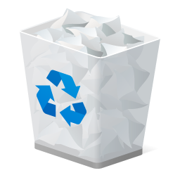


$$$
What are your pains with Windows File Server?
Notes:
Never seem to have enough storage
Never seem to have proper cleanup
Never seem to be able to access what’s needed and when

Slide 42
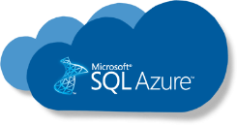

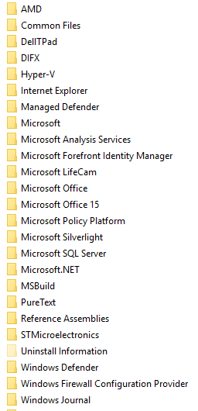



Azure File Sync
Cloud Tiering
West US
File Share
!
HQ
Seattle
Notes:
Set up a server in Seattle
Oh no, I’m running out of space
With cloud tiering, I can say stuff that’s not being used gets moved to Azure
Files turn gray, but files are still there

Slide 43




Azure File Sync
Cloud Tiering
West US
Multi-site sync
File Share
Work Folders
SMB
NFS
Users
Applications
Branch Office
New York
HQ
Seattle
Notes:
Now I need to set up a branch office
Using multi-site sync
NY and Seattle files are the same

Slide 44



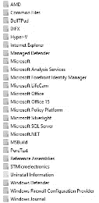

Azure File Sync
PaaS
Azure Backup Vault
Cloud Tiering
IaaS
SMB
REST
West US
Multi-site sync
File Share
Direct cloud access
Rapid file server DR
Integrated cloud backup
Work Folders
SMB
NFS
Users
Applications
HQ
Seattle
Branch Office
New York
HQ
Seattle
Notes:
PaaS and IaaS Services being used for access to those same files
Uh oh… the server and Seattle just failed, but those files are in the cloud
Plug in new server, enable file server role, synchronize with Azure, and files start moving back to the server as they’re used
Can be used with Server 2012 R2
From a backup standpoint Azure Backup Vault
Gets backed up automatically
storage is super cheap
Better availability, DR capabilities and Bottomless Storage

Slide 45


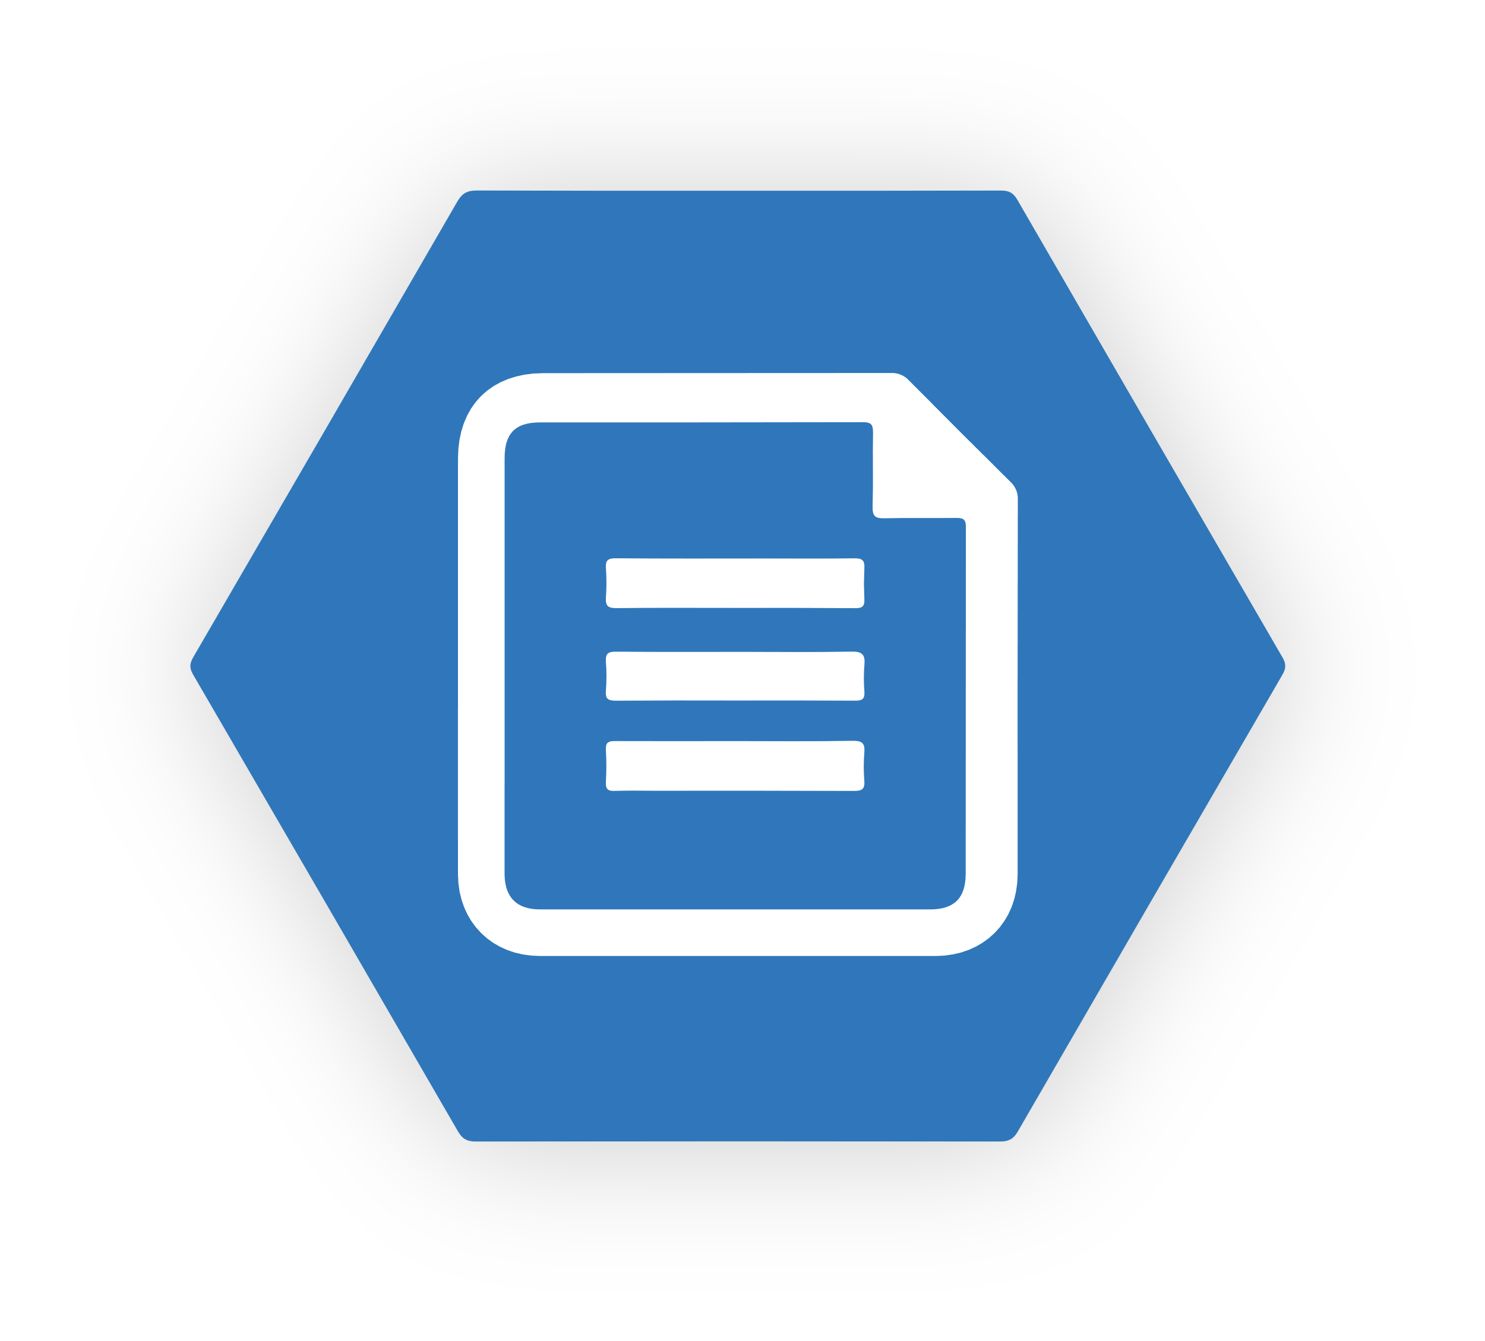






Azure File Sync
file sync
Centralize file services in Azure storage
file sync
Branch
Cache in multiple locations for fast, local performance
file sync
Utilize cloud-based backup and fast DR
Branch
aka.ms/afs
HQ Cluster

Slide 46
Hybrid Protection with Azure Site Recovery

Slide 47
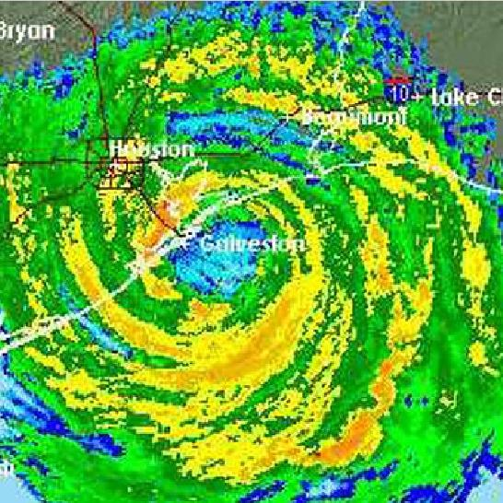
Hurricane Harvey
2017

Slide 48
Causes of IT disasters
Operational Failures
Natural Disasters
Human-caused events
43%
31%
16%
15%
12%
13%
10%
9%
4%
3%
1%
1%
1%
1%
Power failure
Hurricane
Flood
Fire
Network failure
Winter storm
Earthquake
Human error
Chemical spill
Terrorism
IT hardware failure
Malicious insider
IT software failure
Malicious outsider
Source: Forrester “The State of Business Technology Resiliency Q2 2014”, May 12, 2014
Notes:
We all know about the crazy year 2017 was with natural disasters: Hurricanes, Fires, Earthquakes, etc
But, when we look at the real causes of outages…
Any one of these have a significant impact

Slide 49
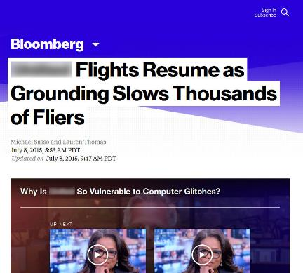

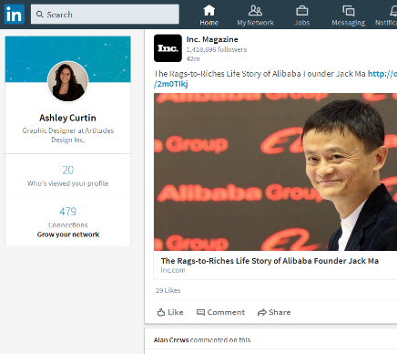
The impact of an outage on your digital business
Business continuity and data protection are critical
Impact of the outage itself
Impact to your brand
Impact to your IT career

Slide 50
IT challenges implementing business continuity
Business continuity and data protection are critical issues for every organization
Cost
Complexity
Coverage
and compliance
Data center cost
Resource cost
Hardware cost
Multiple data centers
Restoring tape
Managing management software
Need to retain data
Need to provide service
Challenging to comply
Notes:
So, the challenges are:
Cost
Complexity
Coverage and Compliance
How do you know you’re doing DR for the right resources

Slide 51
How Microsoft Azure can help
Accelerate your business continuity strategy
Reduced
cost
Reduced complexity
Increased compliance

Slide 52
Backup and replication Moving to Cloud…
September 22, 2017
  Sales of purpose-built backup appliances have dropped markedly, with year-on-year dips of 16.2 per cent by revenue and 14.9 per cent by capacity, according to analyst firm IDC's Worldwide Quarterly Purpose-Built Backup Appliance Tracker for 2017's second quarter.
  IDC's research manager for storage systems Liz Conner said: "The traditional
  backup market is declining as end users and vendors alike explore new technology."
  She mentioned "cloud-based backup tiers, hybrid flash arrays, emphasis on replication and data recovery" as reasons for the market's decline.
http://www.theregister.co.uk/2017/09/22/idc_q2_2017_storage_trackers/
Notes:
Seeing a big trend of backup and replication moving to the cloud
Storage and operational costs are much cheaper

Slide 53
Business continuity strategy
You need all three
Primary site
Primary site
Secondary site
Original
Backup
DATA
DATA
High availability
Disaster recovery
Backup
When your applications have a catastrophic failure, run a second instance
When your site has a catastrophic failure, run them in Azure or a secondary datacenter
When your data is corrupted, deleted or lost you can restore it
Notes:
With Azure Site Recovery, you’re taking the best solution to offer the best DR strategy

Slide 54







Azure Site Recovery: The complete disaster recovery solution
Any Cloud
Site to Site
Site to Azure
AWS*
Physical/VMware to VMware
Hyper-V/VMM to Hyper-V/VMM
VMware
Hyper-V
Physical
Any OS
Windows
Linux

Slide 55
Azure Stack

Slide 56
Accurately positioning Azure Stack
What it is
What it isn’t
First consistent Hybrid Cloud Platform
Virtualization-replacement play
Integrated system with IaaS & PaaS
DIY infrastructure
Regularly updated for Azure-consistency
Static system you deploy & forget
Cross Platform Hybrid Cloud
Windows Only Cloud

Slide 57
Microsoft Azure: Only consistent hybrid cloud
Azure Active Directory
Azure management and security
Azure
data services
Azure services
Clouds
Common Identity
Integrated Management and Security
Consistent Data Platform
Unified Development and DevOps
Active
Directory
On-premises
infrastructure
SQL Server
Azure Stack

Slide 58

Azure Stack is an extension of Azure
Only consistent hybrid cloud platform
Consistency
Azure
Azure Stack

Slide 59
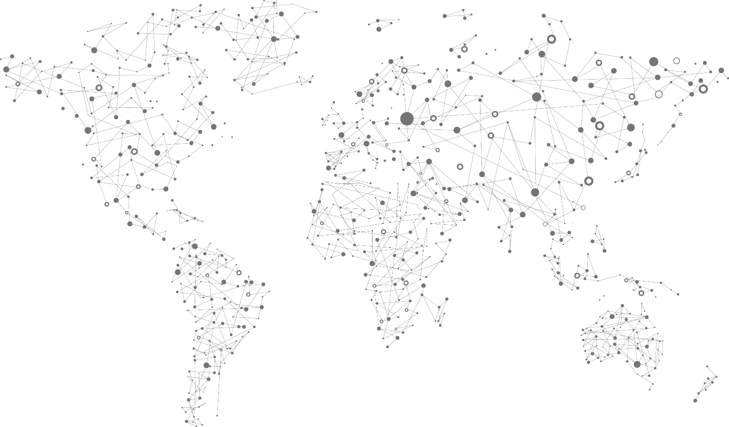
Azure services
everywhere
42 Azure regions
100s of service providers
1,000s of enterprises

Slide 60


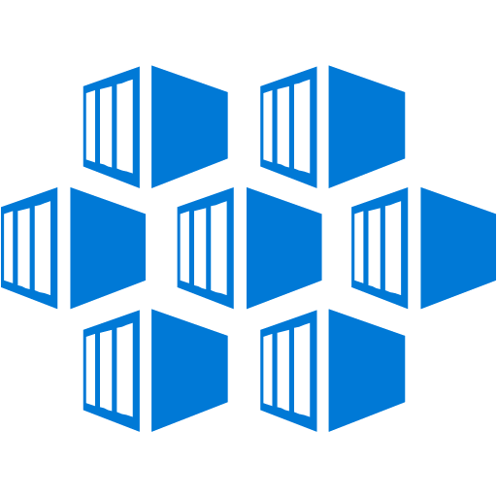
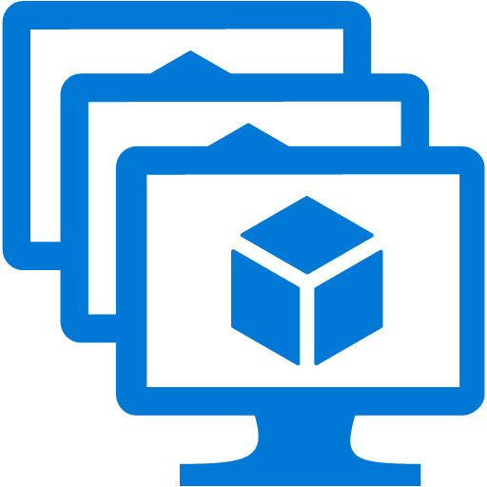
Azure Services on Azure Stack: PaaS and IaaS
Web, Mobile, and API apps
Serverless computing
Microservices platform
Container orchestration
Pivotal and
Open source
Azure App Service
Azure Functions
Service Fabric
Kubernetes
Cloud Foundry
Virtual Machines
Docker Containers
Networking
Storage
Key Vault
Linux and Windows
(including VM scale sets)
Linux and Windows
Virtual network, load balancer,
VPN gateway
Blobs, Tables, Queues, Disks
Application keys and secrets

Slide 61






Integrated delivery experience
Integrated systems
Fast to deploy
Pay-as-you-use
Integrated support, broadly available
Get up and running quickly
Deliver 100s of VMs initially (and grow
over time)
Extension of Azure model
Receive one bill
Consistent support experience, no matter who you call
Available in 46
geos initially

Slide 62
Get going with Azure Stack
1
2
3
Develop
applications in Azure
Validate
Download Azure Stack Development Kit
Deploy
Order Azure Stack integrated systems for production deployment
Start your journey to be a certified Azure Stack operator today

Slide 63
Modern, Remote Windows
Server Management
Notes:
What does this have to do with Hybrid?

Slide 64
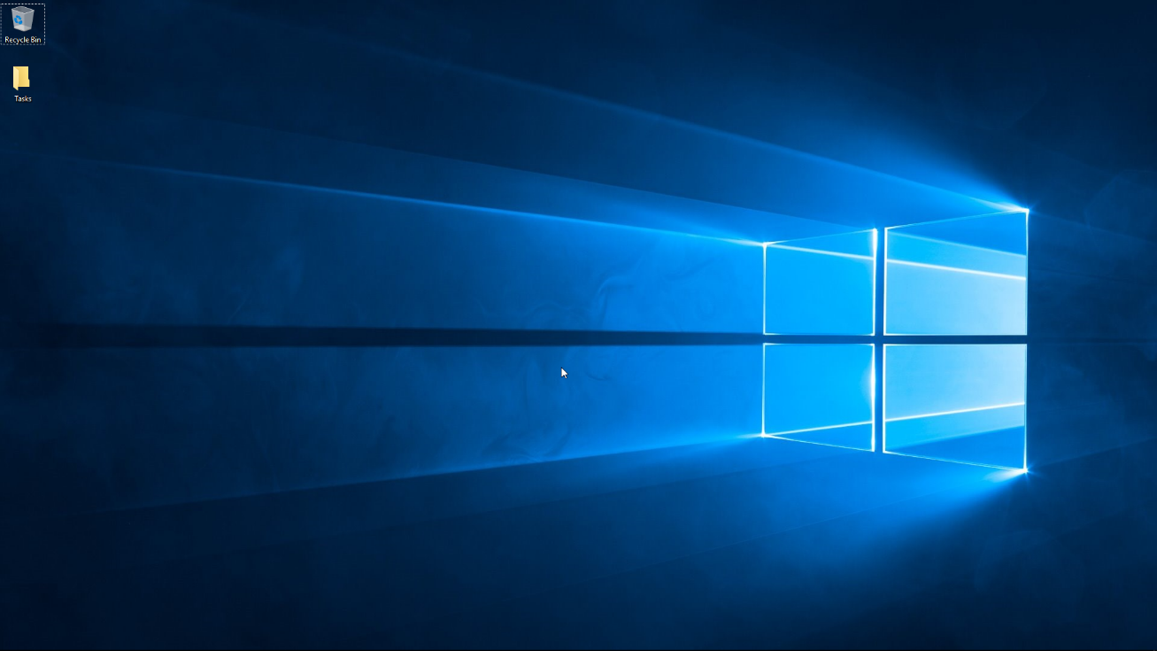
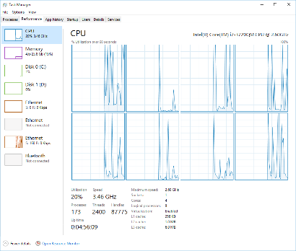
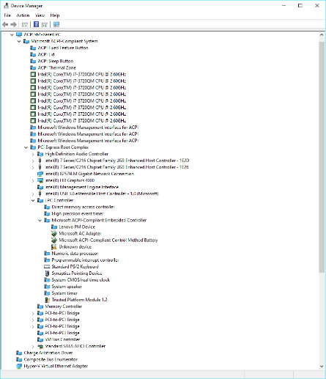
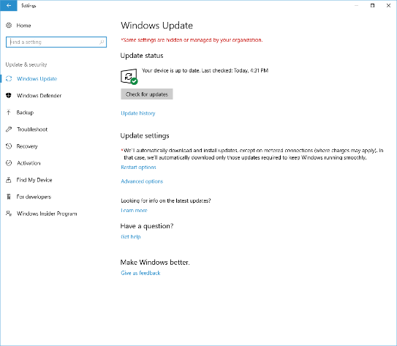
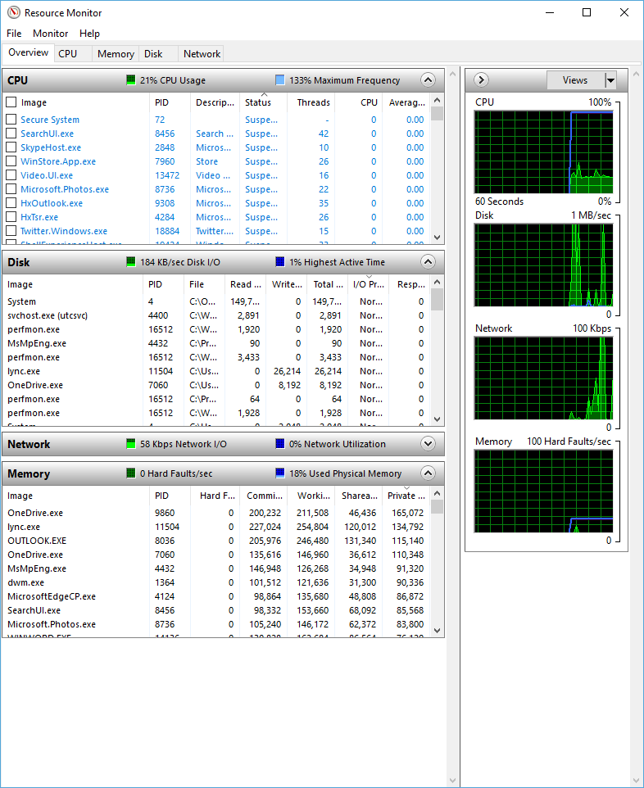
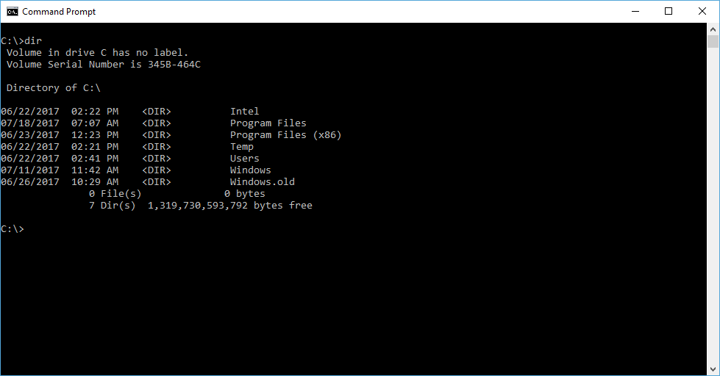
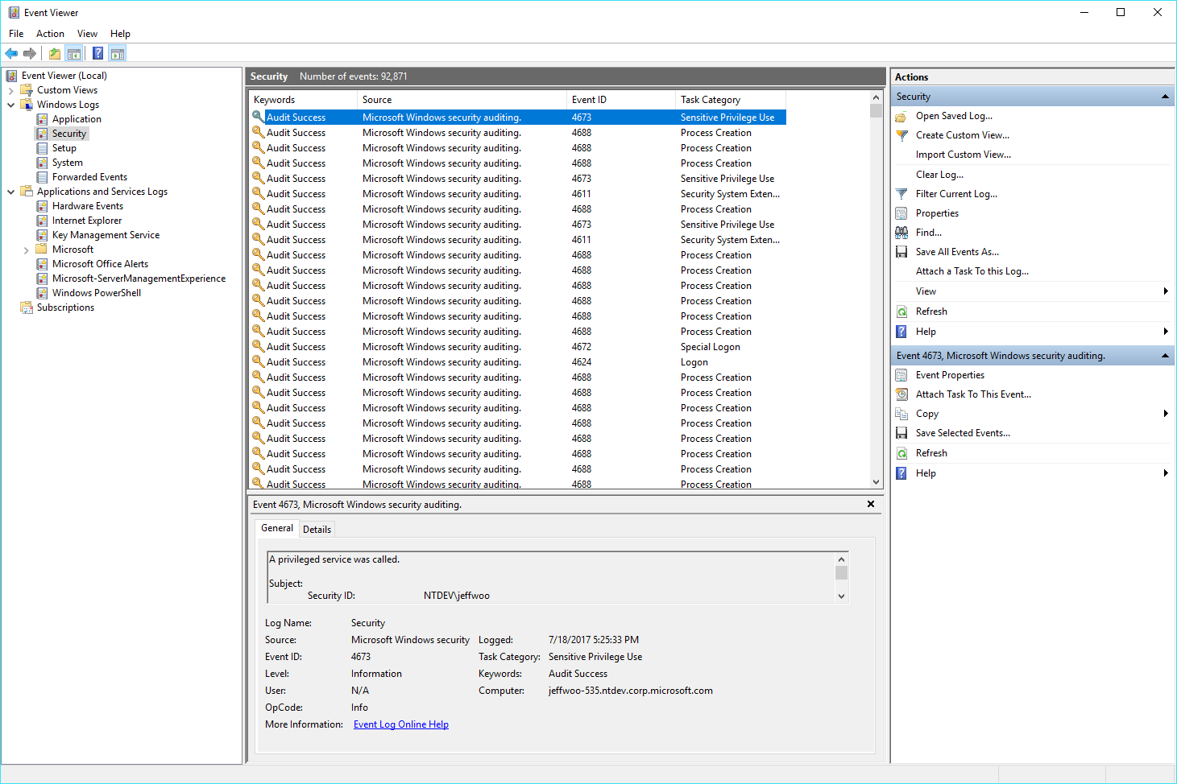
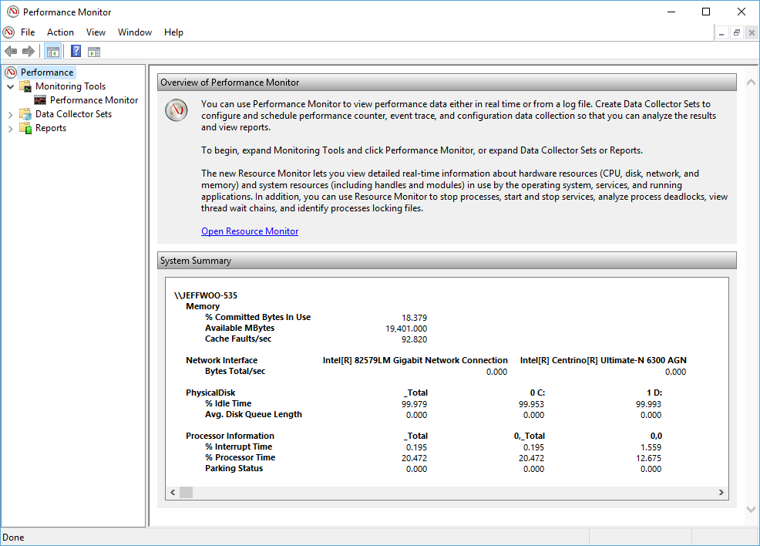
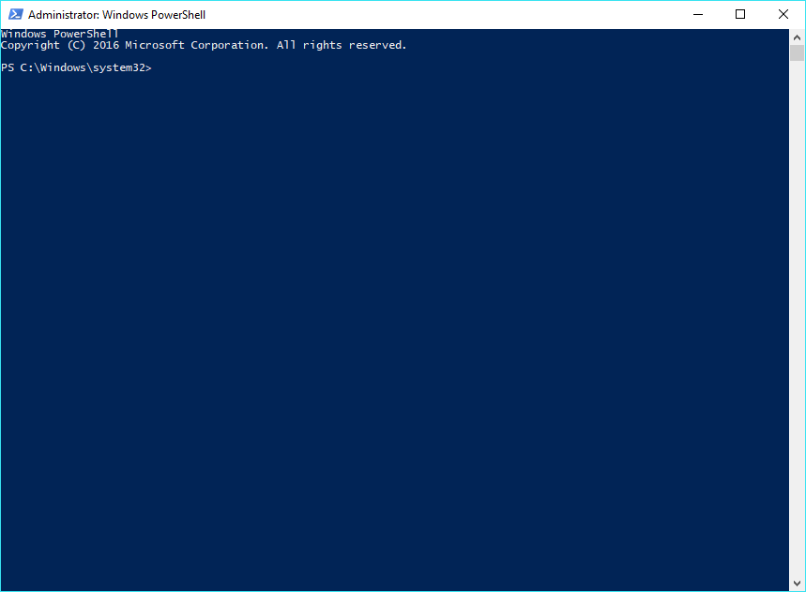
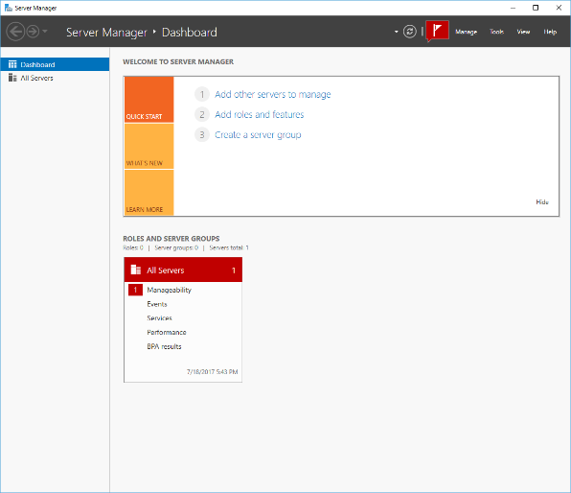
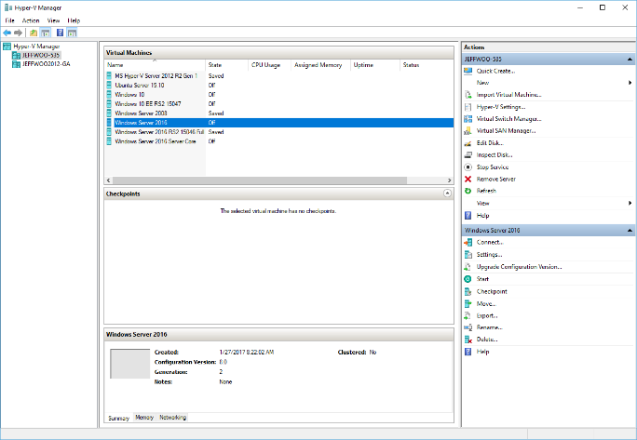
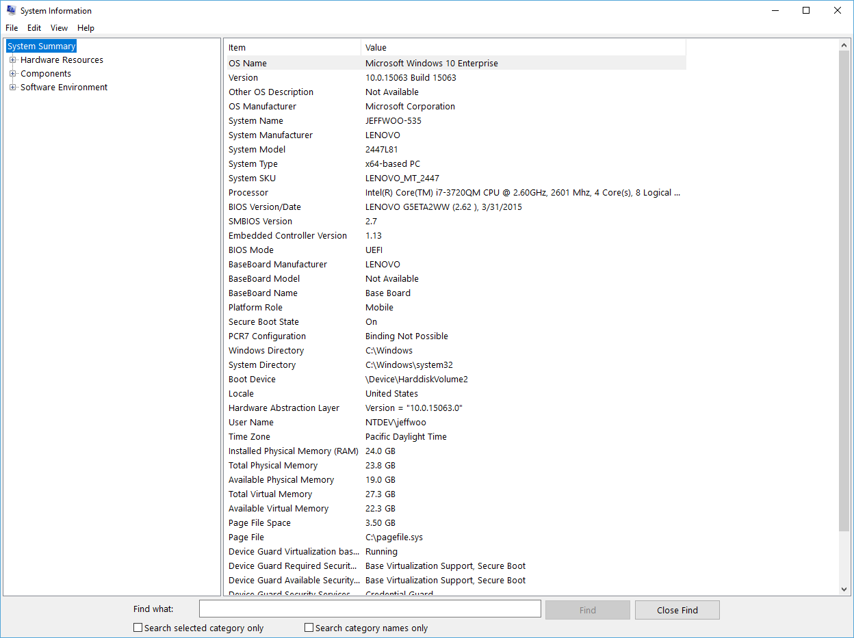
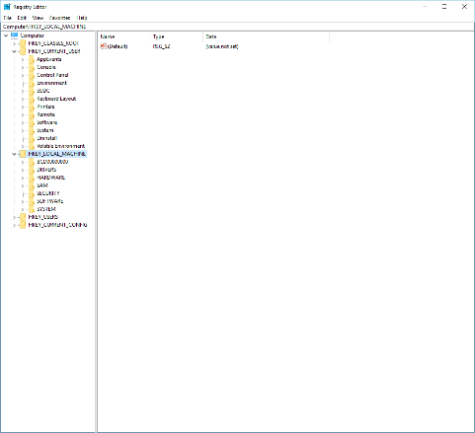
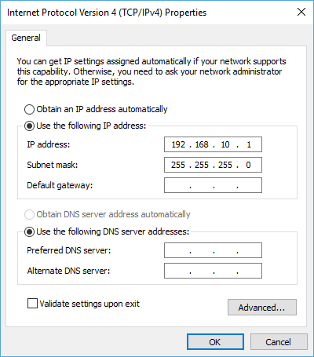
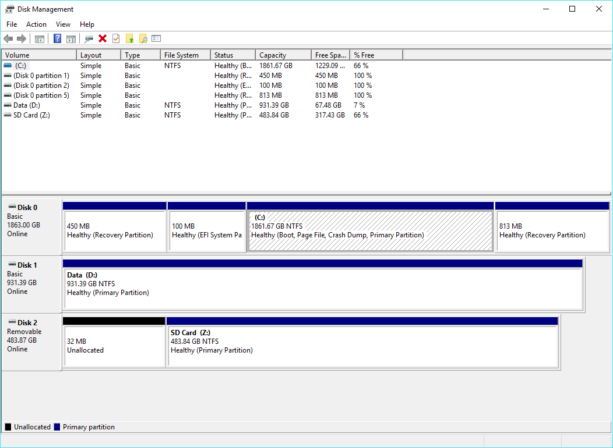
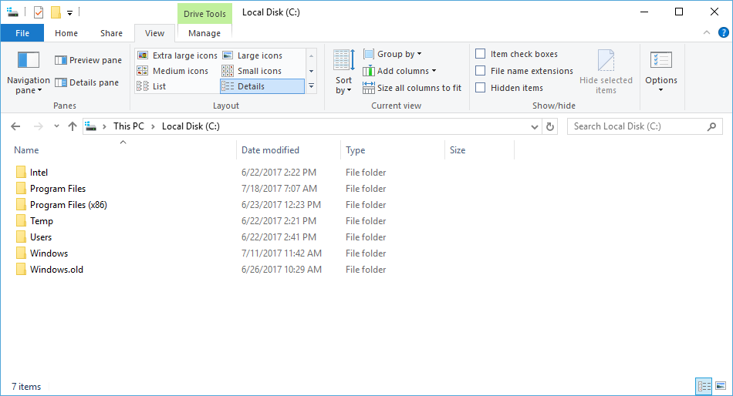
Notes:
So many tools for managing so many areas of Windows

Slide 65
Project “Honolulu”

Slide 66
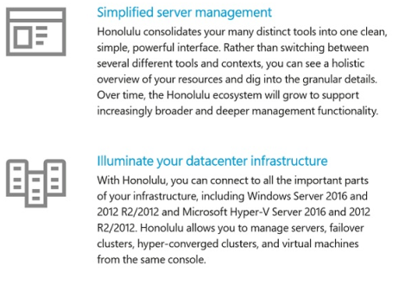
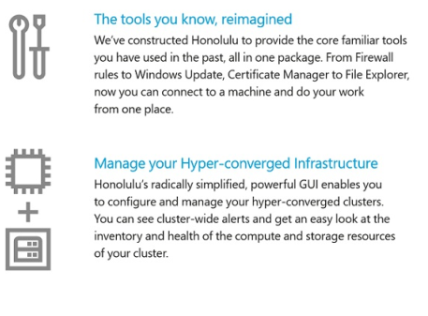
What is Project “Honolulu”?
Modern Management Platform
Aggregate “in-box” tools (Server Manager/MMC)
Manage On-Prem and Azure

Slide 67
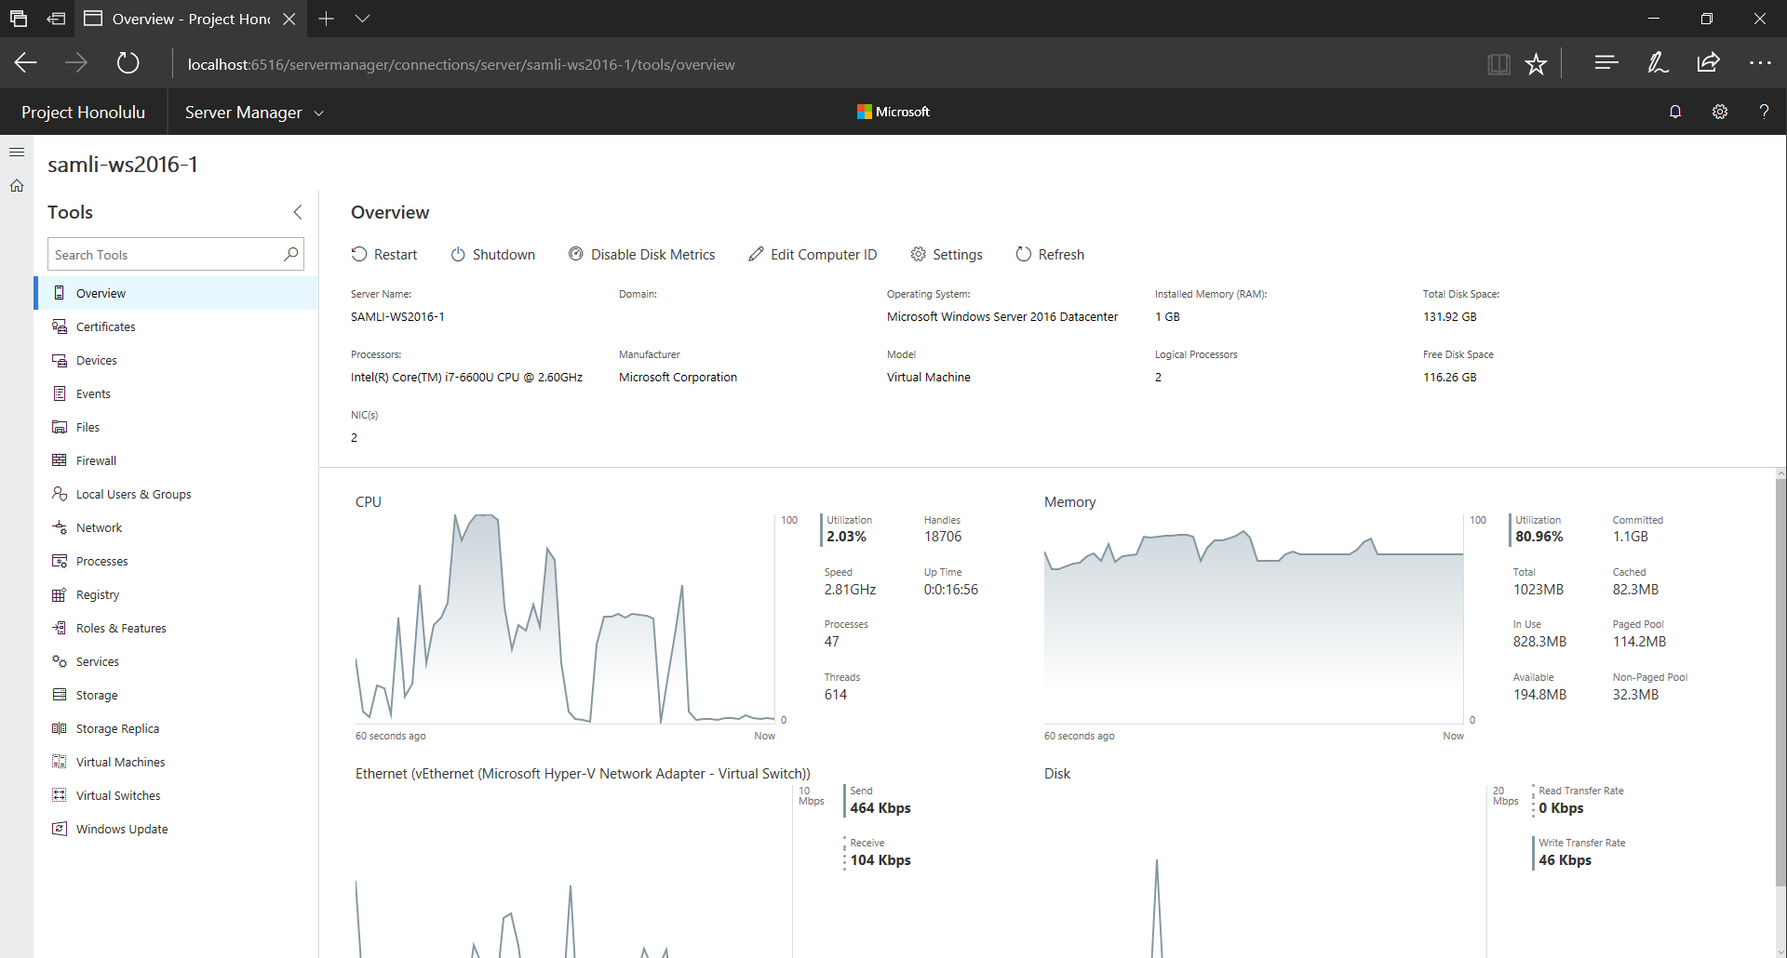

Slide 68
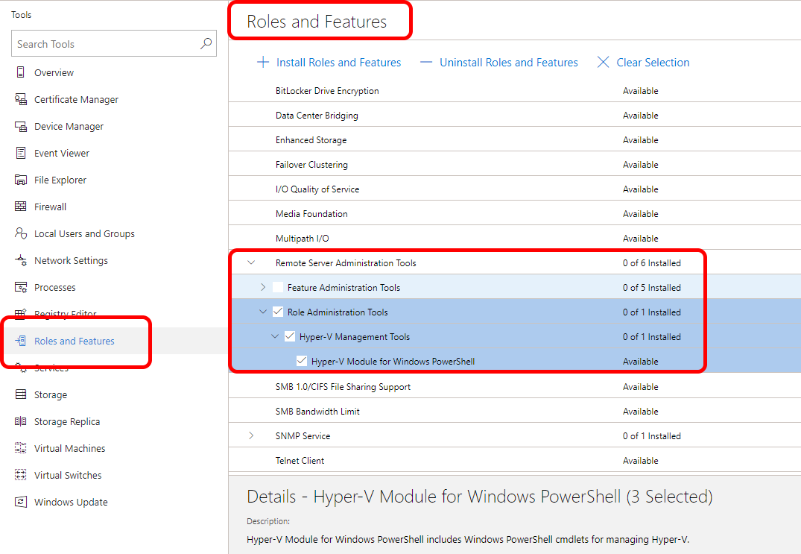

Slide 69
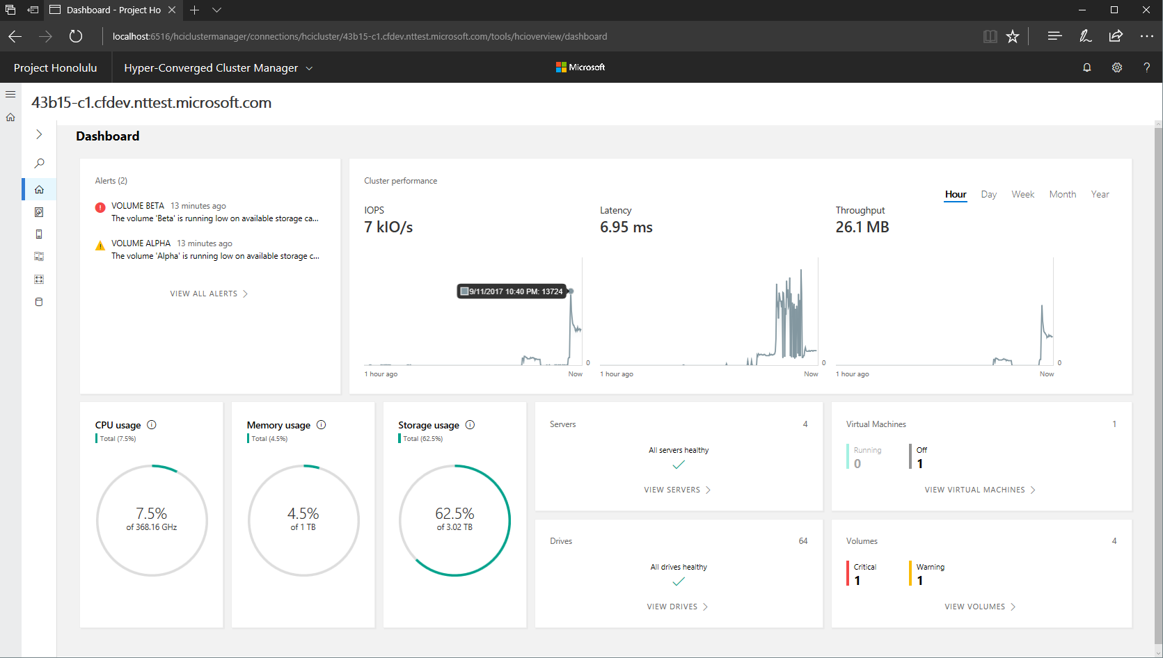
Notes:
This is the HCI UI looks like
Green - Alerts for the cluster
Blue - Overall cluster performance
Yellow - Overall resource uses

Slide 70
What’s next for
Project Honolulu
A peek in the pipeline…
Notes:
It’s Hybrid

Slide 71
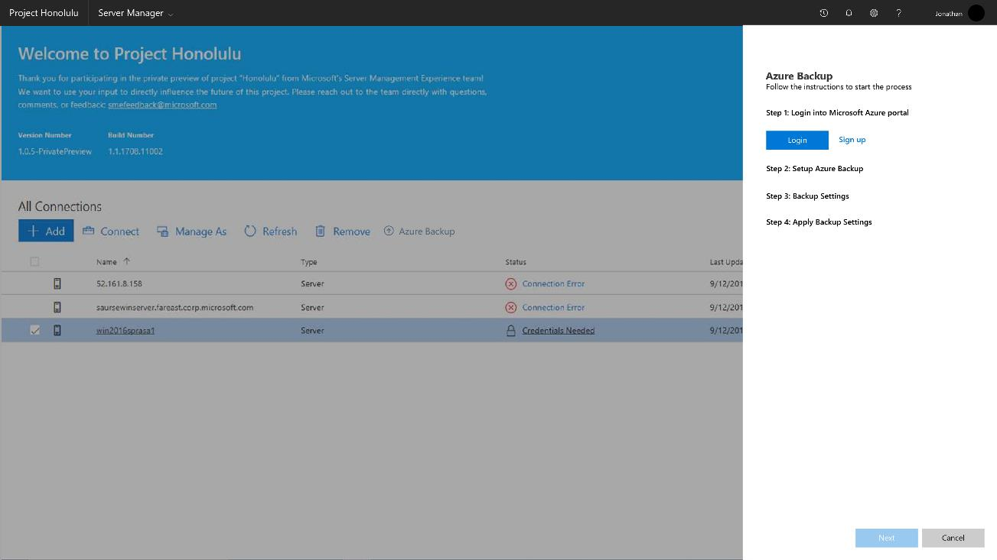
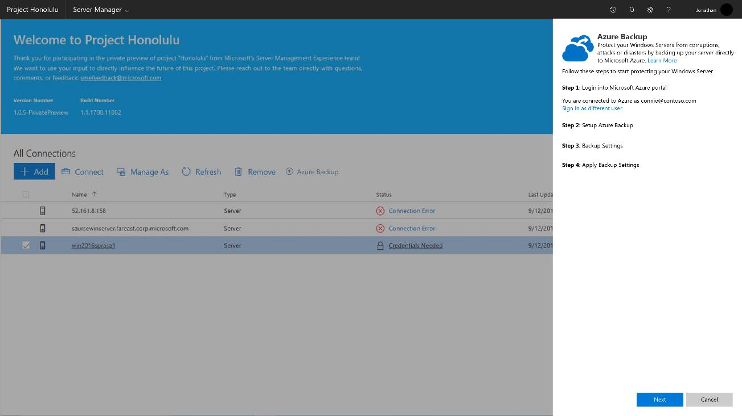
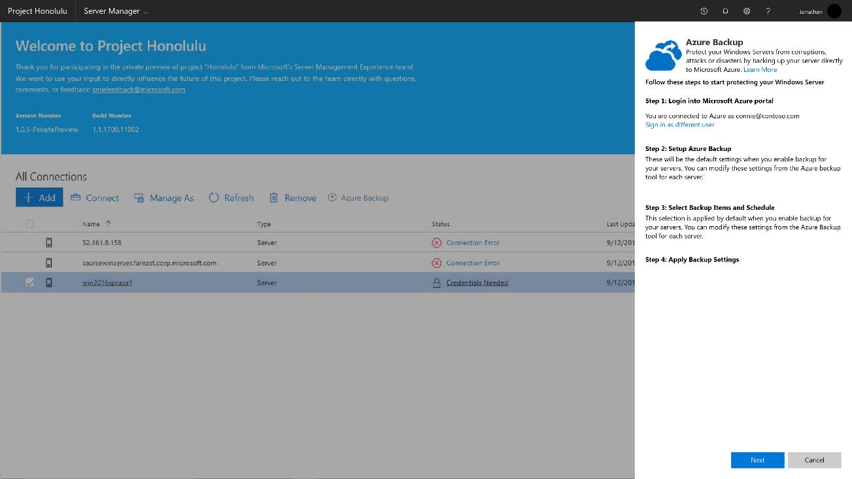
Login
Sign-up
Notes:
Set up Azure Backup
Log In to backup

Slide 72
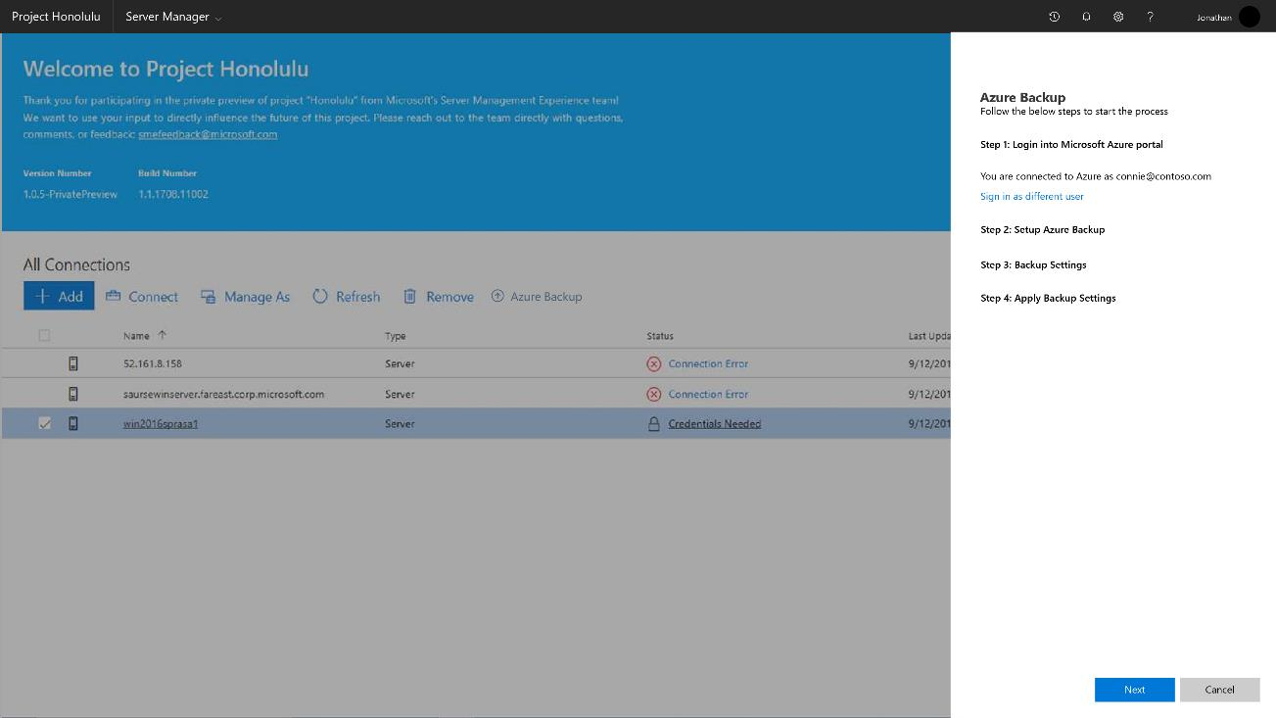
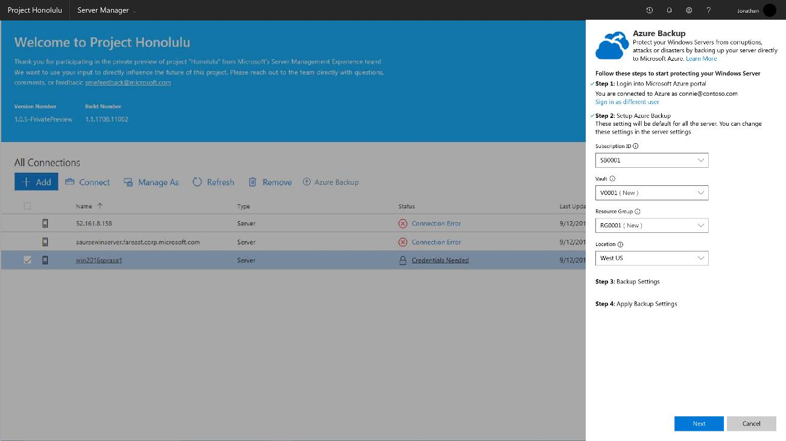
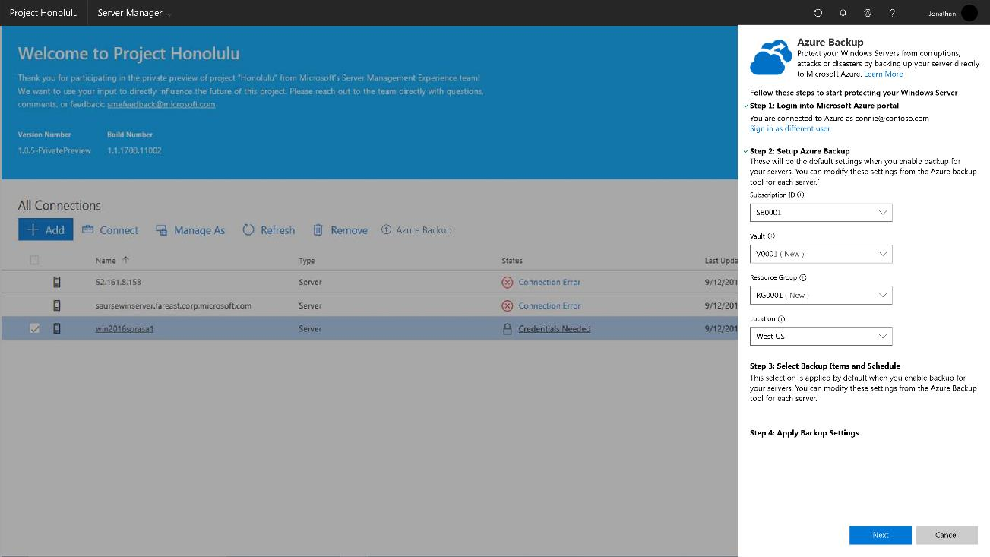
Day 0
Notes:
Set up Backup Parameters

Slide 73
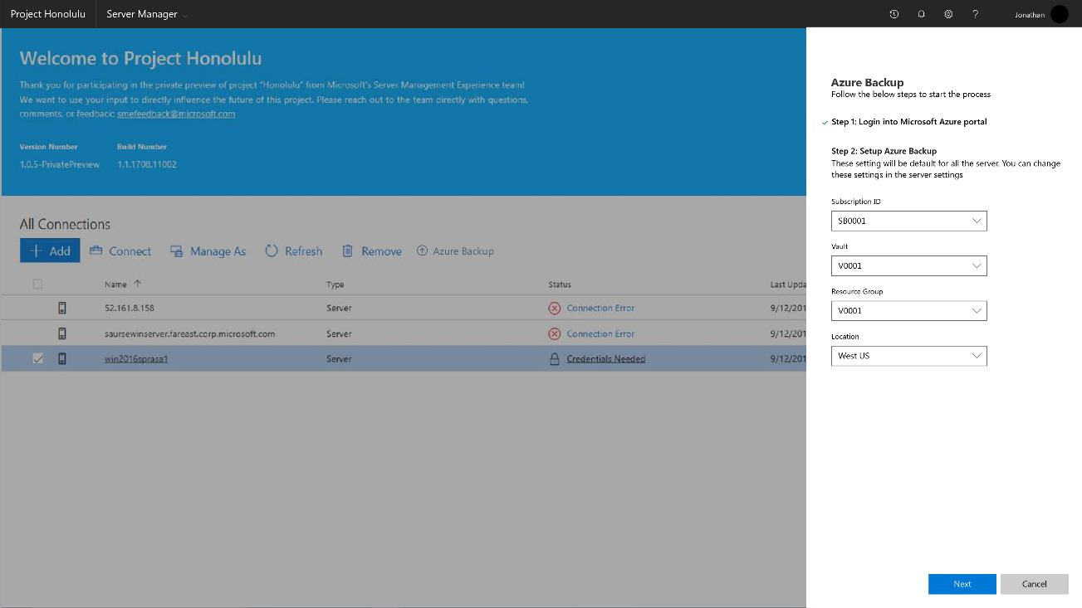
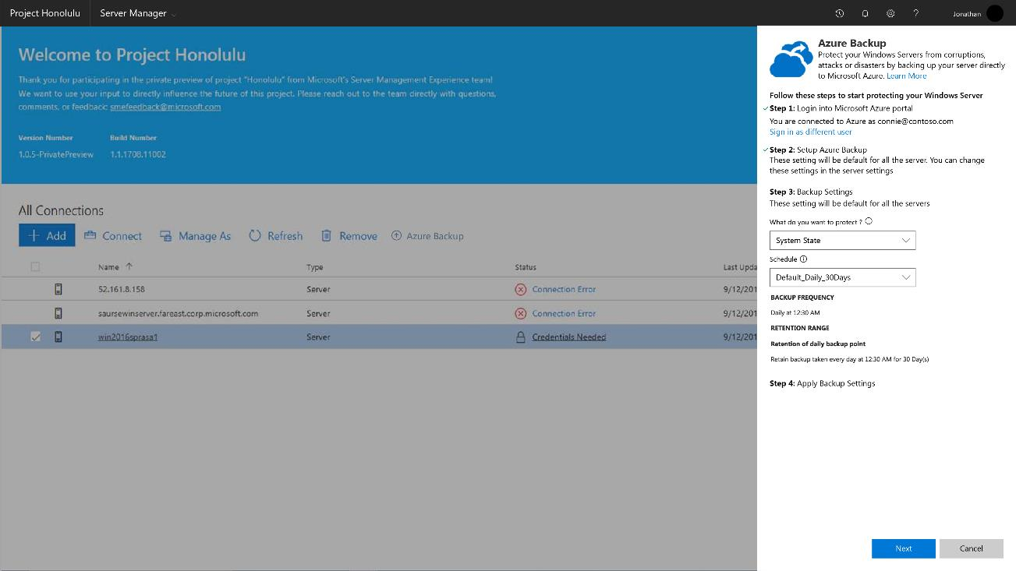

Notes:
Select what you want to backup and when

Slide 74




Day 0
Notes:
Apply to just the machine specified or by checking the box at the bottom, apply to all

Slide 75

Honolulu FAQ
Cost
Browse using
Installs on
Manages
Connectivity
Free!
Edge
Chrome
Windows Server, version 1709
Windows Server 2016
Windows Server 2012 R2*
Windows 10
Windows Server, version 1709
Windows Server 2016
Windows Server 2012 R2
Windows Server 2012
Microsoft Hyper-V Server
Azure not required
Internet not required
AD not required
Security
Configuration
Positioning
Feedback
Extensions
HTTPS
LAPS
Delegation
IIS not required
Agents not required
SQL not required
WMF 5.1 required on WS 2012 and 2012 R2
Evolution of “in-box” tools
Complementary to RSAT, SC and OMS
Upvotes via UserVoice
Early alpha SDK in private preview

Slide 76
Containers…

Slide 77

Where to start?
CONTAINERIZE EXISTING APPLICATIONS
Containerize for portability, efficiency and reliability
TRANSFORM MONOLITHS TO MICROSERVICES
New code and transforming existing code
ACCELERATE NEW APPLICATIONS
Agile cloud native app development

Slide 78

Image2Docker
ConvertTo-Dockerfile `
-RemotePath \\192.168.1.5\c$ `
-OutputPath c:\newDockerFile `
-Artifact IIS
# escape=`
FROM microsoft/aspnet:windowsservercore-10.0.14393.693
SHELL ["powershell", "-Command", "$ErrorActionPreference = 'Stop'; $ProgressPreference = 'SilentlyContinue';"]
RUN Remove-Website 'Default Web Site';
# Set up website: iis-env
RUN New-Item -Path 'C:\iis\iis-env' -Type Directory -Force;
RUN New-Website -Name 'iis-env' -PhysicalPath 'C:\iis\iis-env' -Port 8090 -Force;
EXPOSE 8090
COPY ["iis-env", "/iis/iis-env"]
Notes:
Open-source Powershell module
Connect to VHD file for a vm
Extracts components installed and compiles a docker file
Builds Docker Container
Artifact based tool
looks at features installed
For instance IIS
Finds ASP.NET files and builds a docker container around that app

Slide 79
Image2Docker
Open Source PowerShell Script
Targets
  WIM
  VHD/VHDX Files
  Live Servers
Supported artifact types:
  Roles and Features
  Add/Remove Programs
  Internet Information Services (IIS)
    HTTP Handlers in IIS configuration
    IIS Websites and filesystem paths
    ASP.NET web applications
  Microsoft SQL Server instances
  Apache Web Server
Image2Docker Available Here:
  https://www.powershellgallery.com/packages/Image2Docker/
  https://github.com/docker/communitytools-image2docker-win

Slide 80
Session Objectives and Takeaways
Start using Hybrid Cloud Today:
  Azure AD Connect
  Azure File Sync
  Project Honolulu
  Azure Site Recovery
  Embrace Containers
  Check out Azure SQL Server and Managed Instances
IT Heroes are Hybrid Cloud Admins

Slide 81
Next steps
Deploy and explore Windows Server 2016
and Server 2019
Join the Windows
Insiders program
Evaluate Project “Honolulu”
https://www.microsoft.com/en-us/evalcenter/evaluate-windows-server-honolulu
https://www.microsoft.com/en-us/evalcenter/evaluate-windows-server-2016
https://insider.windows.com/en-us/for-business/

Slide 82
Cloud Migration Accelerator
The Cloud Migration Accelerator uses Pragmatic Works’ cloud expertise to identify
applications and databases that are the best fit for the cloud. During this process we’ll:
• Remove limitations and frustrations by moving off legacy platforms (Oracle,
Teradata, Neteeza, Sybase, etc.)
• Create and optimize migration and deployment model
• Forecast an intelligent cost estimate
• Reduce migration time by up to 75%
Visit our table today for more information!

