Slide 1
Power BI at Enterprise-Scale
Paul Turley
Principal Consultant, Data Platform MVP
@paul_turley
LinkedIn.com/in/PTurley

Slide 2
What’s This All About?
BI models: then and now
Power BI enterprise features
Modeling choices
Merging design tool features
High volume & massive scale
Healthcare Reference Project
Composite models
Demos
Parameterized queries
Incremental refresh policies

Slide 3
The Way We Were
“Serious” BI solutions use SQL Server Analysis Services for modeling and storing analytical datasets

Slide 4
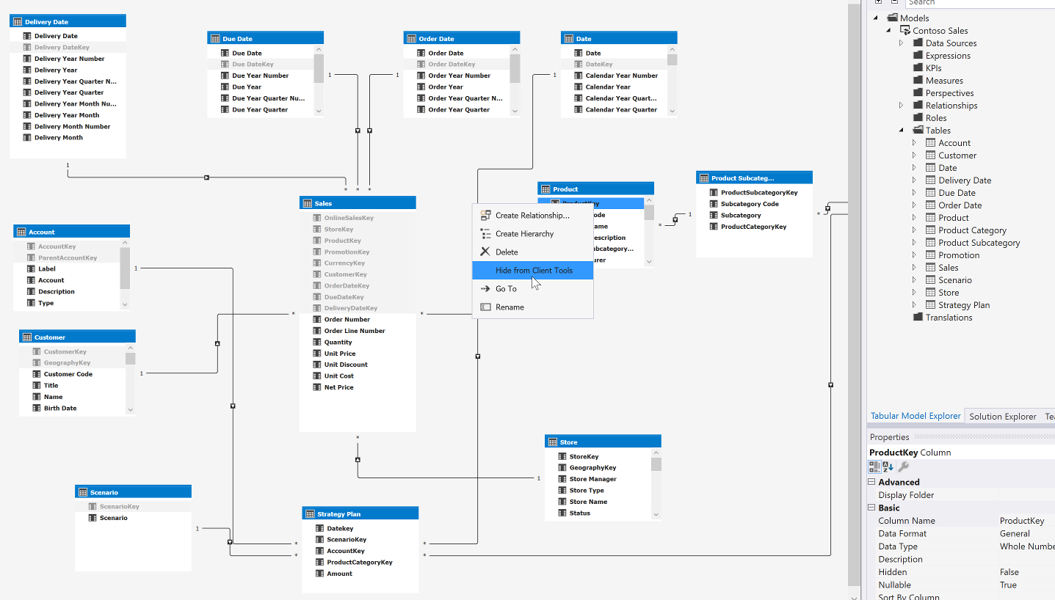
Times They Are a-Changin'
Visual Studio has long been the design tool of choice for serious semantic data model design. SSDT remains a supported but may be considered a “legacy” design tool.

Slide 5
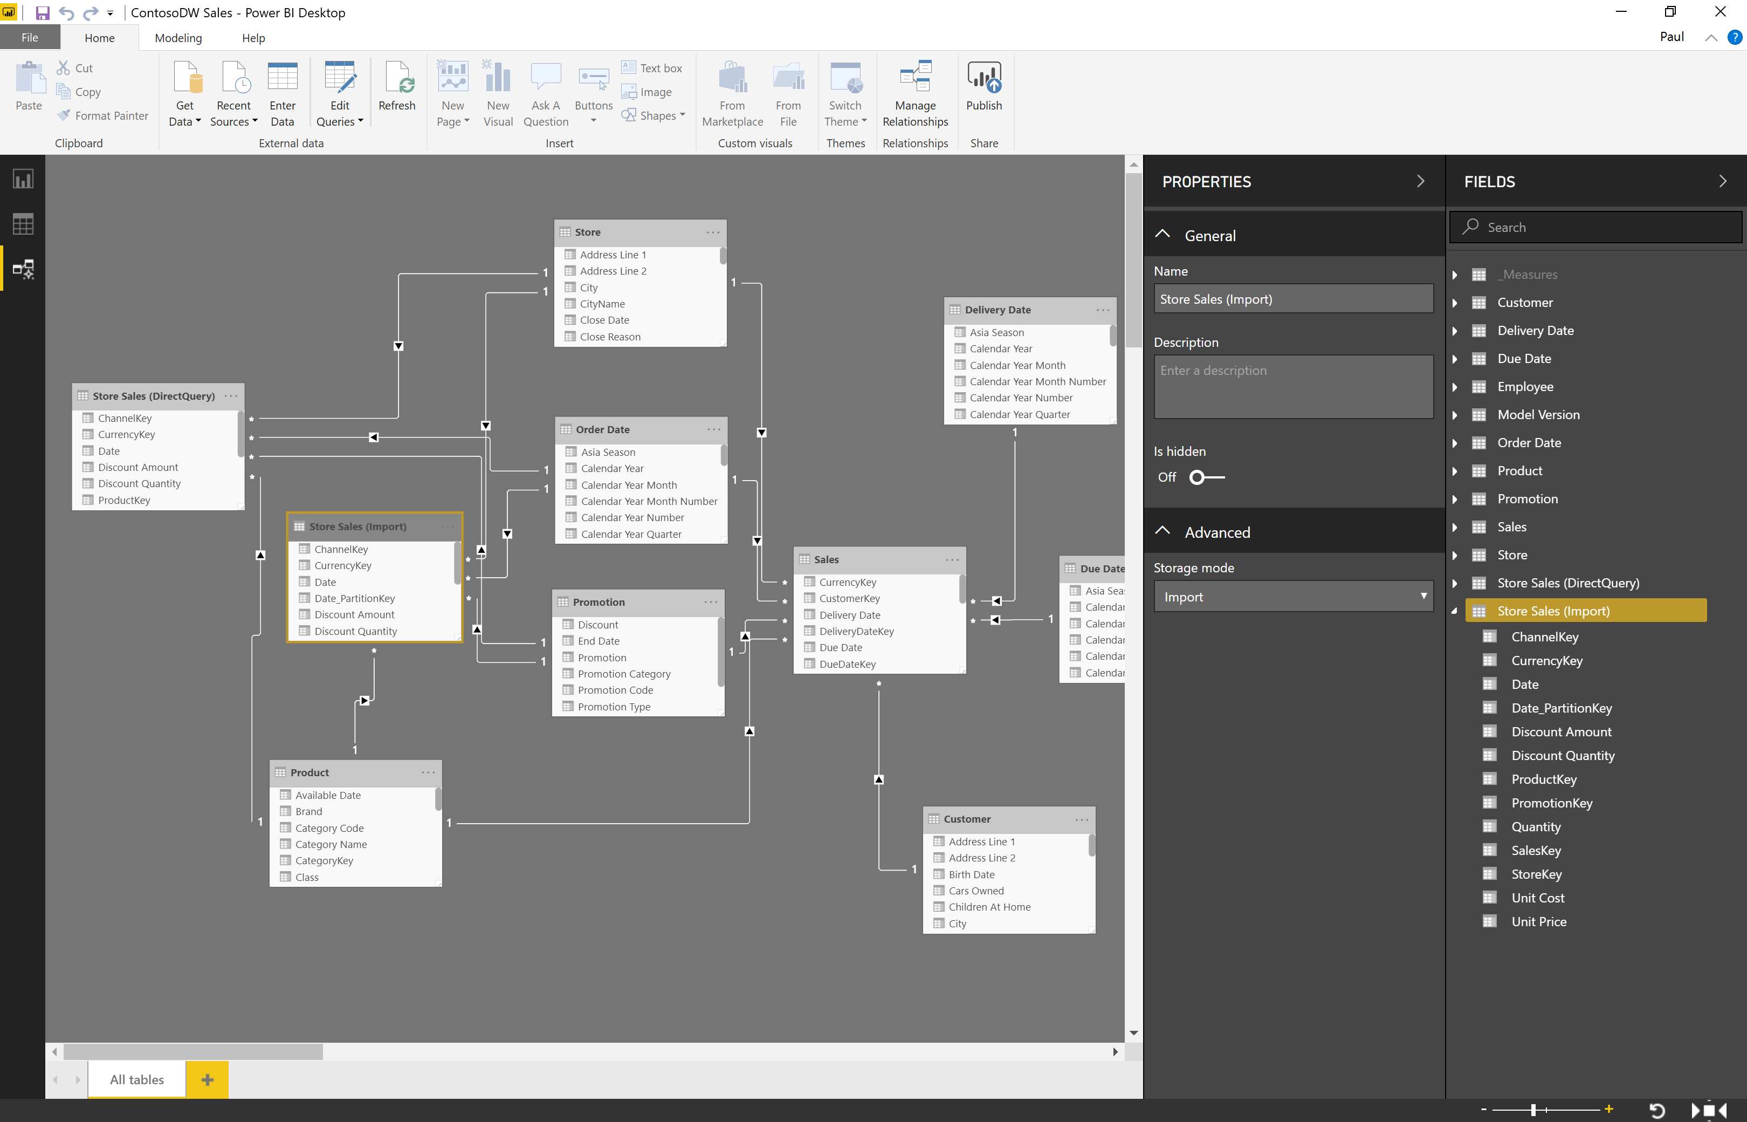
Come Together
New features being added to Power BI Desktop rival and, in many ways, supersede those in Visual Studio SSDT

Slide 6
That Was Then But This Is Now
To maintain the rapid pace of development and cohesive BI tool experience, Power BI Desktop is quickly becoming the recommended enterprise BI development tool

Slide 7
Enterprise Features
DirectQuery
Composite data models
Aggregations
Incremental data refresh policies
XMLA endpoint

Slide 8
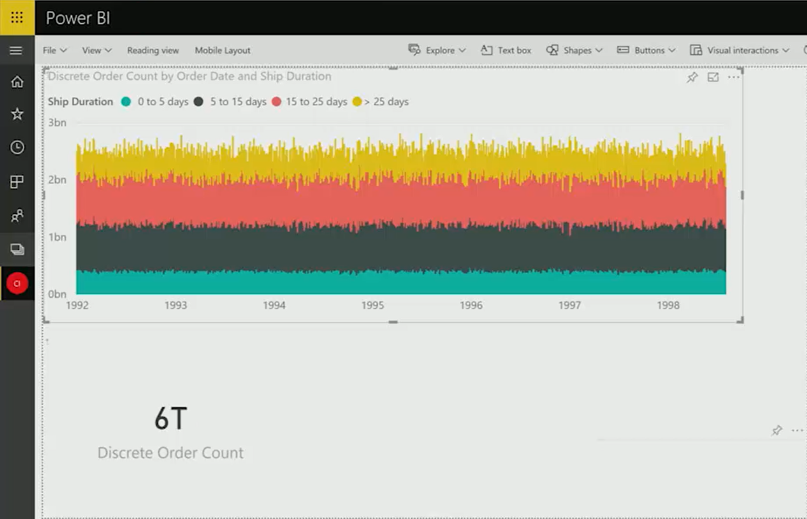
How Is This Possible?
…a semantic data model, designed & visualized in Power BI, with over 6 trillion rows of data.

Slide 9
Data Model Size Limits
compressed data sizes
Power BI Shared Capacity 1 GB
Power BI Premium Dedicated Capacity 3-12 GB
Azure Analysis Services 400 GB
SQL Server Analysis Services Std 16 GB
SQL Server Analysis Services Ent (no limit)

Slide 10
Blurred Lines
…between the features of Analysis Services and the enterprise capabilities of Power BI

Slide 11
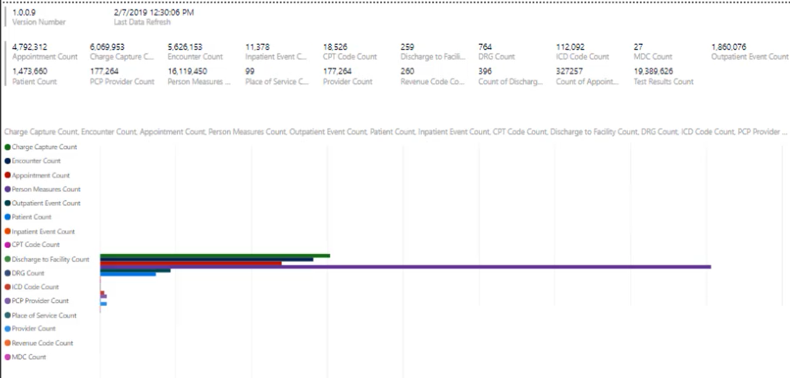
Reference Solution
…

Slide 12
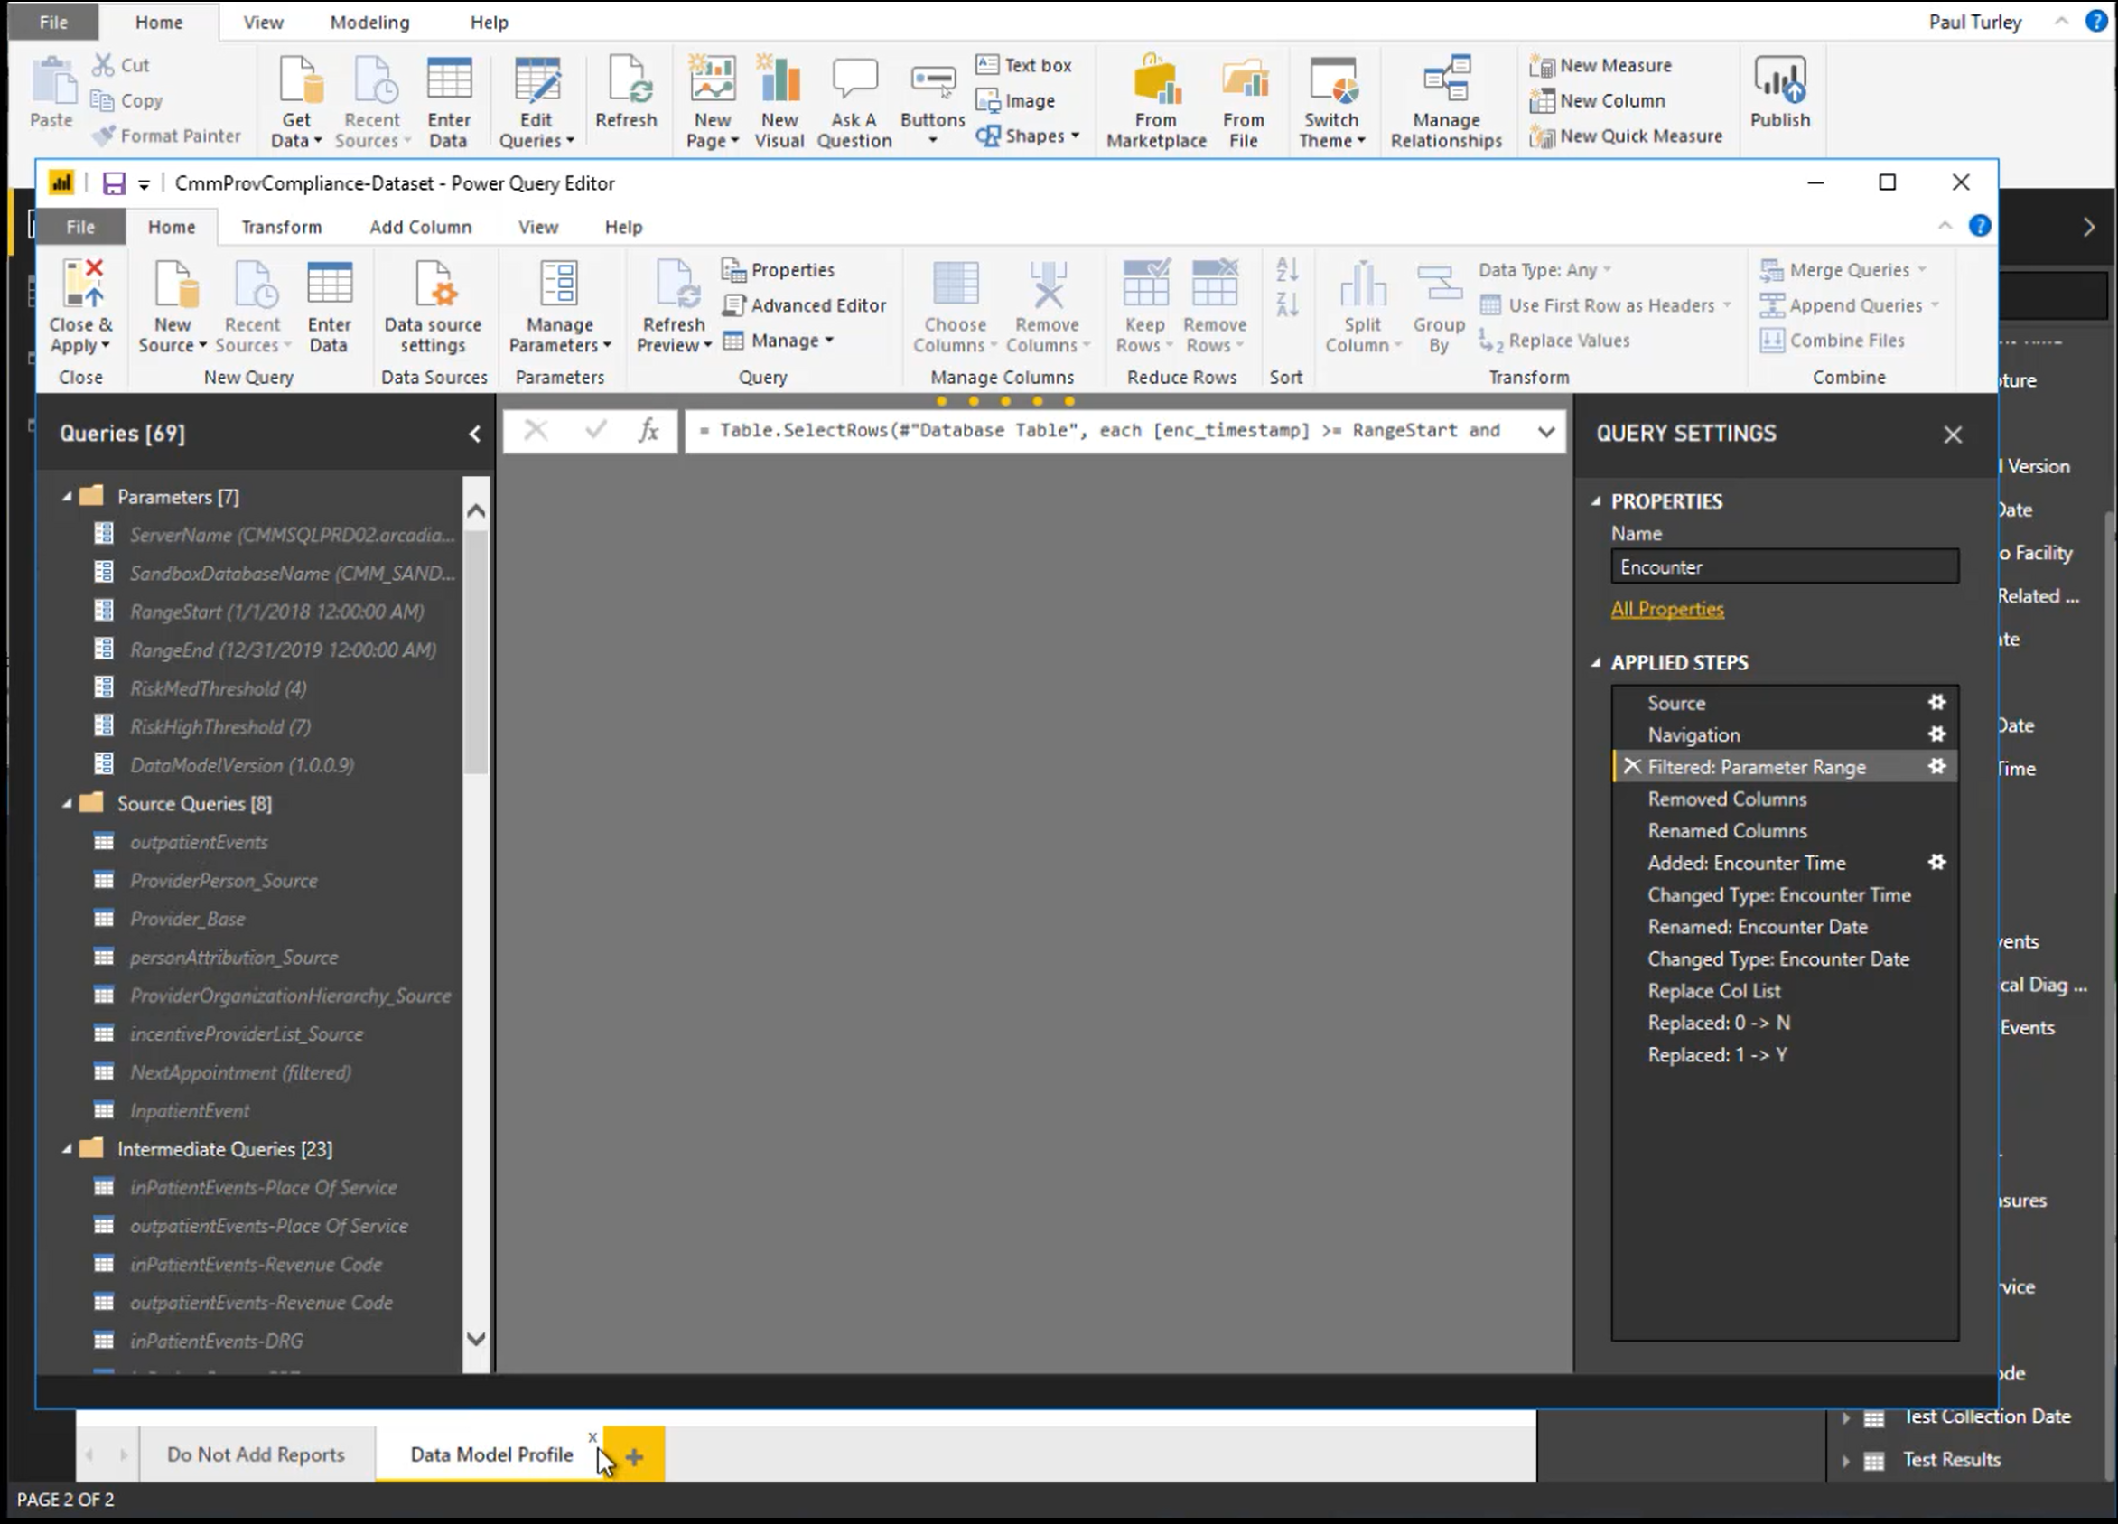
Reference Solution
Several high volume tables were parametrized & partitioned
Reduce working dataset size
Reduce PBIX file size
Enable full refresh in the service

Slide 13
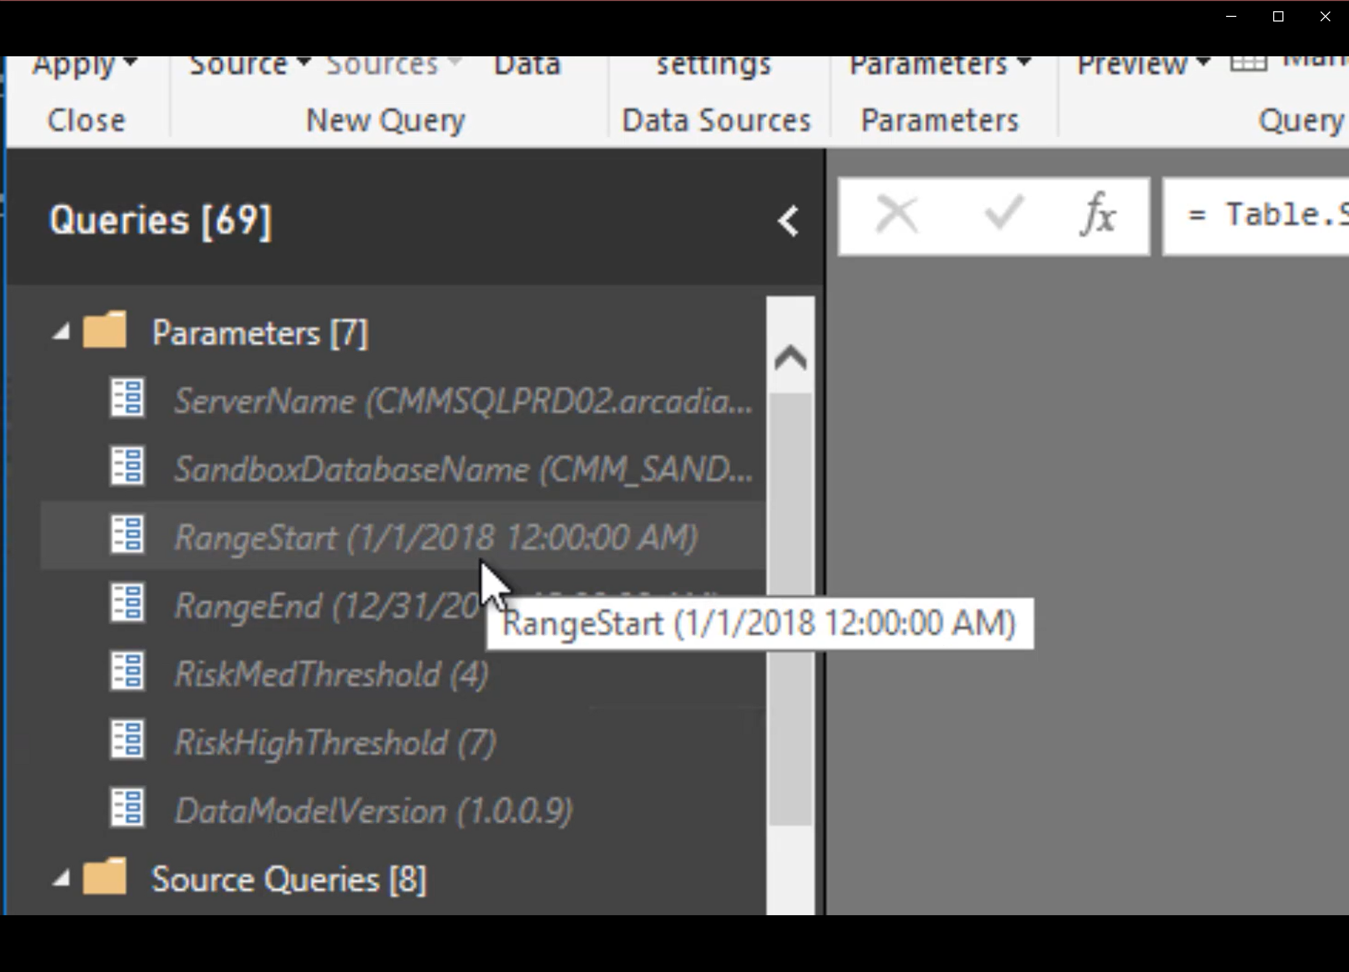
Reference Solution
Parameters:
RangeStart & RangeEnd
Date/Time type
Default values

Slide 14
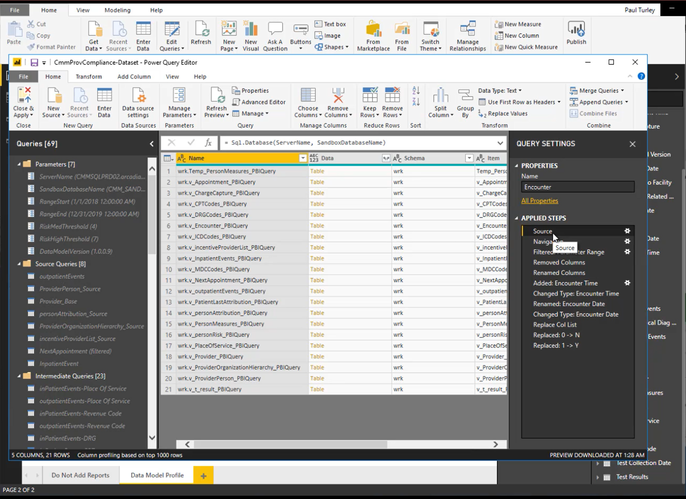
Reference Solution
Select database objects from source
No in-line SQL queries
Created views to consolidate database queries

Slide 15
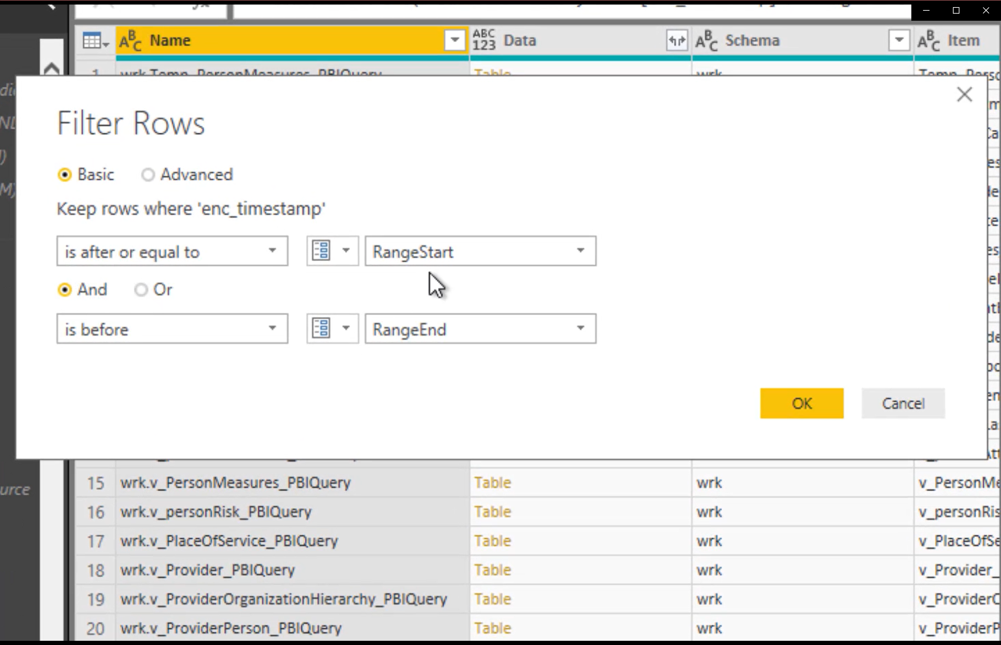
Reference Solution
Define row filters on all fact tables
Filter Date/Time type column
Filter as early in query as possible

Slide 16
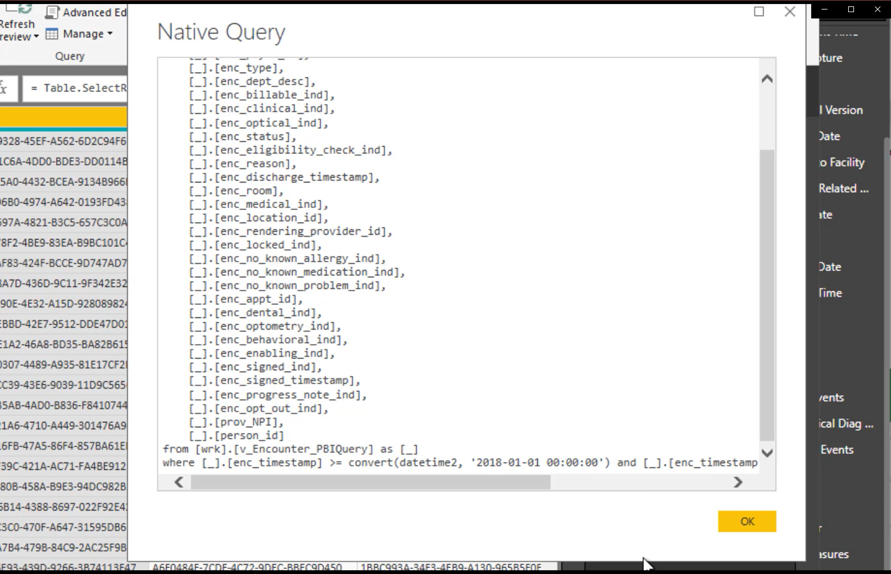
Reference Solution
Row filter generates “folded” native query
OK if later query steps break query folding

Slide 17
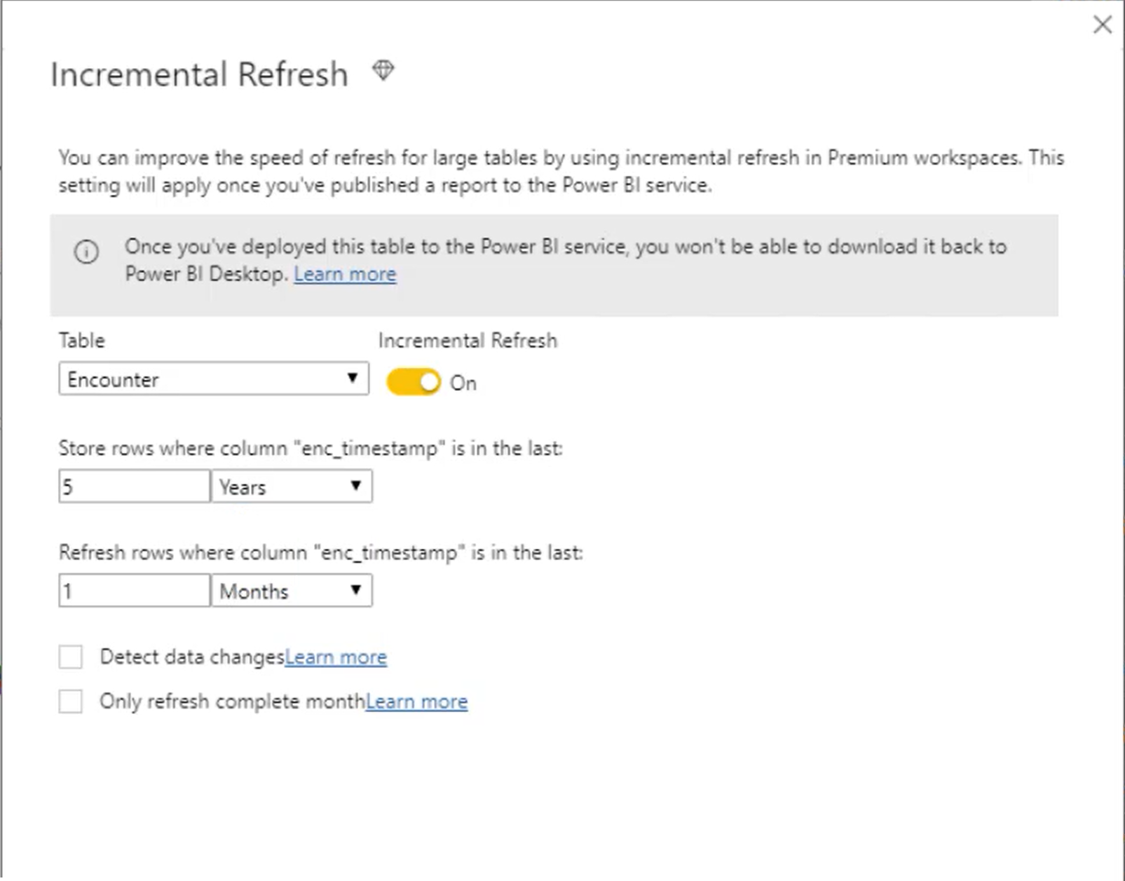
Reference Solution
Add incremental refresh policies to tables in data model
Define period number & period type
Smaller periods generate more partitions
Optionally detect changes

Slide 18
To Cache or Not to Cache
Imported, in-memory data tables provide high performance.
DirectQuery tables offer scalability.
Now, composite data models offer the best of both worlds with dual-mode tables and pre-defined aggregations.

Slide 19
Previously: Two separate choices

Slide 20
Composite Models
Best of both worlds:
Fast performance for cached, in-memory tables
High-volume & near-real-time access from data source
DirectQuery typically has performance & calculation restrictions

Slide 21
Aggregations
Resolved performance issues by storing cached aggregate results
Aggregate tables are rolled-up at higher grain than detail table
Requires planning & advanced design

Slide 22
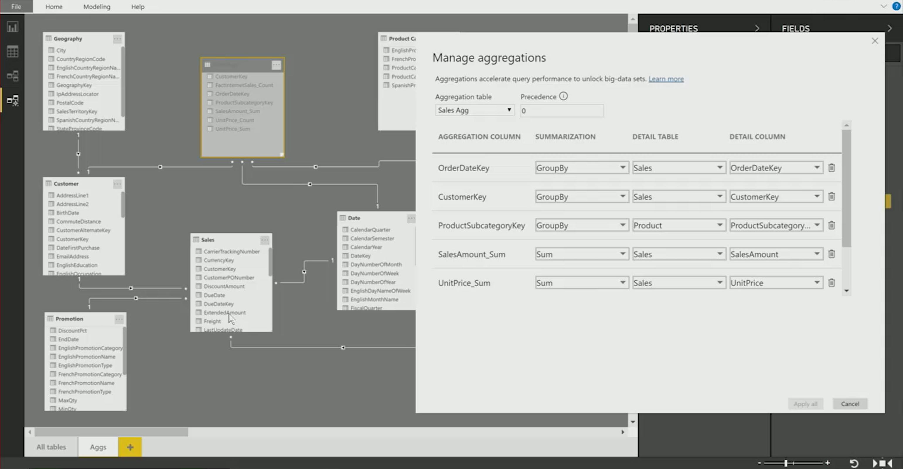
Aggregations
Multiple aggregates tables can be defined
Support different levels of detail
Increased model size
Improves performance
Mitigates performance handicap of DirectQuery tables
Aggregate values are synchronized when processed*
*aggregate tables should be refreshed when source detail changes.

Slide 23
Show Me The Way
DEMOS
Query Parameterization
Incremental Refresh Policies

Slide 24
Questions?
Paul Turley
PragmaticWorks.com/blog
SqlServerBi.Blog
@paul_turley
LinkedIn.com/in/PTurley
THANK YOU

