Slide 1

Consulting, Communications, and Covid-19
Consulting in the Covid-19 Pandemic
Kathy Vick
Lead Consultant

Slide 2
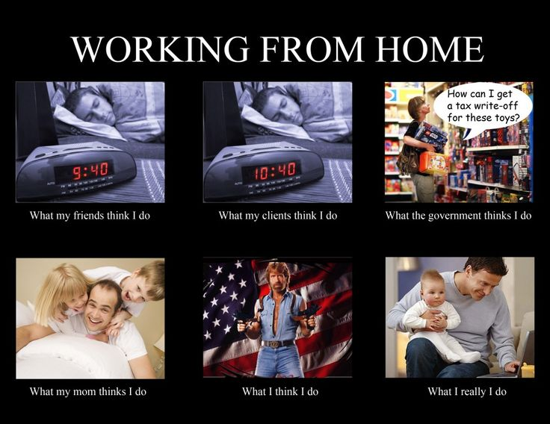



Slide 3
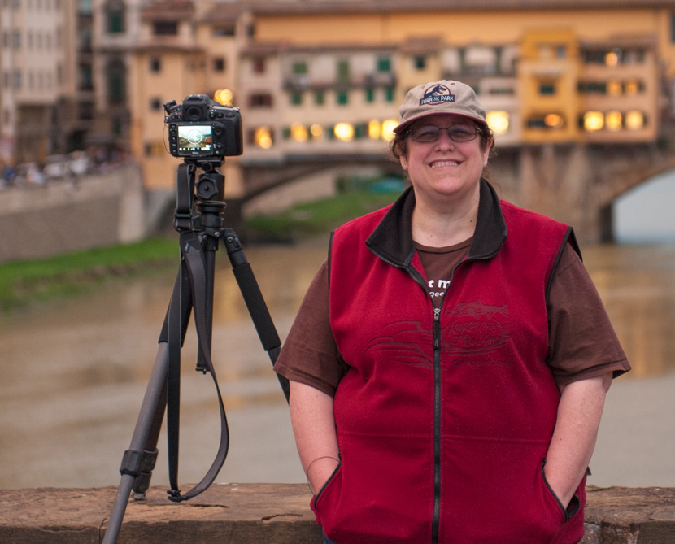
A little about Me
7 years at Pragmatic Works
12 years at MSFT
  7 as Dev/Lead, Manager of DB Dev group (IT)
  5 years in MCS – Microsoft Consulting Services
10 years at Boeing
Managed small teams, large teams, multi-function teams
Have worked remote on development teams on three projects in a row
When I’m not working, I love travel and photography!

Slide 4
A little about my Presentation
The Covid-19 pandemic has impacted almost every industry, causing many companies to develop new strategies for effective remote work
Consulting has always been strong on remote work, but this style of work is new to many of our customers
I want to talk about how the Covid-19 pandemic has impacted our company, how we work with our customers, and how we can help customers in this “new” remote work environment
Our President of Consulting Adam Jorgensen just gave a similar talk:
Pandemic Proof Your Business, Adam Jorgensen with Reza Rad
Notes:
https://www.youtube.com/watch?v=ro4rTLY5KHE&feature=youtu.be&fbclid=IwAR1SL3wv3poVxJJo64wL_sbSIfIY53JLygLXfn1Q8gTXdpIyuwbYPxKGhb0
For Adam’s Presentation

Slide 5
A little about Pragmatic Works
We staff a team about approximately 30-40 National Consultants
We also staff local services in Jacksonville office
  Sales in multiple locations
We work as ONE TEAM regardless of physical location
Several current multi-person projects with geographically dispersed staff, including our consultants and contractors and customers
Quite a few remote-only engagements even before the pandemic
  My current engagement is 26 months remote

Slide 6
Working with Consultants remotely
Communications is the biggest challenge and key to success
To us, a remote engagement is no different than on premise – we meet with you, understand what you need, and produce quality deliverables
We focus on writing things down! Verbal is important, but having documentation of things is critical for later review
“Do we have to be on the phone with the consultant all day?”
  Nope! We are very good at working independently, and only taking up your time as needed – no different than when we are onsite
Consulting Engagements should not “suffer” due to remote participation – expect the same level of quality as on-prem assignments

Slide 7

“Remote” vs “Offshore”
The Pandemic has forced many of our customers
into establishing a remote workforce,
even when they are geographically close
To limit travel, almost all of our current projects are worked as “remote”
“Offshore” is a common practice to use teams located overseas (outside the US) for lower-priced development
  This presentation is aimed at “remote” workforces, not “offshore”, although same
  principles apply!
As Cloud-based technologies have become more “normal”, opportunity to work remote increases, even with “onshore” teams

Slide 8

Challenges working with a Remote team
Separating “home” from “work”
Time Zones
Measuring productivity
Collaboration
Over/Under communicating
Morale
Potential challenge – languages/accents
Technology hiccups​
Small misunderstandings snowballing into drama​
Plus all the challenges of a local team!

Slide 9
Listening is critical
Reflective Listening – Summarize conversations back in writing
If you run into conflicts, address them in a timely manner and have a plan for moving forward.
Define clear tasks and goals, this should ideally be done in writing.
Don’t be afraid to assert yourself.
When working virtually, use video if needed, it’s amazing what you can pick up from nonverbal cues
Don’t be afraid to pick up the phone!!

Slide 10
My Current Project
Mid-sized company uses reports as data to accumulate and build Corporate data repository
Azure Data Factory for ETL, file/data consumption
  Including Logic Apps, Python, DataBricks, and Blob Storage (some day DataLake), and online sFTP server
Azure SQL DB for data storage and Reporting source
Azure VM with SSRS for reporting (Power BI soon!)
Citrix Desktops for “onsite” development
DevOps, Visual Studio, SSMS, Azure Portal for Code Development and Management of Assets

Slide 11

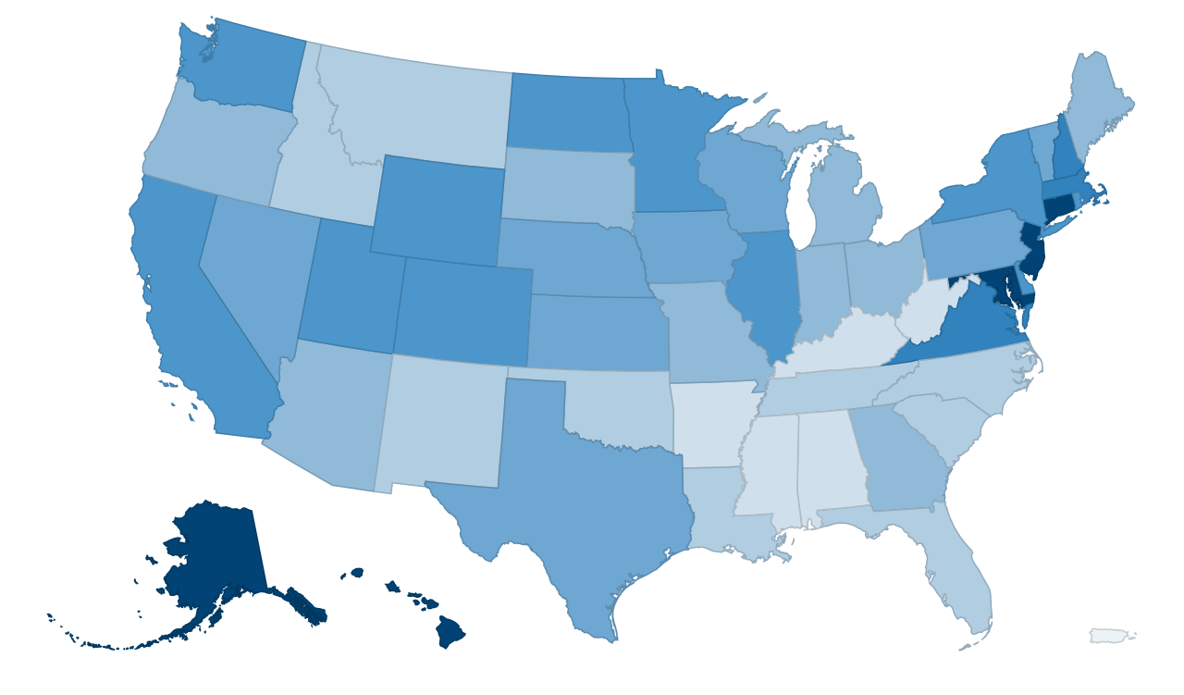






My Current Project Team
Team Lead
“The Boss”
Project
Manager
Developer
Developer
Sales

Slide 12




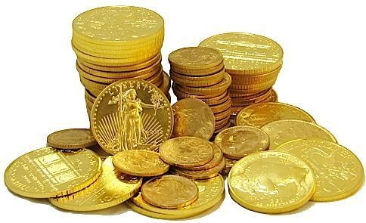
There are advantages!
No commute time for team members
  Better work-life balance since commute time can be repurposed!
  No snow days but occasional power/Internet outage days
  “Work” can happen anywhere there is a reliable internet connection!
Less interoffice “chit chat”
No travel costs, no office space cost
Can hire people without concern for geography location
  Not limited by local talent
  SQL Folks in Seattle (near Redmond) are very expensive
  SQL Folks in Jacksonville are cheaper

Slide 13

Keys to Success
Strong leadership is a must
  Customer knows who to contact on the team
  For my team “We speak with one voice – mine”
  Have a clear chain of command
  Set expectations
Strong Project Management
  Not just someone to manage the calendar
  Must understand and clearly define deliverables
  Has to know when the developers/team members are “stretching the truth”
  Should help set expectations and limit scope creep
  Define Deliverables with short delivery timeframe

Slide 14

Keys to Success
Strong Communications
  Daily Meetings (“standup” style)
  Status Reports
  Chat
  Email
  Desktop Sharing
  Virtual Meetings
Documentation!
  Kathy’s Law at Pragmatic Works: “If it isn’t written down, it didn’t happen”
  Even more critical to write it down when you need “evidence”
  that is happened
Notes:
Halfway

Slide 15

Team Leader Responsibilities
Pick the right people – independent workers
Make sure you have well defined requirements!
Insure everyone knows their role, and their responsibilities
Don’t be shy – encourage everyone to speak up
Know how to use your technology
  Desktop sharing, VoIP, Chat, Video, etc
Place a lot of value on Standards
Ensure quality Code Management
  Azure Development Environment is still challenging
  Tool selection is critical

Slide 16
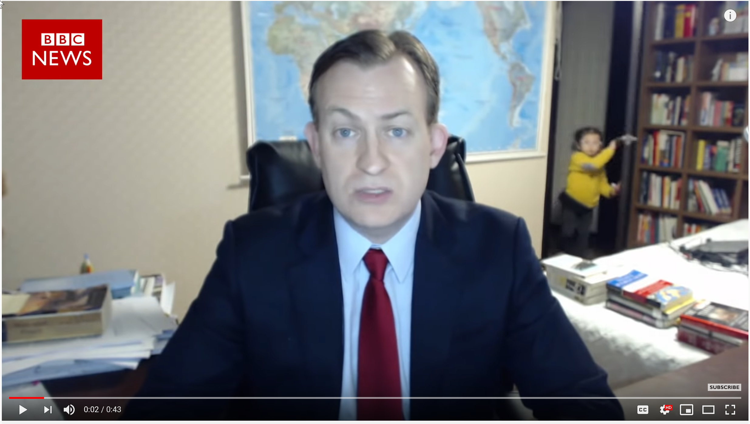
Team Members Responsibilities
Limit household interruptions
Have a good place to work
  Take advantage of technology
  Multiple screens, full size keyboards
Work appropriate hours
  Know when to start, stop
  Uses your time management skills!
Check in code, documents often
Utilize your management team
Support your team members
If you don’t recognize this image, go do a search of “BBC Children Interrupt”… best example of NOT having a good isolated work environment!!!!!

Slide 17

Managing Communications
Don’t forget to just call someone when it’s important!
MSFT Teams/Skype/Yammer, Slack, other Chat utilities
WebEx, GoToMeeting, etc for effective Meetings
Encourage the team to be reactive
  Use Cellphones, Text Messages for critical notifications
Learn to use the tools to:
  Speak with the entire team, call on specific attendees
  Mute people who are making background noise
  Share Screens, work with multiple screens
  Mute apps that will interfere in the presentation

Slide 18

Use Video Meetings (where possible)
Video is a great way to encourage participation
Also a great way to insure people are paying attention
Discourages “put the meeting
on hold and talk in the background”
Respect team member’s feelings
about Video
  I am not video-ready at 7AM
Be sensitive to bandwidth issues
  Not all users or devices can handle video

Slide 19

Common Business Hours
Critical to establish times when entire team will be
available for communications and meetings
Encourage independent workloads during other working hours
Example: For 4-time zone teams – establish 11AM Eastern until 5PM Eastern as common office hours (8AM Pacific until 2PM Pacific)
  Use remaining hours for individual work
  Be flexible on lunch hours
Don’t abuse your West Coast team – no 5AM Pacific meetings
Don’t abuse your East Coast team – no 7PM Eastern meetings

Slide 20

Some Personal Advice
Have “office Hours”, work the same times every day
Limit background noise for meetings
Have a separate area in your house so you “go to work”
Make sure your family knows when you are working
and when you aren’t
While UberEats, DoorDash, Grubhub, and Amazon make it easy to never leave your house again – get out once in a while
Make sure to occasionally “disconnect” from work
  Vacations, Weekends, Late Nights

Slide 21

“Can I go to the bathroom?”
Avoid the “you aren’t responding immediately,
you must be goofing off” mentality when managing
remote team members
Recognize that people occasionally step away from the computer
  Bathroom breaks
  Stand and stretch
  Walk the dog breaks
  Lunch, snacks
Encourage the team be proactive – tell people when you are going offline for more than 5-10 minutes

Slide 22
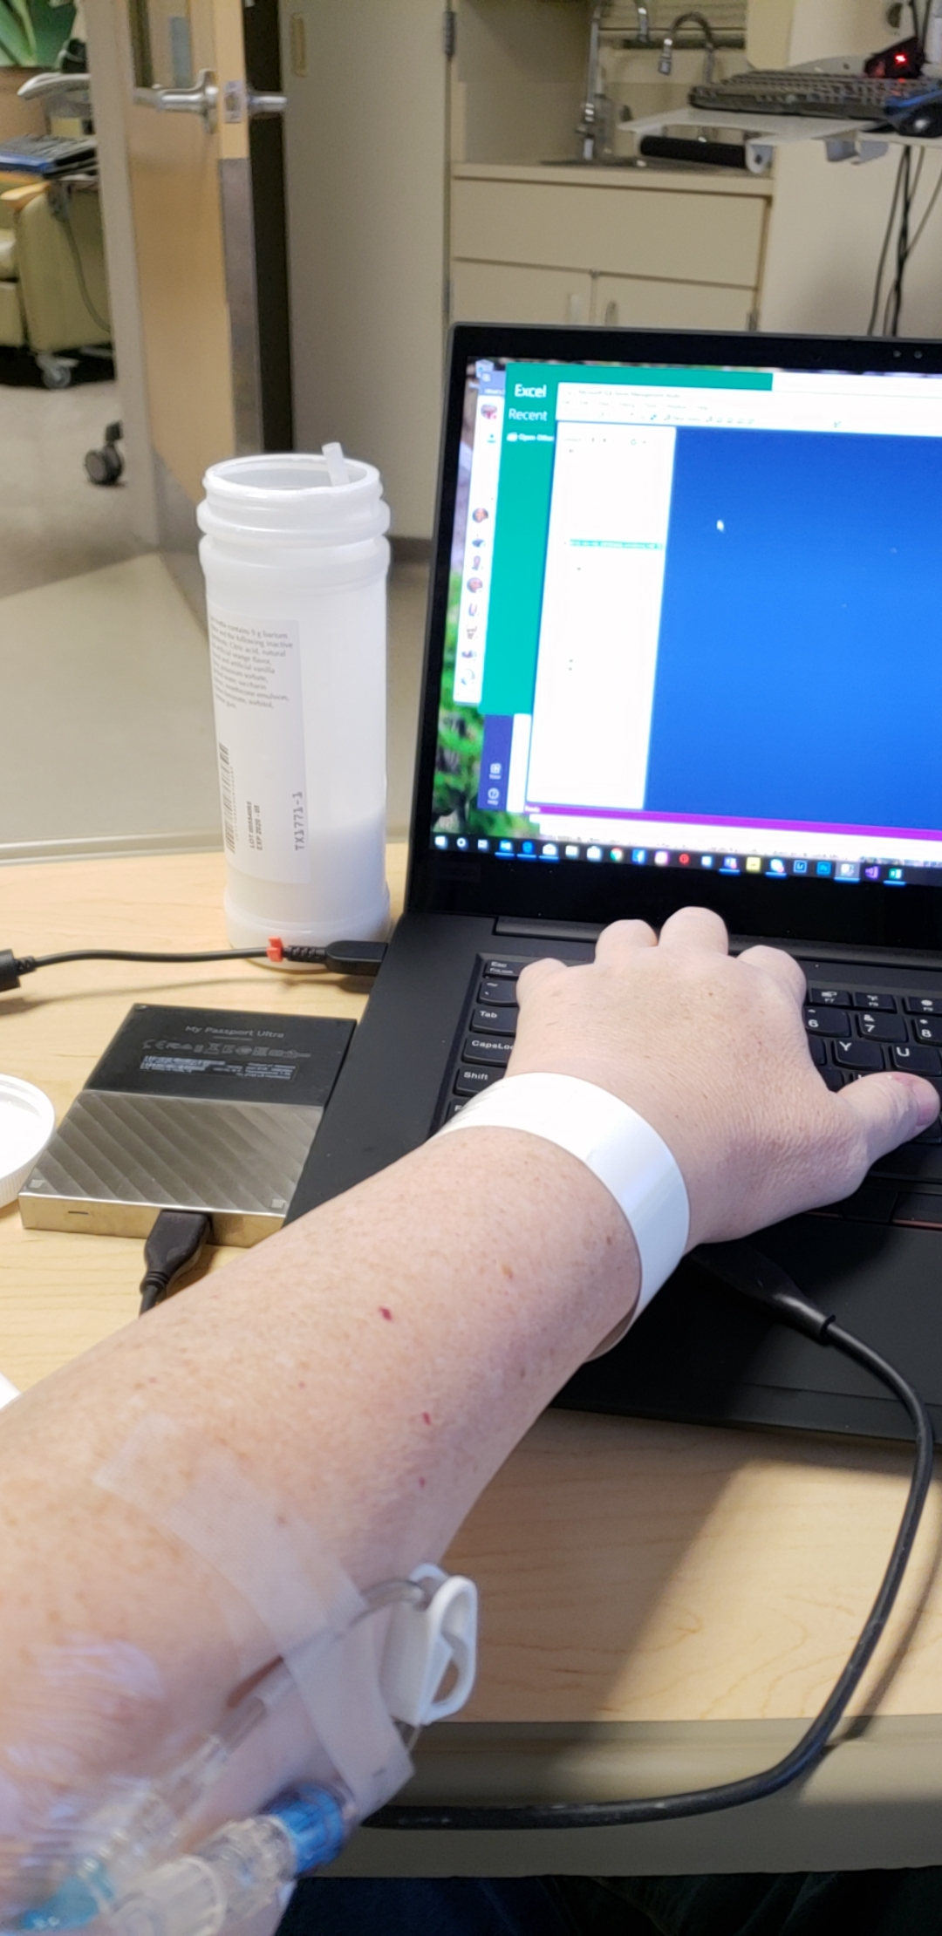
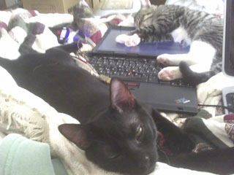
Take Time Off
Treat time off the same as working local
My boss told me “If you are too sick to go to
work, you are too sick to work”
Encourage the team to take a day off
when they are sick or
have appts
Leave room in the
schedules for time off
Just because you work
from home doesn’t mean
you work 24x7

Slide 23

Morale and Inclusion
Critical for the team to feel like a team and not a group of individuals
Get to know your team, even if you can’t see them
  Have a few minutes of chit-chat starting a meeting
  Share personal things (within reason)
  Treat remote meetings the same as in-person
    Include everyone – insure participation from all
    Don’t let one or two people dominate the conversation
  Focus on positive feedback
On occasion, have a ‘get to know each other’ meeting

Slide 24

Some Technical Jargon
Make sure team members regularly save project
assets to a cloud location (shared drives)
  Code
  Documents
  Presentations
Watch out for security
  Manage access
  Personally Identifiable Information (PII) data
Validate that remote access is managed appropriately
  Citrix (or other vendor) Remote Desktops/Virtual Machines
  Azure IP security

Slide 25

How to tell if you are doing it right
You don’t even realize you have a remote team

Slide 26

Wrap it up
Stop the spread of the pandemic using appropriate workforce guidelines
Use the same skills you use for any successful team
Focus on great communications, inclusion
Focus on well-defined deliverables and timelines
Have strong leadership and team management
Participate!!
Support the team!!

Slide 28
This is a Header
SOFTWARE
Software designated to optimize your data
CONSULTING
Enterprise data services
TRAINING
On-demand, in-person, and virtual training

